Slide 1
Section 502 Direct Loan Program Overview
Presented by Tammy Repine
Single Family Housing Direct Loan Division
Revision Date: June 19, 2017
Notes:
The purpose of this presentation is to give viewers a basic overview of the Section 502 direct loan program. Through this presentation, you will be briefly introduced to this program and pointed to resources where you can learn more about the program.

Slide 2
Section 502 Direct Loan Program Overview
Authorized by the Housing Act of 1949
Provides affordable housing loans to eligible low- and very low-income applicants who wish to obtain modest housing in rural areas
https://eligibility/sc.egov.usda.gov/eligibility/welcomeAction.do
Rural Development (RD or Agency) is the lender and servicer
Notes:
Low-income is defined as up to 80% of the median income adjusted for household size for the property location, and very low-income is defined as up to 50% of the median income. In addition to meeting the program’s income limits, applicants must meet the program’s eligibility requirements related to:
Citizenship status – The applicant must be a U.S. citizen or a noncitizen who qualifies as a legal alien.
Primary residence – The applicant must agree to and have the ability to occupy the home on a permanent basis.
Current homeownership – An applicant who owns adequate housing is generally not eligible. A current homeowner may receive a RD loan in limited circumstances.
Legal capacity – The applicant must have legal capacity to incur the loan.
Suspension/debarment – The applicant cannot be suspended or debarred from participating in federal programs.
Repayment ability – The applicant must show adequate repayment ability for the loan based on the program’s qualifying ratios.
Credit qualifications – The applicant must have a credit history that indicates a reasonable ability and willingness to meet their debt obligations. While the Agency uses credit scores to potentially expedite the creditworthiness analysis, there isn’t a credit score eligibility requirement.
Homeownership education – First-time homebuyers are required to take an approved homeownership education course.
Modest housing is defined as a property that:
Is considered modest for the area.
Does not have a market value in excess of the applicable area loan limit.
Generally does not exceed 2,000 square feet living area (above grade).
Does not have an in-ground swimming pool or income producing structures/land.
The land must be minimally adequate and not large enough to subdivide under local zoning rules. In some places, this might be 5 acres. In other places, it might be 0.25 acre or less. There is no “one size fits all” definition.
Rural areas are defined as open country and places with a population of 10,000 or less and, under certain conditions, towns and cities between 10,000 and 35,000 population. Use the property eligibility website to determine if a property is in a rural area: https://eligibility.sc.egov.usda.gov/eligibility/welcomeAction.do
While there are some program similarities, the direct loan program fundamentally differs from the guaranteed loan program in that direct loans are subsidized loans funded by the government and serviced by RD’s Customer Service Center. Guaranteed loans are nonsubsidized loans funded and serviced by an approved lender; the government guarantees the loans. The income level served also differs between the programs. The guaranteed loan program largely serves applicants with moderate incomes (up to 115% of the statewide non-metro median income).

Slide 3
Section 502 Direct Loan Program Overview
100% financing without private mortgage insurance
Eligible loan purposes and uses include site-related costs, dwelling-related costs, and fees/related costs
Eligible loan amount is limited by the applicant’s repayment ability and the home’s appraised value
Notes:
A down payment is only required if the cash value of the applicant’s non-retirement assets is greater than $15,000 for nonelderly households or $20,000 for elderly households. Assets aside, the Agency will limit the financing to 90% of the home’s value if the construction quality of a new home cannot be adequately documented.
The appraisal fee, tax service fee, and initial contribution to fund the escrow account can exceed the appraised value. For first-time homebuyers, who are required to take a homeownership education course, the fee for the course can also exceed the appraised value.

Slide 4
Section 502 Direct Loan Program Overview
Standard loan term is 33 years
Loans up to 38 years is permitted when the household’s adjusted income doesn’t exceed 60% of the area median and a longer term is needed for repayment
Manufactured homes have a maximum 30 year term

Slide 5
Section 502 Direct Loan Program Overview
Interest rate is fixed
www.rd.usda.gov/programs-services/single-family-housing-direct-home-loans
Borrowers may be eligible for payment subsidies that reduce their effective interest rate and their monthly mortgage payment
Depending on the home’s value, subsidies received may be repaid at the time of sale or non-occupancy
Notes:
The program’s interest rate is posted at the beginning of each month on the Agency’s website under Single Family Housing Direct Home Loans (see Interest Rates tab).
www.rd.usda.gov/programs-services/single-family-housing-direct-home-loans
The applicant’s loan will have an interest rate that is the lower of the interest rate at the time of loan approval or the interest rate at the time of loan closing. The lower of these two interest rates is fixed for the life of the loan and is referred to as the applicant’s full note rate.
Applicants eligible for payment subsidies have a reduced monthly payment which is the greater of:
At least 24 percent of the household’s adjusted monthly income, or
An equivalent interest rate of 1 percent.
Household income changes affect this subsidy. Regardless of changes, USDA re-verifies household income each year.
All or part of this subsidy is repaid when the borrower transfers title or does not occupy the home. The subsidy repaid never exceeds the home’s increased value or the amount received.

Slide 6
Section 502 Direct Loan Program Overview
Headquarters (HQ) Office
Issues nationwide loan making guidance
Provides technical assistance
Conducts program and compliance reviews
Manages nationwide funding allocations
Markets program to nationwide partners
State Office
Issues state specific guidance, which must be approved by HQ
Liaison between HQ and Field Offices
Manages statewide funding allocations
Markets program to statewide partners
Conducts statewide program and compliance reviews
Provides feedback to HQ regarding program guidance and delivery
Field Office
Delivers the program to the customers
Markets the program locally
Accepts and processes applications
Provides feedback to State Office regarding program guidance and delivery
Works with CSC to assist with servicing actions when needed
Customer Service Center (CSC)
Issues nationwide servicing guidance
Services loans after closing
Requests Field Office assistance when needed
Notes:
Several RD offices are responsible for administering the direct loan program.
While by no means a comprehensive list of the activities performed by each RD office, this slide shows the relationship between Headquarters (HQ), the Customer Service Center (CSC), the State Office, and the Field Office. The work performed by each RD office is critical in creating homeownership opportunities as well as successful homeownership following loan closing.
In the following slides, the potential involvement of a loan application packager will be discussed.

Slide 7
Section 502 Direct Loan Program Overview
One way parties seeking affordable homeownership may hear about the direct loan program is through loan application packagers. A loan application packager, who does not work for or represent RD, provides an optional service to parties seeking a housing loan by helping them navigate the loan application process.
Notes:
A loan application packager can help determine if the Section 502 direct loan program is a good fit for a prospective homebuyer, and if so, help them assemble a complete loan application package for consideration by the local RD office. Applicants are not required to work with a loan application packager to receive assistance from RD; they may work directly with RD.
A loan application packager generally charges a fee for their service. The amount of the packaging fee and whether it can be included in the RD loan varies depending on the packaging type.

Slide 8
Section 502 Direct Loan Program Overview
On May 19, 2016, RD implemented a certified loan application packaging process under the Section 502 direct loan program that imposes reasonable experience, training, structure, and performance requirements on the following three parties involved in the certified packaging process: Agency-certified loan application packager, qualified employer, and Agency-approved intermediary (as determined necessary by a RD State Director). Together, the certified packager and the qualified employer are referred to as the certified packaging body.
Notes:
The certified packaging process assists with program marketing and application origination.
Next a high level list of roles and responsibilities within the certified packaging process will be provided.

Slide 9
Section 502 Direct Loan Program Overview
Agency – Makes all decisions regarding eligibility, underwriting, final approval, and closing
Certified Packager – Markets the program, prescreens potential applicants, counsels clients, and assists the applicant in assembling a complete application
Intermediary – Performs quality assurance reviews, recruits certified packaging bodies, and provides supplemental training, technical assistance and support to certified packaging bodies
www.rd.usda.gov/programs-services/single-family-housing-direct-home-loans
Notes:
To learn more about loan application packaging, please see Attachment 3-A of Handbook-1-3550. Details on how to view the handbook will be provided soon.
Parties interested in serving as a certified packaging body should contact the intermediary or intermediaries that cover their particular state. The list of approved intermediaries and their contact information can be found on the Agency’s website under Single Family Housing Direct Home Loans.
www.rd.usda.gov/programs-services/single-family-housing-direct-home-loans
Under the “Forms and Resources” tab, select “Intermediaries under the certified loan application packaging process”. This will take you to an interactive map. Simply click on your state and you will be directed to the intermediary contact(s) for that state.

Slide 10
Section 502 Direct Loan Program Overview
The direct loan program’s regulation is found in the Code of Federal Regulations (CFR) at 7 CFR Part 3550. The program’s regulation and guidelines can be found using the following link:
www.rd.usda.gov/publications/regulations-guidelines
Notes:
As stated previously, RD was established with the Housing Act of 1949. The regulation which governs the direct loan program is 7 CFR 3550. This regulation provides the overarching requirements of the program and is supplemented by Handbook-1-3550, Administrative Notices, Procedure Notices, Unnumbered Letters, and Forms. Additionally, there are RD Instructions which Agency staff must be aware of and follow when delivering the program. Applicable RD Instructions include but are not limited to:
RD Instruction 1924-A, Planning and Performing Construction and Other Development
RD Instruction 1924-C, Planning and Performing Site Development Work
RD Instruction 1901-E, Civil Rights Compliance Requirements
RD Instruction 1970 series, Environmental

Slide 11
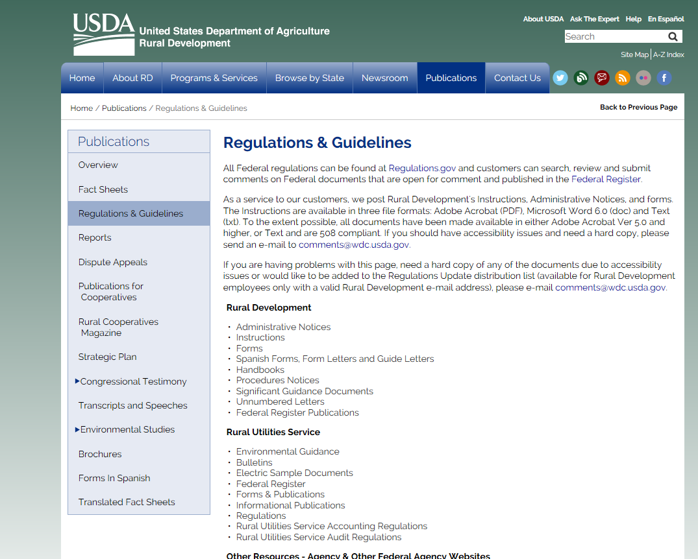
Section 502 Direct Loan Program Overview
www.rd.usda.gov/publications/regulations-guidelines
CLICK HERE
Notes:
This is a screen print of the Regulations & Guidelines webpage. Since Handbook-1-3550 provides the day-to-day guidance on processing direct loan applications, let’s go through the steps on how to find it.
On this page, click “Handbooks”.

Slide 12
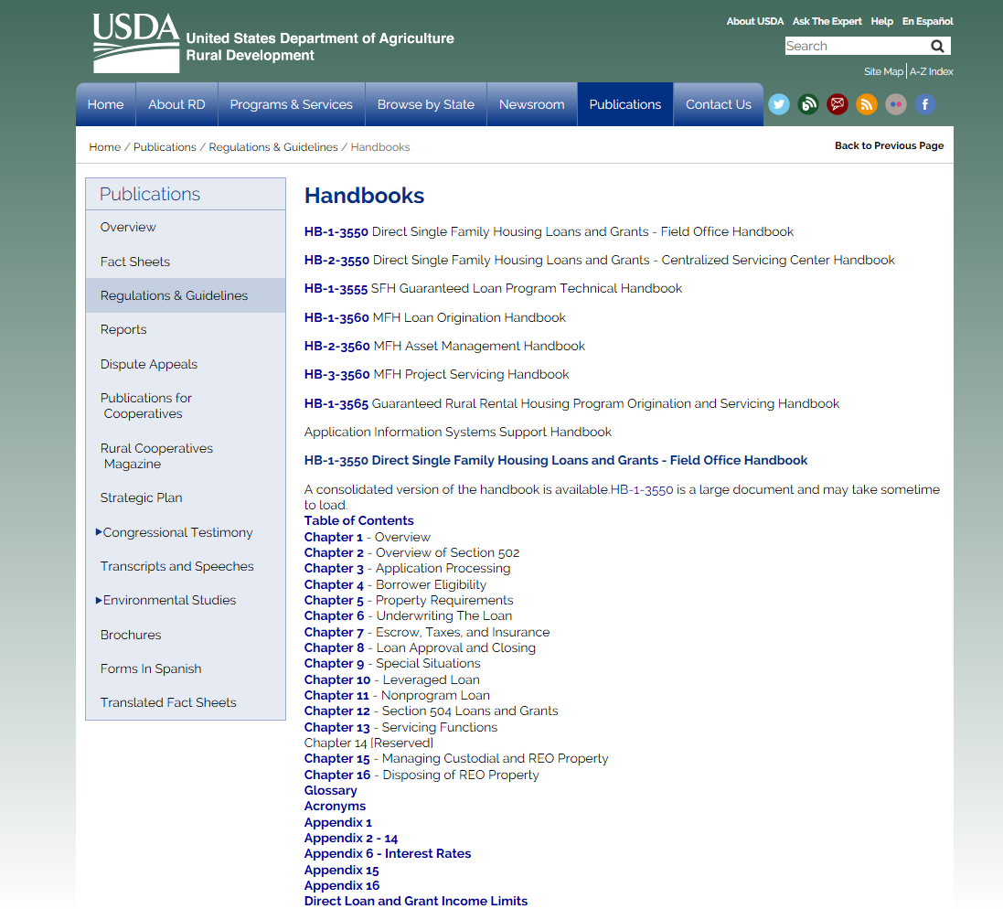
HB-1-3550 is chapter by chapter, or you can open the entire HB and search
Notes:
On the Handbooks webpage, you will see the various handbooks for the RD housing programs (direct, guaranteed, single family, and multi family). You will also notice that there are handbooks for loan origination as well as for loan servicing.
Handbook-1-3550 (aka HB-1-3550) is the first handbook listed. Handbook-1-3550 contains 16 chapters as well as a glossary, a list of acronyms, and various appendixes. Please note that Appendix 1 contains a copy of 7 CFR 3550.
The handbook can be opened chapter by chapter, or you can open the entire document using the “consolidated version” link. The second option is helpful when you are searching for guidance and may not know which chapter to reference.

Slide 13
Section 502 Direct Loan Program Overview
Sign up for Govdelivery to receive email updates on this program.
Using the link below, enter your email and select the “SFH Direct Loan and Grant Programs” (and any other programs of interest) and then click “Submit”.
https://public.govdelivery.com/accounts/USDARD/subscriber/new?qsp=USDARD_25
Notes:
This email subscription service is used to provide updates regarding the:
Program’s interest rate,
Changes to Handbook-1-3550,
Certified packaging process,
And much more.

Slide 14
USDA is an equal opportunity provider, employer, and lender
To file a program discrimination complaint, complete the USDA Program Discrimination Complaint Form, AD 3027, found online at http://www.ascr.usda.gov/complaint_filing_cust.html and at any USDA office or write a letter addressed to USDA and provide in the letter all of the information requested in the form. To request a copy of the complaint form, call (866) 632-9992. Submit your completed form or letter to USDA by mail at: U.S. Department of Agriculture, Office of the Assistant Secretary for Civil Rights, 1400 Independence Avenue, S.W., Washington, D.C. 20250-9410; by fax (202) 690-7442; or email at program.intake@usda.gov.

Slide 15
Are you interested in learning more about the Section 502
Direct Loan Program?
Please contact your applicable RD State Office.
https://www.rd.usda.gov/contact-us/state-offices
Notes:
Contact information can be found at https://www.rd.usda.gov/contact-us/state-offices.
Finally, please note that the contents of this training are current as of this presentation’s revision date. Please refer to Handbook-1-3550 for the most recent program guidance.

