Slide 1
Sustainable Management of Rural and Small Systems Workshop
Team Exercise Workshop
[Workshop Date] | [Workshop Location]

Slide 2
Welcome and Introductions
Moderator:
Welcome
Purpose of Workshop
Introduction of Team Members
Participant Introductions –Name, Community, Role
Workshop Materials
Meeting Logistics
Meeting Agenda

Slide 3
Our Schedule
Welcome and Introductions
Workshop Objectives
Key Management Areas
Self Assessment Exercise
Lunch
Improving Outcomes
Practices, Tools, and Measures
Creating an Action Plan
Notes:
Agenda Review:
Team Leader uses this slide, which should specifically reflect the workshop agenda topics and sequence, to provide an overview of the day.

Slide 4
Workshop Objectives
Learn about key utility management areas
Engage in a self-assessment process to understand your respective system’s, needs, wants, requirements, and options
Discuss tools, tips, and measures for performance improvement
Exchange insights and tips with other local utilities
Begin to create an action plan for moving forward
Notes:
Points to Make:
1. There are two overarching objectives for the day:
Learn about ways to think about managing your system more sustainably.
Learn about a self assessment process that can be used in various settings to improve understanding about utility operating and capital requirements and build support for needed performance improvements.
2. The workshop reflects a “joint-learning” model:
Learn from what USDA and EPA have compiled from utility experience.
Learn from each other through “team based” table discussions.
Learn from local technical assistance providers (if they are present at the workshop).
3. Overall, participants will learn about and use the key management areas, the self assessment process, and tools, tips, and measures for performance improvement.

Slide 5
Overview of the
Ten Key Management Areas
Outcomes that well-managed utilities strive for
Notes:
Points to Make:
This session has two parts:
A brief presentation on the ten Management Areas; then
Group discussion about the relevance and completeness of the Management Areas to utility managers – any observations indicating gaps in the Management Areas will be used to supplement the self-assessment process.

Slide 6
Common Challenges for Utility Managers
Aging infrastructure
Rate issues
  Prioritize demands for utility expenditures
  Long-term rate adequacy strategy
Customer satisfaction and confidence with services and rates
Notes:
Note to Team Leader:
Slides 5 and 6 present challenges common to many water sector utilities regardless of size or location. You should tailor your discussion of these challenges consistent with local conditions, though reviewing all of the challenges may be helpful as an educational exercise.
Points to Make:
1. Before talking about the Management Areas, we will focus on a quick overview of the system challenges the Management Areas are designed to speak to and address.
2. Aging Infrastructure is a common challenge faced by many systems. Many of the initial investments in clean and safe water infrastructure are nearing their functional end of life posing a capital needs challenge.
3. Rates are often a sensitive topic to discuss with decision makers and customers, while many systems have fallen behind on increases needed to provide for system renewal and replacement needs.
4. Customer Satisfaction – maintaining operations responsive to customer needs and expectations and reliably delivering the quality of product expected requires customer understanding of the value of your service, the constraints it operates under, and the resources needed to operate and maintain the system over the long term.

Slide 7
Common Challenges for Utility Managers
Operational issues
  Labor and material costs
  Regulatory compliance and new requirements
Workforce complexities
  Attracting and keeping reliable and competent staff
  Succession planning
Knowledgeable and engaged board members
Notes:
Points to Make:
1. Operational Issues
Labor and material costs have been on the rise;
Regulatory requirements drive additional infrastructure needs and administrative requirements.
2. Workforce complexities:
Staff turnover is commonplace – training takes place, then operators move on.
Ability to pay competitive wages is often constrained.
Growing leadership in a context where opportunities for advancement may be very limited.
Risk of critical, undocumented knowledge leaving with staff departures.
3. Knowledgeable and Engaged Board:
Must understand capital and operations & maintenance (O&M) requirements
Must understand value of service
Must understand regulatory requirements

Slide 8
The Well-Managed Utility
Ten Management Areas framed as outcomes
Building blocks for utility performance improvement: where to focus and what to strive for
Most water and wastewater utilities pay attention to these areas and likely perform well in at least some of them
Fit into, draw on, and support asset management, long-term business planning, continual improvement management systems
Notes:
Note to Team Leader:
Slides 8 to 18 provide background information about the ten Management Areas. Your presentation of these areas can emphasize that USDA and EPA worked with a wide range of water sector utilities to identify and define performance under these areas. The slides do not necessarily reflect your perspective, but they do provide an outside, independent perspective on what a sustainably managed utility focuses on and strives to achieve.
Points to Make:
1. The ten management areas are a response to the challenges and to help bring focus to utility manager efforts to manage more sustainably.
2. A substantial number of tools, initiatives, programs, etc. exist presenting a potentially confusing array of management improvement opportunities and options.
3. Management areas are an organizing framework – they provide the ability to connect improvement options to one or more management areas – they also seek to help cut through the confusion and provide a concrete focus for improvement efforts.
4. Management areas are described as outcomes – they are what a sustainably managed utility will strive for.
5. Anticipated that a utility manager will focus efforts incrementally in one or two management areas as resources and time allows.

Slide 9
The Ten Key Management Areas
Product Quality
Customer Satisfaction
Infrastructure Stability
Community Sustainability & Economic Development
Stakeholder Understanding and Support
Employee and Leadership Development
Operational Optimization – Energy and Water Efficiency
Operational Resiliency
Water Resource Adequacy
Financial Viability
Notes:
Points to Make:
1. There are ten management areas, and they are designed to cover the full range of management initiatives critical to a well functioning utility.
2. Just take a quick look at this list, we will be reviewing each of them individually in a moment.
3. There is no explicit or implied hierarchy or priority among the management areas – need and priority will be totally driven by the individual utility’s operating environment.

Slide 10
Product Quality
Clean and safe water
Produce potable water, treated effluent, and process residuals/recovered resources:
  Full compliance with regulatory and reliability requirements
  Consistent with customer, public health, and ecological needs
  Consistent with local economic development and business needs and opportunities
Notes:
Points to Make:
1. This management area addresses the “products” of both drinking water and wastewater services.
2. Three key areas define quality:
Compliance with applicable requirements
Customer, public health, and ecological needs
Local economic development and business needs/opportunities
3. The latter two quality areas are to a great extent locally defined, and the sustainably managed utility will be clear with its community about setting expectations in these areas (e.g., establishing explicit service levels).

Slide 11
Customer Satisfaction
Know what your customers expect in service, water quality, and rates
Set goals to meet these expectations
Help your customers understand the value of water
Develop a way to gather feedback from your customers, review the feedback, and then act on it
Notes:
Points to Make:
1. There is a need to establish explicit service levels to manage expectations consistent with the utility’s capacity.
2. Create goals to meet the service level expectations to bring a crisp focus to the utility’s operations.
3. Establish the means to understand how the utility is doing in the eyes of the customer base:
Conduct regular and systematic customer complaint review
Create a means to obtain positive perspectives (e.g., after action survey) – this will bring balance to the utility’s understanding of customer views

Slide 12
Employee & Leadership Development
Enable a workforce that is competent, motivated, adaptive, and safe working
Ensure employee institutional knowledge is retained and improved on over time
Create opportunities for professional and leadership development
Notes:
Point to Make:
The overall focus of the Employee and Leadership Development Management Area is to support overall, effective team building at the utility.

Slide 13
Operational Optimization
Ensure ongoing, timely, cost-effective, and reliable performance improvements in all facets of operations (i.e., continual improvement culture)
Minimize resource use, loss, and impacts from day-to-day operations (e.g., energy and chemical use, water loss)
Maintain awareness of information and operational technology developments to anticipate and support timely adoption of improvements
Notes:
Points to Make:
1. The sustainable utility will encourage a “how can we do this better” culture.
2. The sustainable utility will identify the best places to stay on top of developments:
Maintain awareness of new equipment and practice opportunities
Maintain awareness of efficiency and optimization opportunities

Slide 14
Financial Viability
Ensure revenues adequate to recover costs, fund timely maintenance, repair, and replacement of assets, and provide for reserves
Establish predictable rates, consistent with community expectations and acceptability – discuss rate requirements with customers, board members, and other key stakeholders
Notes:
Points to Make:
1. There is substantial guidance available on financial management for utility managers – can help the manager better predict future revenue needs related to large, future capital expenditures.
2. The sustainable utility will create community understanding of rate requirements that is informed and supportive of revenue needs to avoid deferred maintenance and deferred replacement.

Slide 15
Infrastructure Stability
Understand costs and condition for each system component
Understand operational performance factors (e.g., pressure)
Plan for system component repair and replacement over the long-term at the lowest possible cost
Coordinate asset repair, rehabilitation, and replacement within the community to minimize disruptions and other negative consequences
Notes:
Points to Make:
1. The sustainable utility will implement at least basic asset management practices.
2. There is an opportunity to reduce operational and capital costs over the medium to long-term if asset management in done well.
3. Disruption in the community associated with repair, rehabilitation, and replacement activities is one of the most visible of utility actions – it is when the “hidden infrastructure” is not so hidden. These highly visible actions can leave a lasting impression on community residents – they need to be managed carefully as a result.

Slide 16
Operational Resiliency
Identify threats to the system (legal, financial, non-compliance, environmental, safety, security, and natural disaster) – conduct all hazards vulnerability assessment
Establish acceptable risk levels that support system reliability goals
Identify how you will manage risks and plan response actions – prepare all-hazards emergency response plan
Notes:
Points to Make:
1. The sustainable utility will undertake a proactive examination of threats allowing for effective planning.
2. This management area reflects the realization that “zero risk” is not attainable, therefore a utility must explicitly accept risk levels and manage for and communicate about them.
3. Emphasizing consequence management is generally recognized as a utility’s best area of initial focus, involving development of a business continuity plan and an emergency response plan – both will help you know where you can get what help quickly.

Slide 17
Community Sustainability &
Economic Development
Be active in your community
  Be aware of, or participate in, discussions of community and economic development
  Get to know local business needs and be aware of opportunities for new residential or business customers
Align Utility Goals: to be attentive to the impacts utility decisions will have on current and future community and watershed health
Align Utility Goals: to promote community economic vitality and overall improvement
Notes:
Points to Make:
1. This management area seeks to emphasize that utilities are critical assets in and to a community.
2. In the more conventional relationship between a utility and its community, the utility tends to be on the receiving end of broader community plans (e.g., economic development plans that call for new development in a certain area).
3. The sustainable utility will engage proactively in broader community planning efforts to help shape the future consistent with utility capacity and financial considerations.
4. The sustainable utility also will actively seek opportunities to contribute to the economic health of the community.

Slide 18
Water Resource Adequacy
Ensure water availability consistent with current and future customer needs:
  Long-term resource supply and demand analysis
  Conservation
  Public education
Understand the system role in water availability
Manage operations to provide for long-term aquifer and surface water sustainability and replenishment
Notes:
Points to Make:
1. For drinking water, this management area emphasizes the need for the utility to understand how much water the community will need over time and have the ability to make both short and long-term operational and capital adjustments to meet these needs.
2. For wastewater, this management area emphasizes treated effluent is a valuable community resource, particularly in water scarce areas.

Slide 19
Stakeholder Understanding & Support
Create understanding and support from oversight bodies, community and watershed interests, and regulatory bodies:
  Service levels
  Rate structures
  Operating budgets
  Capital improvement programs
  Risk management decisions
Actively engage with the community and customers:
  Understand needs and interests
  Promote the value of clean and safe water
Notes:
Points to Make:
1. The sustainable utility will have a specific and sustained effort to create understanding and support for critical aspects of its operations.
2. The sustainable utility will have a mechanism in place to understand evolving community perspectives on water services and the environment in general.
3. This management area, to a great degree, ties together all of the other management areas and is the critical area to manage effectively as it generates the support needed to succeed in the other management areas.

Slide 20
The Self-Assessment Exercise
Time to go to work!
Notes:
Introduction to the Self Assessment Exercise – Point to Make:
The self assessment is designed to be a straight forward approach to identifying where scarce time and resources can best be focused.
The purpose for today is to have the team produce some initial results, and equip us to set an action agenda for undertaking management improvement.

Slide 21
Getting Started
Step 1: RATE your system’s level of achievement (practice and performance) for each management area
Step 2: RANK the importance of each area
Step 3: PLOT the results
Step 4: IMPROVE by exploring high achievement-related practices
Notes:
Note to Team Leader:
You will have each team member individually complete the team exercise, then compile the results into a single results sheet. You can then use the compiled results to discuss similarities and differences in team member perspectives and work to generate consensus among the team members regarding important management areas for improvement.
Points to Make:
1. Please pull out the worksheet titled “self assessment worksheet.”
2. It lists all of the management areas (plus any write ins from the group discussion of the management areas) and asks you to think about them from two perspectives:
Rating our achievement
Ranking the importance
3. There are four steps to the process as listed in this slide.
4. Each of us individually will complete the exercise. We will then compile the results and discuss similarities and differences in our sense of achievement in and importance of the management areas.

Slide 22
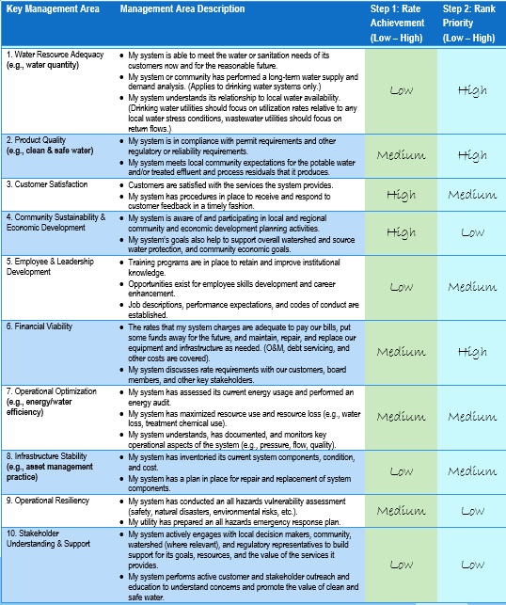
STEPS 1 & 2: Rating and Ranking Areas
Self-Assessment Demonstration
Step 1: RATE your system’s level of achievement (practice and performance) for each management area
Step 2: RANK the importance of each area
Step 3: PLOT the results
Step 4: IMPROVE by exploring high achievement-related practices

Slide 23
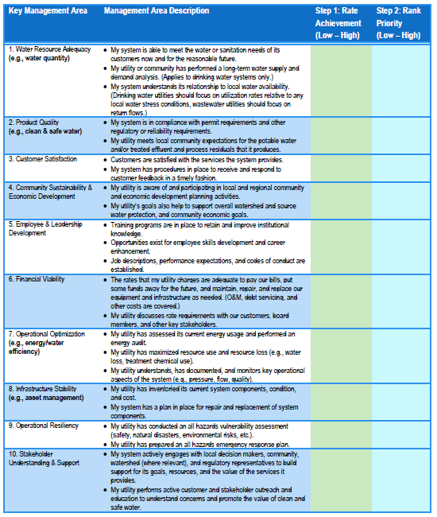
STEPS 1 & 2: Rating and Ranking Areas
Self-Assessment Demonstration
Step 1: Use the first blank column to rate achievement in the 10 key management areas.
Step 2: Use the second blank column to rank the importance of each of the 10 key management areas.

Slide 24
STEP 1: Rating the Management Areas
Scale from LOW to HIGH achievement
Select Low if your system has no workable practices in place for addressing this area – very low capacity and performance.
Select Medium if your system has some workable practices in place with moderate achievement, but you could improve – some capacity in place.
Select High if your system has effective, standardized, and accepted practices in place. It either usually or consistently achieves goals – capacity is high and in need of very little or no further development.
Notes:
Points to Make:
1. For RATING the management areas, please use the criteria listed on this slide (and repeated on the front of your worksheet).
2. Note that there is a dual focus on practices and performance – you need to think about your achievement from both perspectives.
3. When rating, realize that current high performance that is not supported by well developed and systematic practices may not be sustainable or reliable.
4. Further note that each of the management areas has more than one statement relating to practices and performance – to assign a single rating across these, use your best judgment, but tend toward using the statement or statements where you believe your achievement is lowest to assign your rating level.

Slide 25
STEP 2: Ranking the Management Areas
Scale from LOW to HIGH priority keeping in mind the following:
Current or expected challenges
Customer or stakeholder impact: reliability; quality; timeliness
Consequences of not improving: compliance; cost; credibility; health; safety
Urgency – near or long term need
Community priorities
Notes:
Points to Make:
1. You will next RANK each management area using the criteria listed on this slide (and repeated on the front of your worksheet) or any other reason you may believe a management area is important to your organization.
2. For example, you would rank a management area as “high” if the area is critical to you to deliver on community expectations or if there is particular urgency for improvement in the area.

Slide 26
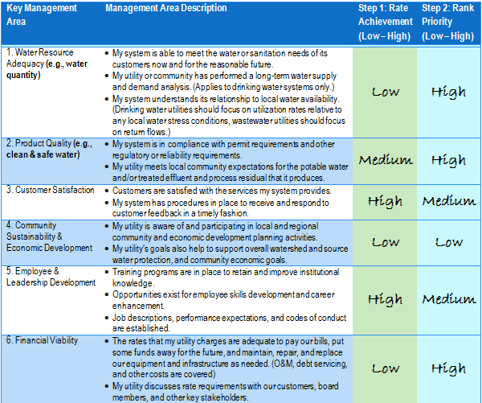
STEPS 1 & 2: Rating and Ranking Areas
Self-Assessment Demonstration
Notes:
Points to Make:
1. This slide depicts an example completed worksheet (also repeated in your hand out materials).
2. For example, this utility has rated Financial Viability “low” indicating its sense that it has low achievement relative to one or both of the Management Area description statements. It has ranked Financial Viability “high” indicating it is an area that is a priority for improvement.

Slide 27
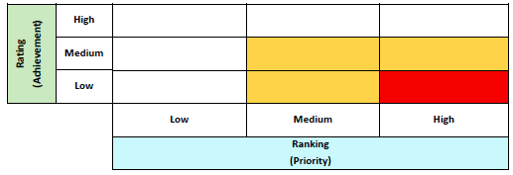
STEP 3 & 4: Plotting Results and Focusing Attention
Self-Assessment Demonstration
Step 1: RATE your system’s level of achievement (practice and performance) for each management area
Step 2: RANK the importance of each area
Step 3: PLOT the results
Step 4: IMPROVE by exploring high achievement-related practices

Slide 28
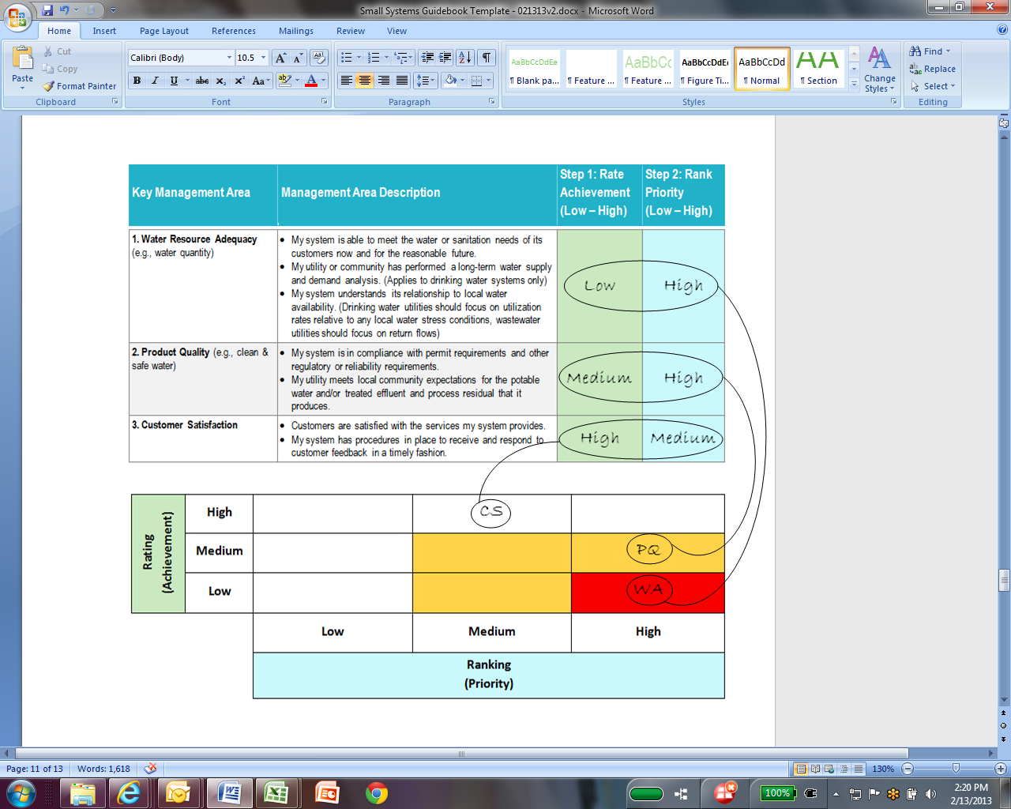
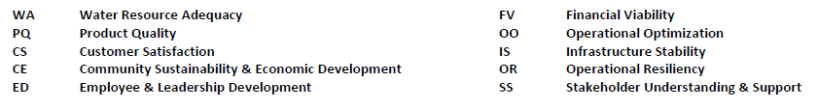
STEP 3: Plotting Results
Self-Assessment Demonstration
Notes:
Points to Make:
1. This slide depicts the process of plotting your self assessment results.
2. For example, Customer Satisfaction, which was rated “high” achievement and ranked “medium” priority gets plotted into the cell at the intersection of the high rating row and the medium ranking column.
3. All other management areas are plotted in a similar fashion.

Slide 29
STEP 3 & 4: Plotting Results and Focusing Attention
Self-Assessment Demonstration
Use the table on Page 5 of Tab 2 to write the two letters corresponding to each management area in the appropriate box that corresponds to intersection of the rating and ranking results (i.e., the achievement rating and the priority ranking).
Example: Consumer Satisfaction (CS):
  High Achievement
  Medium Priority
CS
Notes:
Points to Make:
Use this slide to reinforce the process for plotting the results of the rating/ranking exercise.
Using the green and blue arrows contained in the table, show participants how the rating and ranking of customer satisfaction results in its location in the graph.

Slide 30
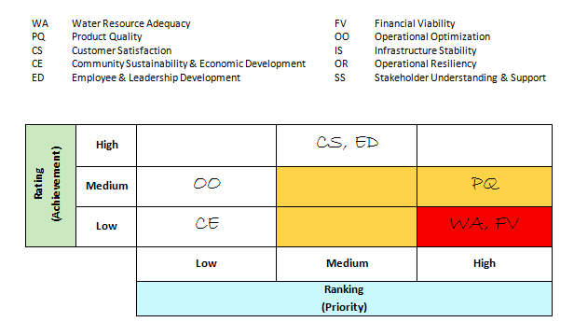
STEPS 3 & 4: Plotting Results and Focusing Attention
Self-Assessment Demonstration
Notes:
Points to Make:
1. This slide depicts a completed plot of self assessment results.
2. Note the use of acronyms for each of the Management Areas as listed on the self assessment worksheet (e.g., “WA” is used for Water Resource Adequacy).
3. Note that the plot has three zones: white = low need for attention; yellow = medium need for attention; red = high need for attention (where achievement is low and priority is high).
4. Once all of your Management Areas are plotted, your areas for initial focus will be obvious.

Slide 31
Self-Assessment Discussion Questions
Where is your utility strong? Why?
Where is there the most room for improvement? Why?
What are your areas of focus?
  Why are they a priority?
  Why is performance low?
    Technical capacity?
    Financial capacity?
    Managerial capacity?
What are the commonalities and differences among table participants?
Notes:
Points to Make:
1. We will not collect individual self assessments or record any specific findings associated with individual utilities – hopefully this will allow you to take a very candid approach to the self assessment. Please try to take no more than about 20 minutes to complete the self assessment.
2. After each table member has completed the self assessment, share results using the discussion questions listed on this slide. Generally, we will target about 30 minutes of discussion time at the tables. As part of these discussions, seek to learn as much as you can from your peers, as well as share as much of your knowledge as you can.
3. After the table discussions, we will hold a full group discussion to have an opportunity to share findings from the individual tables. We will use this discussion to identify commonalities and differences among the tables in terms of Management Areas in need of improvement and some of the reasons why performance has been lacking.

Slide 32
Improving Outcomes
Creating a Plan, Taking Action, Measuring Results
Notes:
Note to Team Leader:
Depending on the number of team participants and the number of management areas you have decided to focus on, seek to assign from two to three team members to each management area that you wish to focus on. Have these team members complete the Improvements Worksheet, then report results back to the full team.
Points to Make:
1. Team members will now organize themselves to complete an Improvements Worksheet for one management area. Please pull out the Improvements Worksheet in your workshop packet. Note the blanks at the top to fill in the management area addressed. These worksheets will be collected for use in carrying our action agenda forward.
2. Management area assignments will derive from the management areas identified as requiring attention during the previous self assessment exercise.
3. Each grouping of team members will tackle a different management area.
4. Team members should record their answers on the worksheet.
5. Discussions should focus initially on the questions that appear in bold type then, as time allows, address the others.

Slide 33
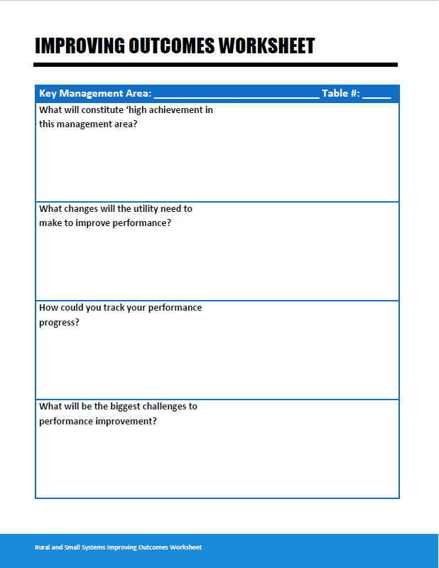
Improving Outcomes
Notes:
Points to Make:
Ask participants to find this worksheet in their packet.
Indicate that this will be the workshop that will support the next session of the workshop.

Slide 34
Table Activity
Each team group completes an improvement worksheet for one low achievement/high priority management area
Share perspectives on:
  What will constitute “high achievement” in this management area?
  What changes will the utility need to make to improve performance?
  How could you track your performance progress?
  What will be the biggest challenges to performance improvement?
Notes:
Points to Make:
Please work through these four questions, and record your perspectives on the “Improving Outcomes” worksheet.
After the table discussions are complete, we will hold a full group discussion with each of the tables reporting on their answers to the questions contained in the worksheet.
We will use the results of these discussions to support preparing an action agenda during the last session of our team meeting.

Slide 35
Tools, Guides, and Other Resources
Resources Available for Your Use
Notes:
Points to Make:
1. This session will focus on presenting information related to materials available to support utility management improvement efforts.
2. Additionally, a synthesis from discussions held at earlier workshops is provided to supplement the discussions you have held today.

Slide 36
Improving Outcomes: Additional Resources
Extensive Compilation of Tools and Resources
  Excel Print Out in Your Packet
  Electronically Available on EPA and USDA’s websites
Organized by Key Management Areas
Covers Resources from NRWA, USDA, EPA, RCAP, AWWA, WEF and others
Supplemental to Locally Available Technical Assistance and Resources
Notes:
Points to Make:
1. The Environmental Protection Agency and the United States Department of Agriculture have prepared a compilation of resources organized by management area.
2. This compilation is provided in your packet (hard copy) as an Appendix at the end of your Guidebook and online to act as a resource as you move forward with improvement efforts.

Slide 37
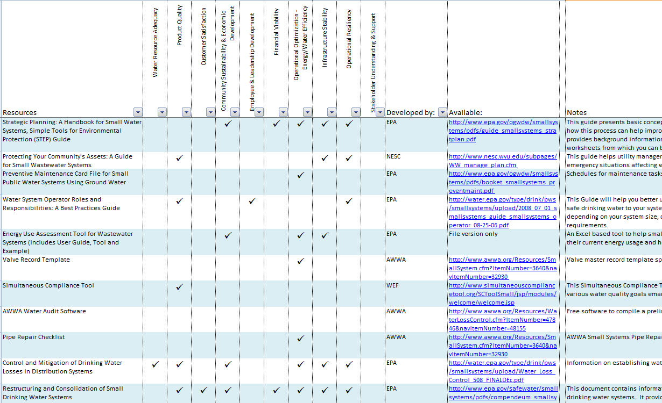
Tools and Resources Demonstration
Notes:
Points to Make:
1. This is a screen shot of the on-line version of the resource compilation.
2. For each listed resource, a check mark is placed in the management area column to which its content relates – many resources cover multiple management areas.
Most resources also have a “hot link” for accessing the material directly, and the notes section provides a brief overview of the nature of the resource.
The resources can be sorted by management area using the functions in the spreadsheet.

Slide 38
Resource Highlights
Four (Typically High Priority) Management Areas
  Operational Optimization – Water/Energy Efficiency
  Financial Viability
  Stakeholder Understanding and Support
  Infrastructure Stability
Areas Typically of High Interest to Utility Managers and The Backbone of A Sustainably Managed System
Notes:
Points to Make:
1. During other workshops conducted for small systems using this format, these 4 management areas were often highlighted as suffering from low achievement, while they are typically very high priority for most water systems.
2. In response, highlighted on the next set of slides are several resources for each of these management areas to help you get started with your improvement efforts.

Slide 39
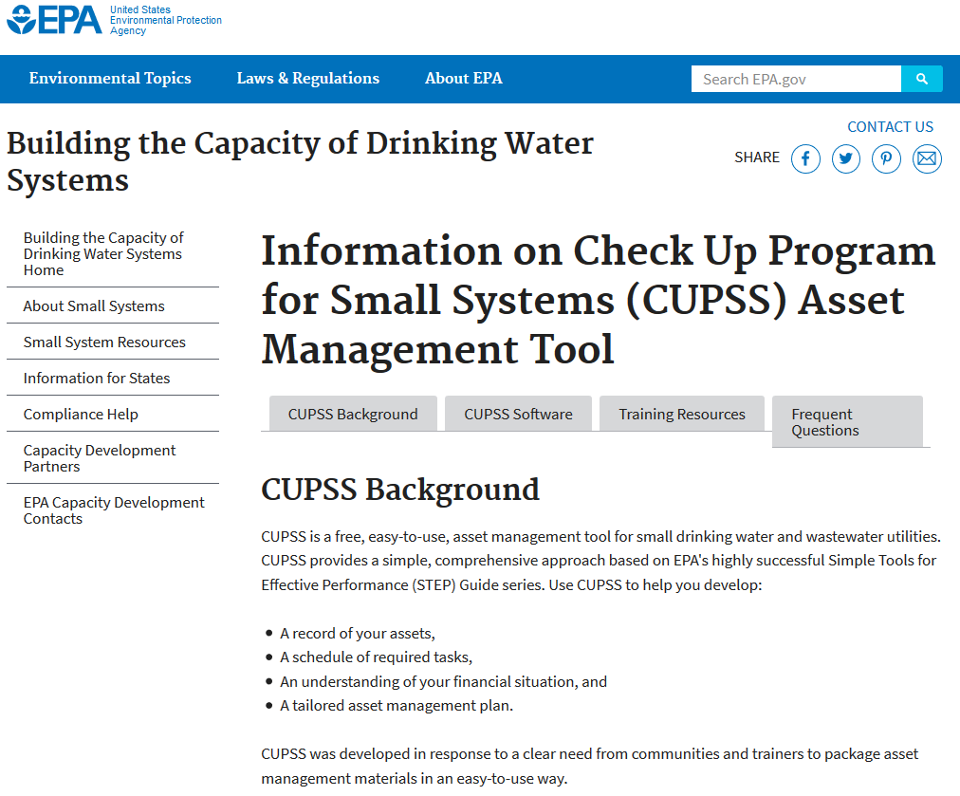
Operational Optimization
Water/Energy Efficiency
EPA: Check Up Program for Small System (CUPSS)
Free Asset Management Tool for Small Drinking Water and Wastewater Utilities
Tips on How to Develop a Record of Your Assets, an Understanding of Your Financial Situation, and a Tailored Asset Management Plan
Notes:
https://www.epa.gov/dwcapacity/background-information-check-program-small-systems-cupss-asset-management-tool

Slide 40
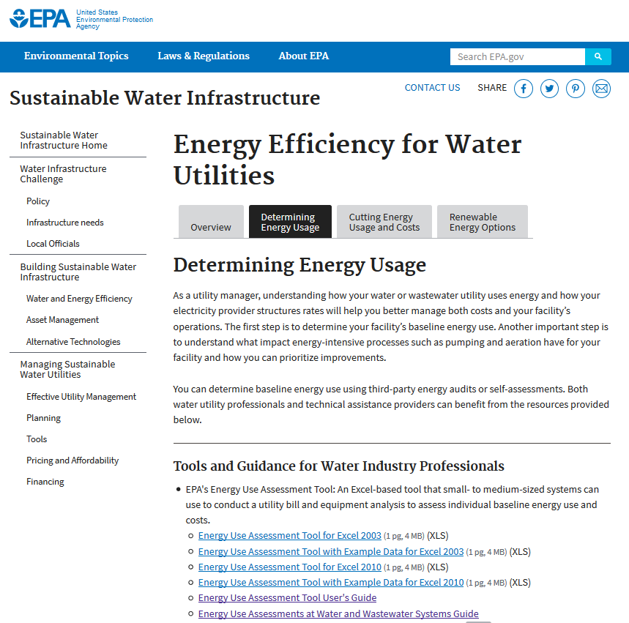
Operational Optimization
Water/Energy Efficiency
EPA: Energy Use Tool for Water and Wastewater Systems
Interactive, Excel-based tool
Detailed Analysis of All Energy Types
Provides Summary Report: Statement of Energy Performance
Notes:
https://www.epa.gov/sustainable-water-infrastructure/energy-efficiency-water-utilities

Slide 41
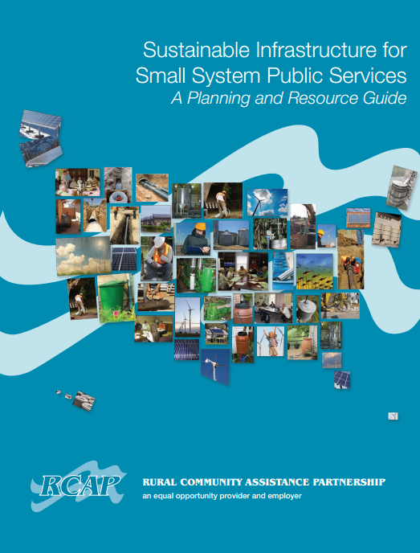
Operational Optimization
Water/Energy Efficiency
RCAP: Sustainable Infrastructure for Small System Public Services: A Planning and Resource Guide
Water Conservation
Energy Efficiency
Renewable Energy
Notes:
https://rcap.org/wp-content/uploads/2016/01/RCAP-Sustainable-Infrastructure-Guide.pdf

Slide 42

Financial Viability
NRWA: Revolving Loan Fund
Established Under Grant from USDA/RUS
Financing for Pre-Development Costs
Also Available for Equipment Replacement and Service Extension
Notes:
https://nrwa.org/initiatives/revolving-loan-fund/

Slide 43
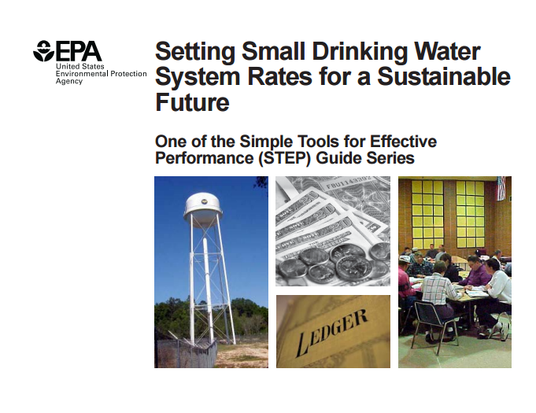
Financial Viability
EPA: Setting Small Drinking Water System Rates for a Sustainable Future
Determining Revenue Needs
Setting Rate Design
Approaching Rate Implementation
Notes:
https://nepis.epa.gov/Exe/ZyPDF.cgi/2000D2NM.PDF?Dockey=2000D2NM.PDF

Slide 44
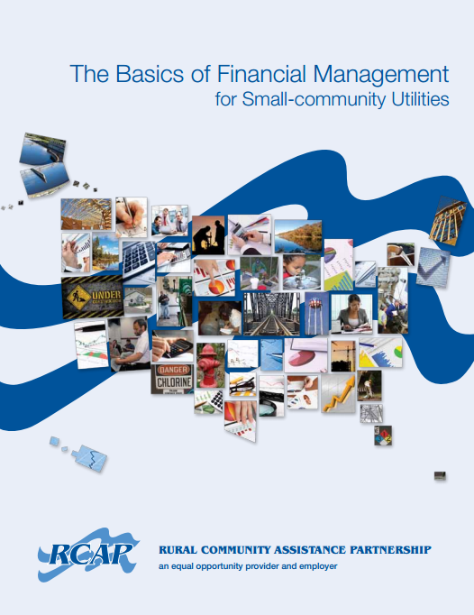
Financial Viability
RCAP: The Basics of Financial Management for Small-community Utilities
Understanding Financial Statements
Using Financial Ratios
Notes:
https://www.rcac.org/wp-content/uploads/2014/12/RCAP-Financial-Management-Guide.pdf

Slide 45
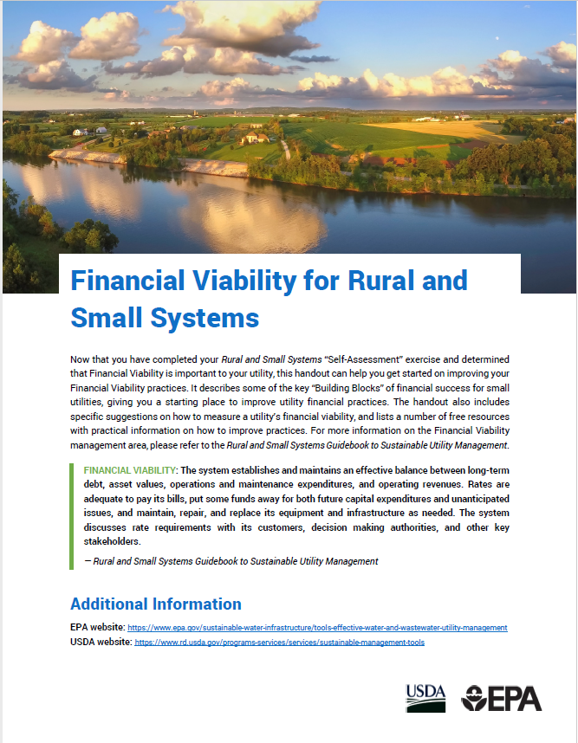
Financial Viability
Financial Viability Handout
Describes some of the key “Building Blocks” of financial success for small utilities
Includes specific suggestions on how to measure a utility’s financial viability
Notes:
https://www.rd.usda.gov/sites/default/files/Financial_Viability_Buildout.pdf

Slide 46
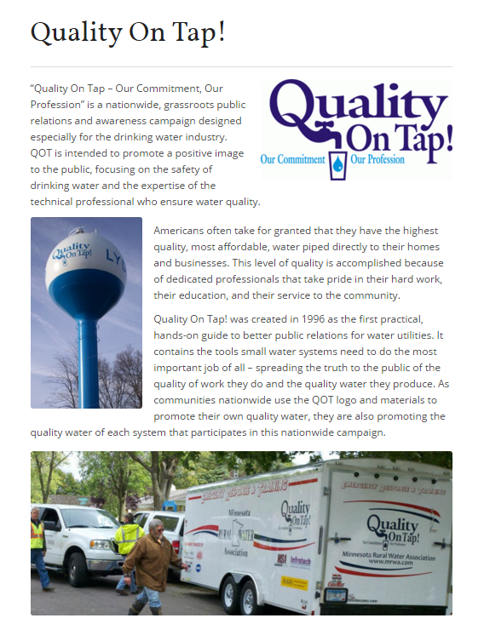
Stakeholder Understanding and Support
NRWA: Quality on Tap!
Nationwide, Grassroots Campaign for Public Awareness
Hands On Guide to Engagement and Communication for Better Community Support
Notes:
https://nrwa.org/initiatives/quality-on-tap/

Slide 47
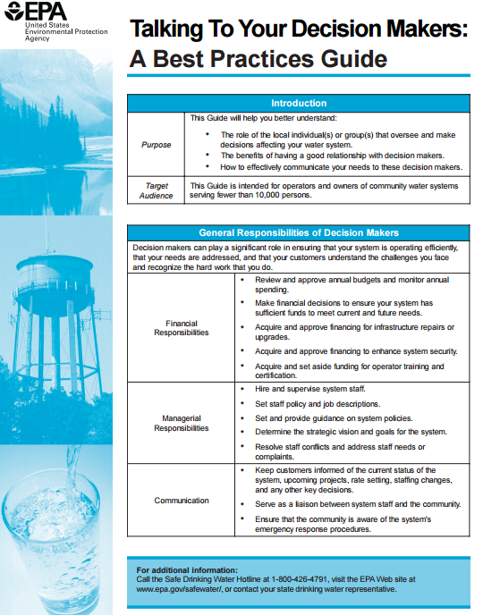
Stakeholder Understanding and Support
EPA: Talking to Your Decision Makers – A Best Practices Guide
Role of Community Decision Makers in Small Systems
Tips on How to Communicate Needs to Decision Makers
Notes:
https://www.epa.gov/sites/production/files/2015-07/documents/epa816f06034.pdf

Slide 48
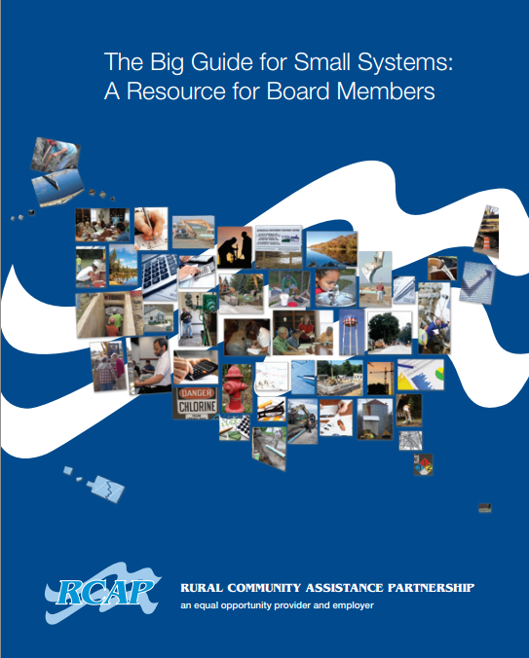
Stakeholder Understanding and Support
RCAP: The Big Guide for Small Systems: A Resource for Board Members
Water and Wastewater Treatment Basics
Regulatory Responsibilities
Board Business
Financial Duties and Responsibilities
Notes:
http://rcap.org/wp-content/uploads/2016/03/Big-Guide-for-Small-Systems.pdf

Slide 49

Stakeholder Understanding and Support
Stakeholder Engagement Handout
Describes some of the key “Building Blocks” of successful stakeholder engagement for small utilities
Includes specific suggestions on how to measure a utility’s stakeholder engagement
Notes:
https://www.rd.usda.gov/sites/default/files/Stakeholder_Understanding_SupportBuildout.pdf

Slide 50

Infrastructure Stability
RCAP: Getting Your Project to Flow Smoothly: A Guide to Developing Water and Wastewater Infrastructure
Water Infrastructure Basis
Project Planning
Design and Construction
Community Engagement
Notes:
http://rcap.org/wp-content/uploads/2016/01/RCAP-Getting-Your-Project-to-Flow-Smoothly.pdf

Slide 51

Infrastructure Stability
EPA: Water Quality in Small Community Distribution Systems: A Reference Guide for Operators
Distribution System Infrastructure
Monitoring, Control, and Security
Notes:
https://nepis.epa.gov/Exe/ZyPDF.cgi/P1000OY3.PDF?Dockey=P1000OY3.PDF

Slide 52
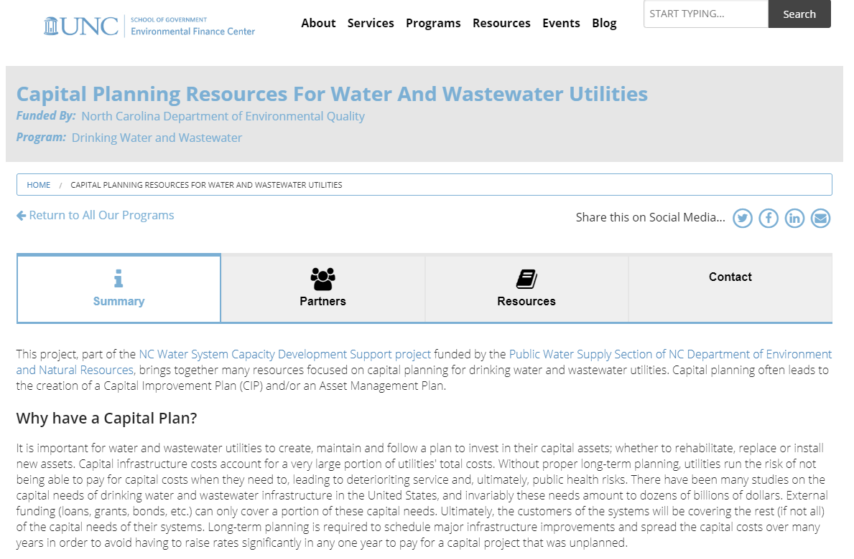
Infrastructure Stability
UNC: Capital Planning Resources For Water And Wastewater Utilities
Interactive, Excel-based tool
Create Easy-to-Understand CIPs
Includes Example Data
Notes:
https://efc.sog.unc.edu/project/capital-planning-resources-water-and-wastewater-utilities

Slide 53
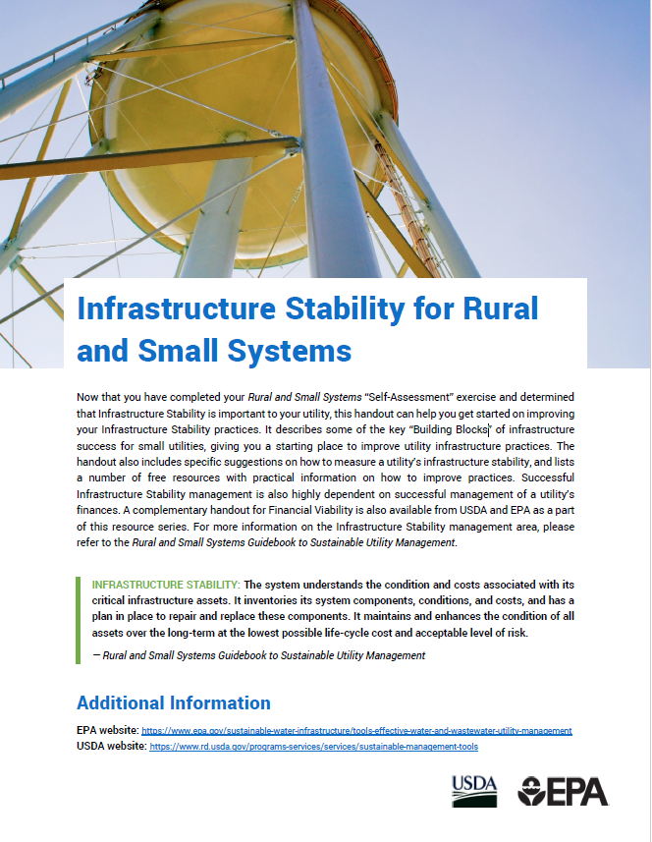
Infrastructure Stability
Infrastructure Stability Handout
Describes some of the key “Building Blocks” of infrastructure success for small utilities
Includes specific suggestions on how to measure a utility’s infrastructure stability
Notes:
https://www.rd.usda.gov/sites/default/files/Infrastructure_Stability_Buildout.pdf

Slide 54

“Buildouts”
Notes:
Points to Make:
1. USDA and EPA have created “buildouts” for four (typically high priority) management areas:
Financial Viability
Operational Resiliency
Stakeholder Understanding and Support
Infrastructure Stability
2. These are documents 9a, 9b, 9c, and 9d in the Workshop in a Box supplemental materials: https://www.rd.usda.gov/programs-services/services/sustainable-management-tools

Slide 55
Tips from Previous Improving Outcomes Exercises
Key management areas selected and discussed at previous workshops:
  Stakeholder Understanding and Support
  Infrastructure Stability
  Financial Viability
  Employee and Leadership Development
  Operational Resiliency
Notes:
Points to Make:
1. This next set of slides provides a synthesis of improvement ideas generated at previous workshops across the five listed management areas.
2. These ideas are provided to supplement workshop participants’ understanding of the opportunities that exist for taking improvement actions in these management areas.
3. Each slide addressed what constitutes “high achievement” in each area, as well as the types of changes a utility will need to make to support the high achievement actions.

Slide 56
Stakeholder Understanding and Support
High Achievement:
  Capital improvement plan or other document that summarizes utility priorities and can be shared with utility board
  Establish standard operating procedures for utility staff that address communication
Changes Needed:
  Educate stakeholders about utility needs
  Create ongoing opportunities for stakeholders and utility to interact (e.g., tours of facility)
Notes:
Point to Make:
The creation of a capital improvement plan is underlined in this slide because it shows up as “high achievement” in other management areas as well. This highlights the very important role preparing a capital improvement plan plays in improving the overall sustainability of the utility.

Slide 57
Infrastructure Stability
High Achievement:
  Capital improvement plan
  Inventory of system components, location, installation date, and condition
  Understanding of system operating parameters (e.g., pressure)
Changes Needed:
  Making time to support an incremental approach (e.g., maintenance and repair driven)
  Ability to do smaller projects and upgrades annually
Notes:
Points to Make:
1. High achievement in the Infrastructure Stability Management Area is linked to having a capital improvement plan, as well as initiating an asset management effort.
2. The changes needed seek to recognize and emphasize that small systems can rarely set aside all of the time required to prepare a capital improvement plan or put in place a complete asset management plan. These points reflect strategies that other small systems have used to incrementally, as time allows, build out an asset management program and to incrementally tackle repair and replacement needs on an annual basis.

Slide 58
Financial Viability
High Achievement:
  Funds set aside for reserves
  Asset management plans, short and long term plans, and quarterly budget reviews
  Utility board is knowledgeable about financial issues and system maintenance and repairs
Changes Needed:
  Good practices in place for rates and shut-offs
  Better communication between elected officials, utility staff and consumer
  Independent rate study
  Document priorities for system improvements
Notes:
Points to Make:
1. Regarding high achievement in the Financial Viability Management Area, system operators identified creating reserve funds and ensuring Board members are fully aware of operational and capital needs of the system as critical to financial success over the long run.
2. Regarding changes needed, many system operators suggested that an independent rate study can act as an outside, neutral validation of utility revenue needs that can be critical to garnering support for rate increases.

Slide 59
Employee and Leadership Development
High Achievement:
  Written job descriptions
  Clear performance expectations
  Staff are cross-trained
Changes Needed:
  Develop neighboring system relationships for staff to learn from each other
  Create merit-based initiatives to reward high performance (e.g., additional leave days, recognition, monetary awards)
Notes:
Points to Make:
1. Regarding Employee Leadership and Development, system operators stressed the importance of “writing things down” both to create clarity for staff expectations and to aide knowledge transfer as staff turnover takes place.
2. System operators also recognized that small systems have substantially constrained capacity for training (both time and money), so have looked to lower cost and less demanding ways to support skill development (such as partnerships with neighboring utilities).

Slide 60
Operational Resiliency
High Achievement:
  Emergency response plans, operations plans, shut-off checklists for equipment
  Drill emergency response plan
  Certify staff and board members
Changes Needed:
  Ensure staff and board know where all emergency documentation is kept
  Have contractor support lined up in case of emergency
Notes:
Points to Make:
1. An emergency response plan was seen as an absolute necessity to ensure a utility has reasonable capacity to respond in an emergency situation. But the plan itself was seen as insufficient to ensure effective response. As a result, practicing (through drills) the plan response was seen as critical.
2. Proactively establishing a relationship with key equipment and service vendors to ensure they can provide timely response support in an emergency situation was seen as a cornerstone of an effective emergency response plan.

Slide 61
Creating an Action Plan
Where do we go from here?

Slide 62
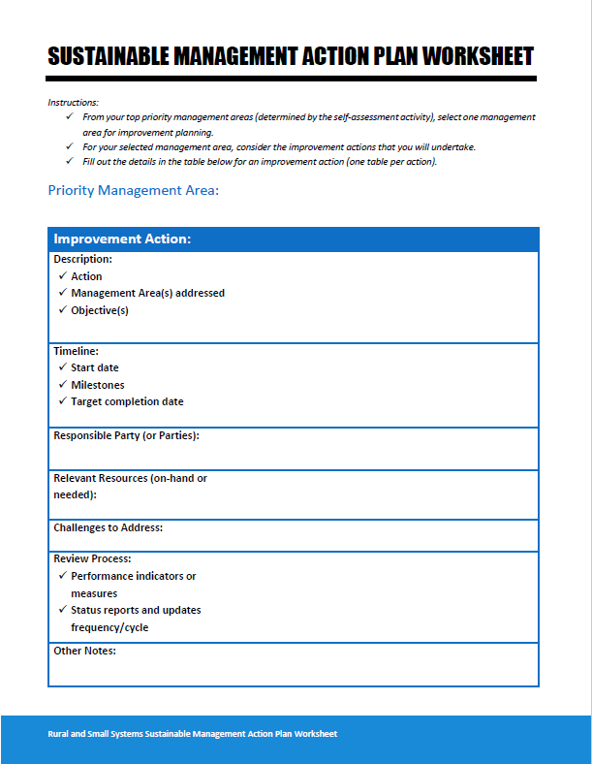
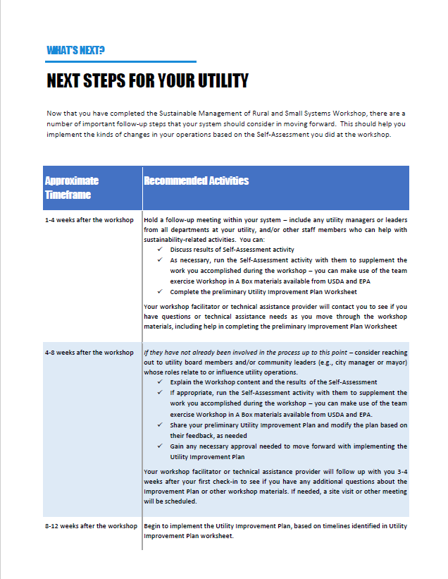
Creating an Action Plan
Notes:
In your folders, you have two sheets for this session – a System Management Action Plan worksheet, and a Next Steps for Your Utility handout.
During this session, we would like each of you to fill out an Action Plan worksheet for one action, but we will first go over the two handouts.

Slide 63
Next Steps for Your Utility
Notes:
The Next Steps for Your Utility handout is a timeline of suggested actions for getting started on working on the management areas that you identified as areas in need of improvement.
The handout describes steps that your utility can take, and also mentions points where you would work with a workshop facilitator or TA provider – these are great opportunities for you to follow up with Georgia Rural Water Association.
You also have a handout that is called “Next Steps for TA Providers,” so that you can see the types of items that TA providers can assist you with.
As you start to fill out your Improvement Plan worksheet, you can see how it fits with the “Next Steps for Your Utility” handout.

Slide 64
Action Plan Worksheet
Notes:
The Action Plan worksheet is an easy way to get started with planning your next steps. You should use a fresh worksheet for each improvement action that you start for your priority management area.

Slide 65
Action Plan Worksheet
Step 1: Fill out your top priority management area from the Self Assessment exercise.

Slide 66
Action Plan Worksheet
Step 2: Choose an action that you could take to make improvements in your selected Management Area.

Slide 67
Action Plan Worksheet
Step 3: Complete the fields below to describe what is needed to complete implement your “Improvement Action”

Slide 68
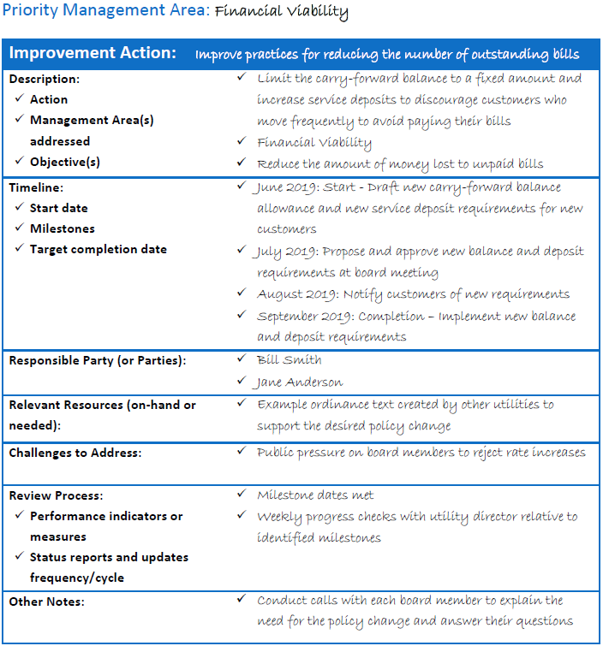
For Example...

Slide 69
Feedback Session
Please complete your evaluation forms.
Thank you!
Notes:
Points to Make:
1. Please complete the evaluation form we have provided. Your observations, comments, and suggestions will help to improve the workshop over time.
2. There is no need to provide your name on the sheet, and please leave the sheet on the back table as you exit the room.
3. Thank you very much for your participation, and feel free to contact us with any follow-up needs you may have.

