Slide 1




Investing in Rural America
Clean, affordable, reliable energy

Slide 2
Rural Utilities Service - Inflation Reduction Act
Inflation Reduction Act (IRA)
Two New Programs:
Powering Affordable Clean Energy (PACE)
IRA Section 22001
Empowering Rural America
(New ERA)
IRA Section 22004
Largest investment in rural electrification since 1936.
BRAND NEW grant, loan, loan modification, and partial loan forgiveness programs to expand clean, affordable, and reliable energy.
Reduced pollution, improved health, and lower energy costs for rural America.
Once in a generation opportunity for economic development and to enhance the quality of life in rural communities.

Slide 3
Powering Affordable Clean Energy (PACE)
Program Overview
Program Goal: Increase clean energy in rural America and make it significantly more affordable for consumers, especially for energy, distressed, disadvantaged, and Tribal communities, to heat and cool their homes, run their businesses and farms, and power their cars, schools, and hospitals.
PARTIALLY FORGIVABLE LOANS for utility-scale clean energy projects – wind, solar, hydropower, biomass, geothermal – including energy storage projects in support of renewable technologies.
Proposed Timeline/Process: (2 stage process)
  a) Electronic submission of Letter of Interest – open June 30, 2023 through September 29, 2023
  b) LOIs accepted on a rolling basis and evaluated as received
  c) If invited by the Agency, applicant submits full application

Slide 4
Powering Affordable Clean Energy (PACE)
Program Details
Eligible​ Applicants | Corporations; States and territories along with their subdivisions and agencies; Municipalities; Utility districts; Cooperatives; Nonprofits; Indian Tribes; Alaska Native, regional, or village corporations; Limited Liability Companies or other for-profit entities. One application from each eligible entity.; the project must produce renewable energy for resale and serve at least 50 percent rural customers
Eligible ​ Activities​ | Renewable power generation from: wind, solar, geothermal, hydropower, or biomass​ Storage for renewable energy​
Forgiveness Levels: RUS will initially allocate a minimum of $300 million to each category | ​Category 1: Up to 20 percent total loan forgiveness for applicants that meet the minimum requirements; Category 2: Up to 40 percent total loan forgiveness if 50 percent or more of the population served by the proposed service area is located within the following areas: (1) Energy Communities; or (2) Distressed or Disadvantaged Communities. Category 3: Up to 60 percent total loan forgiveness if: The proposed service area is located in Puerto Rico, United States Virgin Islands (USVI), Guam, American Samoa or other U.S. territories or Compact of Free Association (COFA) states; or The proposed service area consists of 60 percent or more of a Tribal area or serves an area that constitutes a Substantially Underserved Trust Area; or The Project is owned by an Indian Tribe, defined by the Federally Recognized Indian Tribe List Act of 1994, including their wholly owned subsidiaries and instrumentalities, or Alaska Native Corporations, including regional or village corporations.
Loan and Program size | $1 million – $100 million​, inclusive of forgiveness; $1 billion in funding

Slide 5
Powering Affordable Clean Energy (PACE)
Program Timelines
Target Date | Activity
May 16, 2023 | Publication of the PACE NOFO
May 16 – June 10, 2023 | USDA hosts webinars, speaks at conferences, and is available to answer questions
June 30, 2023 | Opening date for submission of PACE Letters of Interest Letters will be reviewed on a rolling basis
July 2023 | USDA begins reviews of Letters of Interest and begins invitations for applications USDA will inform applications if they are invited to submit a full application. If so, applicants have 60 days to submit unless otherwise agreed to.
September 1, 2023 – December 2025 | PACE awards and announcements are made
September 29, 2023 | Closing date for submission of PACE Letters of Interest
September 30, 2031 | All funds fully disbursed

Slide 6
Empowering Rural America (New ERA)
Program Overview
$9.7 billion in budget authority for the long-term resiliency, reliability, and affordability of rural electric systems to achieve the greatest reduction in CO2, methane, and nitrous oxide emissions.
Eligibility: Electric cooperatives that are or have been RUS or REA borrowers, cooperative entities serving a predominantly rural area, or wholly or jointly owned subsidiaries of such cooperatives.
Activities Supported
Purchase of renewable energy
Renewable energy systems
Zero-emission systems
Carbon capture and storage systems
The deployment of such systems
Energy efficiency improvements to generation & transmission systems of eligible entities
Any combination of the above
Permitted Use of Funds
Grants – maximum 25 percent of project cost
Loans fixed at 2 percent or at a rate tied to the Federal government’s cost of capital; and 0 percent for predominantly distressed, disadvantaged or energy communities
Refinance debt for a stranded assets at 0 percent interest in certain instances
Any combination of the above

Slide 7
Empowering Rural America (New ERA)
Program Details
Eligible Entities | Electric cooperatives (or a wholly or jointly owned subsidiary of such electric cooperatives)
Eligible Uses | Renewable energy, renewable energy systems, zero-emission systems, and carbon capture and storage systems, to deploy such systems, or to make energy efficiency improvements to electric generation and transmission systems.
Process – 2 Stages | Letter of Interest (LOI): Electronic submission of Letter of Interest – open July 31, 2023 through August 31, 2023. Letter of Interest must meet minimum requirements and will be scored according to the selection criteria. Additional requirements (reliability, resiliency, and affordability) 2) Full application: High-scoring applicants will be invited to submit a full application. The full proposal must be submitted within 60 days from the invitation to proceed or a mutually agreeable date. RUS reserves the right to negotiate a final package of assistance.
Allowable Funding Requests | Applicants can propose assistance from any single product or a combination of the following: Loans to finance the cost of new clean energy projects, at Treasury rate or interest rates as low as 2 percent; Grant funding up to 25 percent of the total cost of the proposal; Refinancing of stranded assets at interest rates as low as 0 percent with reinvestment in eligible activities; or Loans with interest rates as low as 0 percent for projects serving predominantly disadvantaged communities. The Agency can offer an Applicant a financial package different than requested.

Slide 8
Empowering Rural America (New ERA)
Selection Criteria
  Scoring (maximum of 60 points):
    Annual tons of CO2 equivalent reduced (self-generated or purchased): up to 30 points
    Annual tons of CO2 equivalent avoided: up to 10 pts
    Percentage increase in renewable or zero-emission energy in the energy mix (owned & purchased): up to 10 pts
    Percentage decrease in carbon intensity of the energy mix (owned & purchased): up to 10 pts
  Score is relative to all applicants in the same category of Total Utility Plant size
  Applicants will be provided the Achievable Reduction Tool to calculate greenhouse gas reductions.
  Evaluation of criteria in addition to greenhouse gas score includes:
    Consumer benefits for affordability (rate & bills reduced from efficiency)
    Project cost per unit of greenhouse gas reduction
    Project costs relative to program funding
    Geographic distribution of projects
    Efficient use of program funds

Slide 9
Empowering Rural America (New ERA)
Application Categories
Applicants will compete in one of three categories based on their 2022 Total Utility Plant value.
  Category 1: Applicants with a total utility plant value equal to or over $500 million – at least 60 percent of funding.
  Category 2: Applicants with a total utility plant value under $500M but over $200M – up to 20 percent of funding.
  Category 3: Applicants with a total utility plant value less than $200M – up to 20 percent of funding.
Joint applications will be considered:
  Consolidated groups of entities may submit a single Letter of Interest for consideration.
  Financial commitments will be disaggregated unless the group members are willing to accept joint liability.
  Group LOIs compete in the category reflective of the combined value of the group’s Total Utility Plant.

Slide 10
Empowering Rural America (New ERA)
Program Timelines
Target Date | Activity
May 16, 2023 | Publication of the New ERA NOFO
May 16 – July 31, 2023 | USDA hosts webinars, speaks at conferences, and is available to answer questions
July 31, 2023 | Opening date for submission of New ERA Letters of Interest
August 31, 2023 | Closing date for submission of New ERA Letters of Interest
September 2023 | USDA reviews, scores, and ranks submitted Letters of Interest
October – November 2023 | USDA invites competitive New ERA applications to file a full application Once applicants are invited to submit a full application, they have 60 days to do so unless otherwise agreed to with USDA.
December 2023 – December 2026 | New ERA awards and announcements are made
September 30, 2031 | All funds fully disbursed

Slide 11
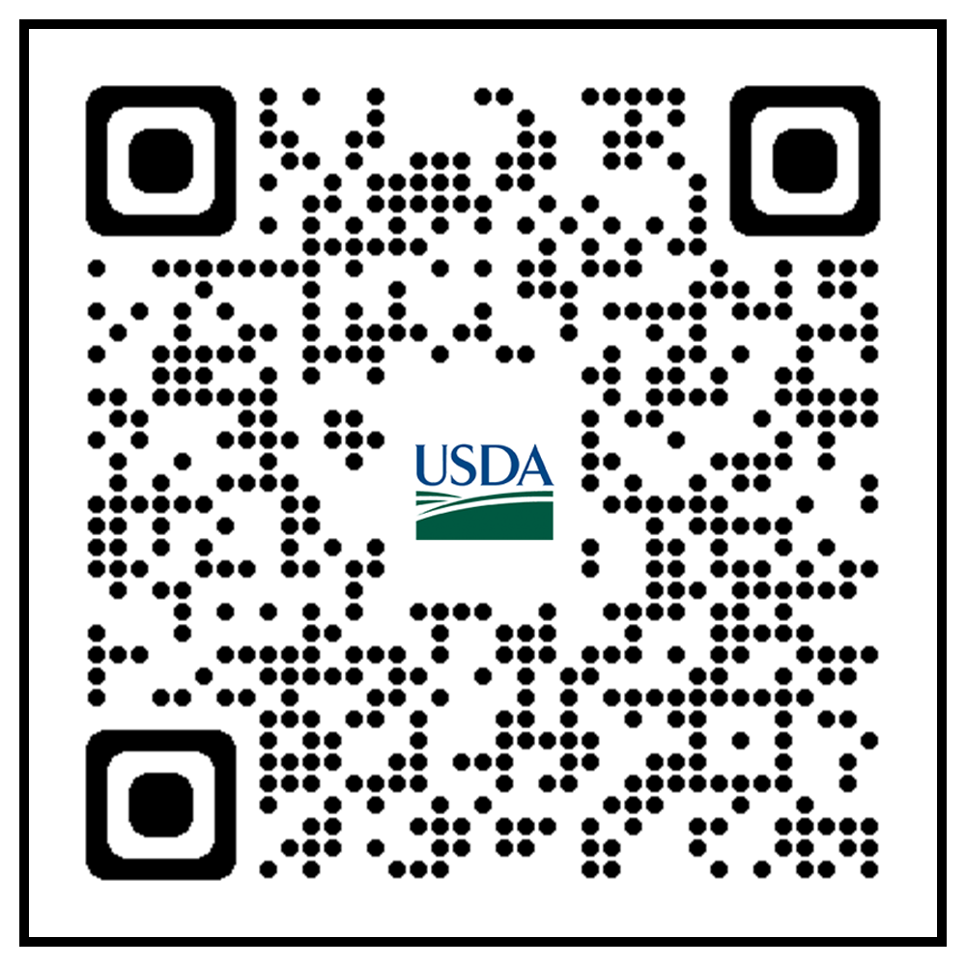
Inflation Reduction Act - Webinars
  Webinar: PACE Program and Eligibility Mapping Overview
    June 6, 2023
  Webinar: New ERA Program and GHG Calculator Overview
    June 8, 2023
  Webinar: Office Hours for PACE and New ERA
    June 22, 2023
    July 6, 2023
    Webinars: Demo: How to Submit PACE Letters of Interest
    June 29, 2023
    Webinars: Demo: How to Submit New ERA Letters of Interest
    July 13, 2023
  Webinar: USDA PACE Application
    July 20, 2023
    August 1, 2023
  Webinar: New ERA Application
    August 15, 2023
    August 29, 2023
Details and information on the webinars, including registration links, will be available on RD's IRA website at https://www.rd.usda.gov/inflation-reduction-act.

Slide 12
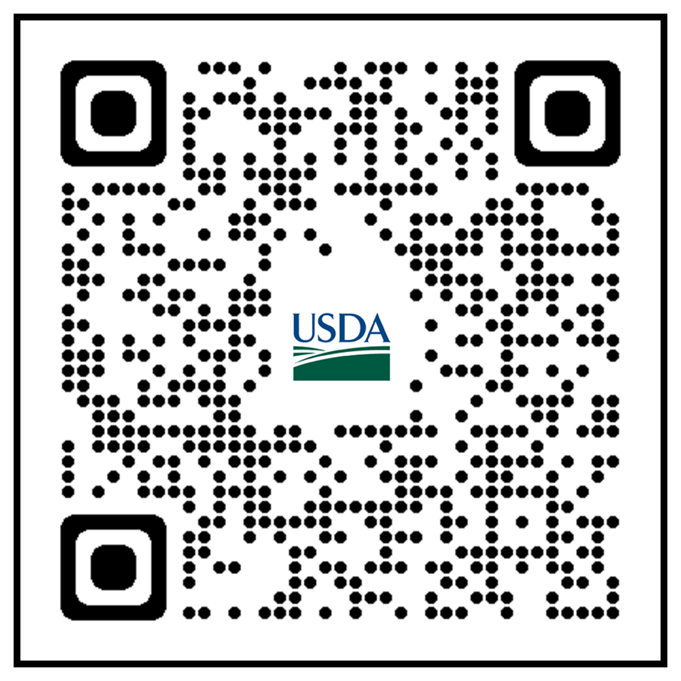
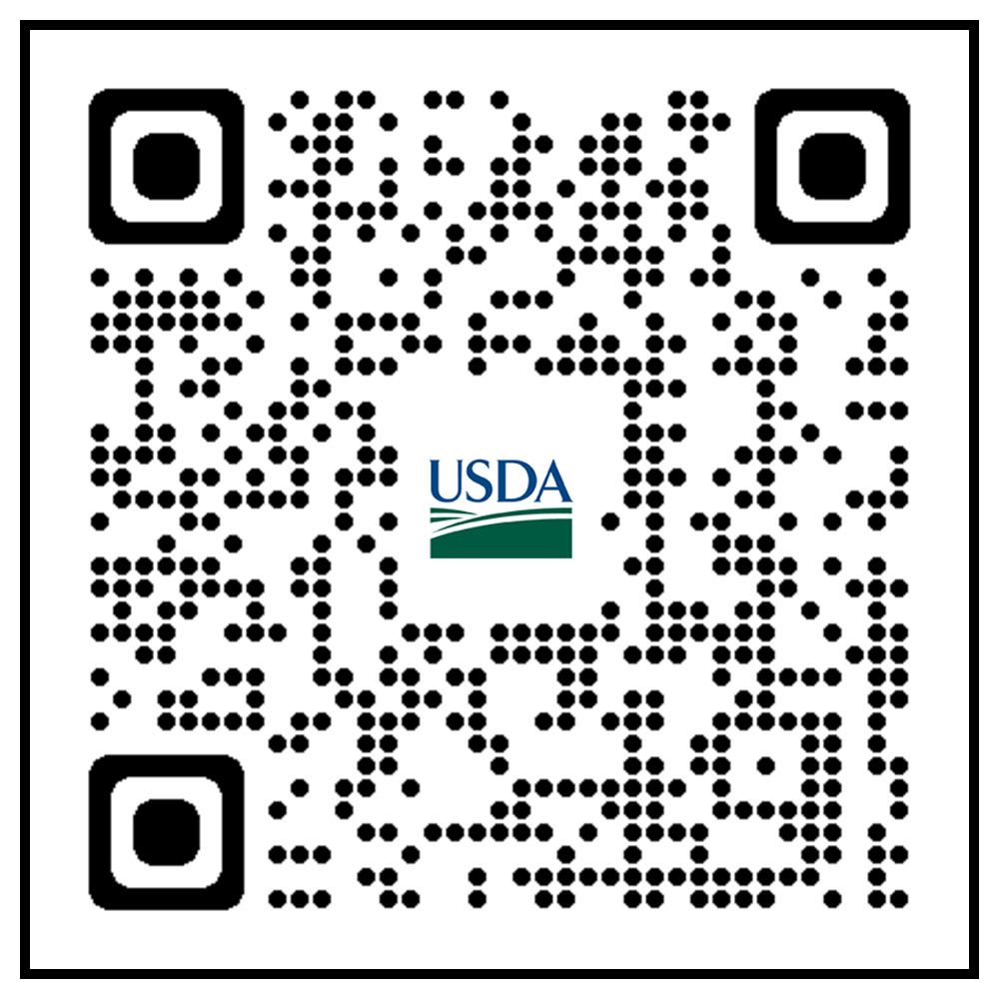
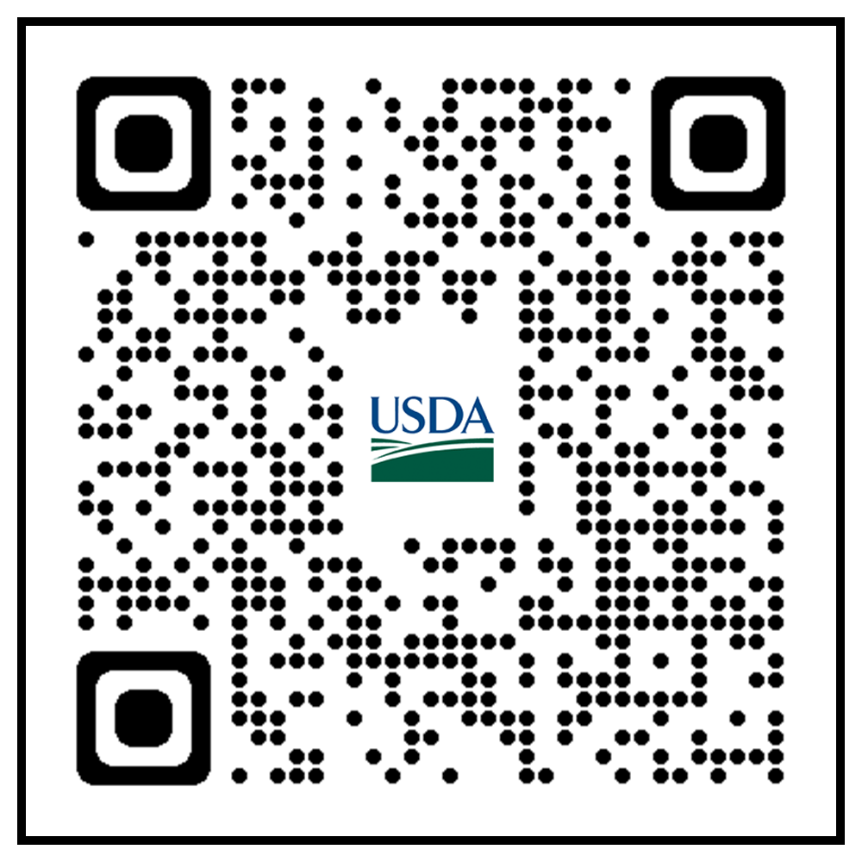
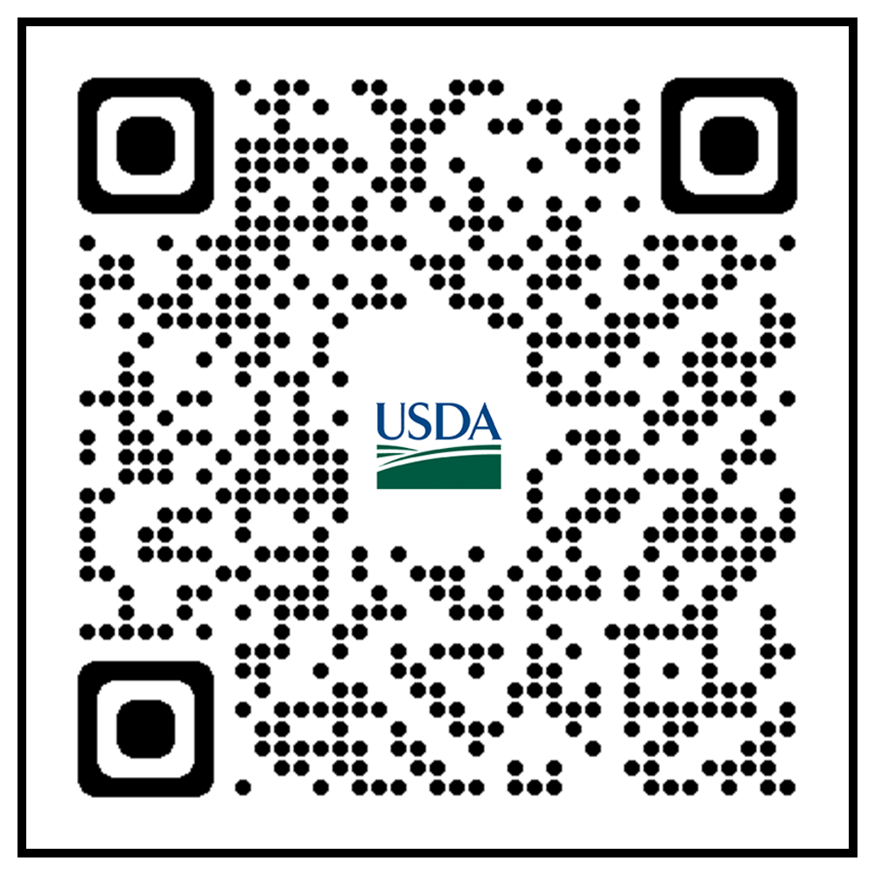
Key Resources
USDA Rural Development IRA page
https://tinyurl.com/a6t9467e
USDA Rural Development Electric Programs
https://tinyurl.com/pmmzkm9v
Sign up for news with GovDelivery
https://tinyurl.com/mtdp45me
Current USDA lending rates
https://tinyurl.com/2p9u3wyc
Register for Sam.gov
https://tinyurl.com/2p9y6u9a

Slide 13

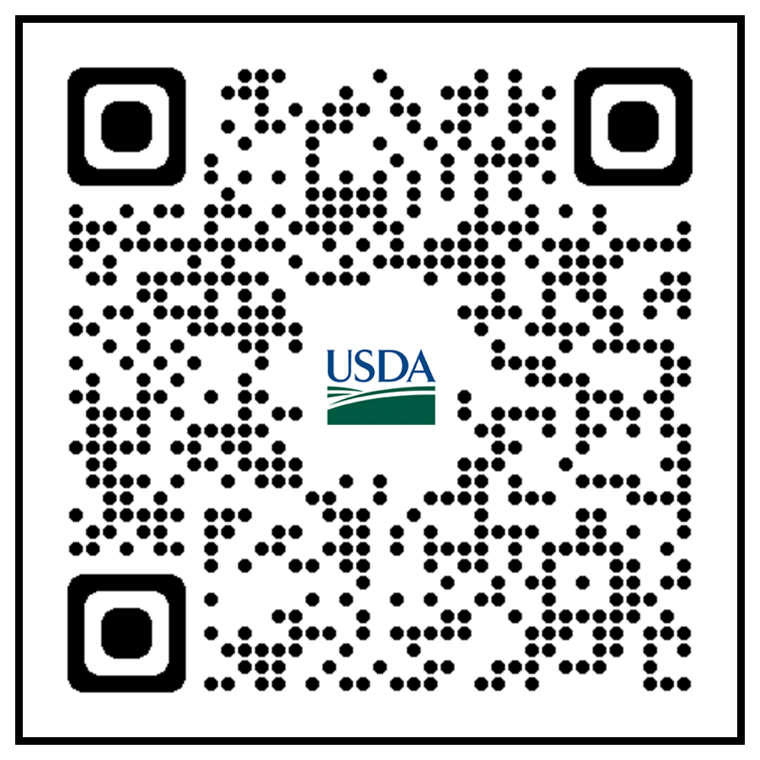
Contact
RUS Electric Program General Field Representative Link:
https://tinyurl.com/mrfk3brh
Frequently asked questions can be found on the RD IRA website.
https://tinyurl.com/a6t9467e
Please send additional questions to:
SM.RD.RUS.IRA.Questions@usda.gov

Slide 14
Thank you !
USDA is an equal opportunity provider, employer, and lender.

