Slide 1
U.S. Small Business Administration Presentation Introduction slide

Slide 2
Introduction to Government Contracting for Small Business
Jorge Betancourt
District Office, Region 2
Economic Development Specialist
PR & and the USVI DO
Jezabel Rodríguez
Government Contracting, Area 1
Procurement Center Representative
PR & and the USVI
Notes:
This training module is designed to help small businesses understand the programs and certifications for small business and how the government buys goods and services.
There are two parts to the GC 101 training program. This part discusses the steps used by the government to purchase what it needs and part two discusses how to do a marketing research and deferments tool to market your business at the federal governmet

Slide 3
Why a Small Business Program?
U.S. policy that small business (SB) concerns shall have the maximum practicable opportunity to participate in the performance of contracts awarded by any Federal agency.
The U.S. uses the procurement process to advance socio-economic policies and objectives.
To aid, counsel, assist & protect the interests of small business concerns.
Goal of policy is to ensure that a fair proportion of purchases, contracts & subcontracts be placed with small businesses.
Notes:
Did you know that out of the 30 million businesses in America, only a little over 500,000 are actually registered to accept government contracts. That mean 1.6% of all American businesses are registered in System for Award Management and can work for the government.

Slide 4
Federal Contracting Facts
The world’s largest buyer of goods and services is the Federal Government, with purchases totaling more than $500 billion per year.
Contracts exist for every item imaginable, from paper clips to armored tanks.
Federal agencies are required to establish contracting goals, with at least 23 percent of all government buying targeted to small firms.
Notes:
The U.S. government is the world's largest buyer of products and services.
Purchases by military and civilian installations amount to nearly $500 billion a year, and include
everything from complex space vehicles to janitorial services.
In short, the government buys just about every category of commodity and service available.
By law, federal agencies are required to establish small business contracting goals.
The current, government‐wide procurement goal is that at least 23% of all government buys should be
awarded to small businesses. The key word here, however, is that it’s only a goal.
Slide

Slide 5
Set-Aside for Socio-Economic Categories
Targeted set-asides and acquisition goals:
Women-Owned Small Businesses (5%)
Small Disadvantaged Businesses (including 8(a) certified) (13%)
HUBZone Businesses (3%)
Service-Disabled Veteran-Owned Small Businesses (5%)
Set-asides are reserved for small business between $10,000 (Micro- purchase Threshold) to $250,000 (Simplified Acquisition Threshold)
Notes:
spending levels when he first took office.
Prime Contracting Government-wide Procurement Goals:
23% of all federal purchasing is set aside for small businesses.
Targeted Set-asides and Acquisition Goals
Women-owned small businesses - (5%)
Small disadvantaged businesses including 8(a) certified - (5%)
HUBZone - (3%)
Service-disabled veteran-owned small businesses - (3%)
Overall small business goal of 23%
Set-asides are reserved for small business between the Micro-purchase Threshold and the Simplified Acquisition Threshold.

Slide 6
What is a Small Business?
Federal Acquisition Regulation (FAR) 2 Definitions
Small business concern means a concern, including its affiliates,
that is independently owned and operated,
not dominant in the field of operation in which it is bidding on Government contracts,
and qualified as a small business under the criteria and size standards in 13 CFR part 121 (see 19.102).
Notes:
Such a concern is “not dominant in its field of operation” when it does not exercise a controlling or major influence on a national basis in a kind of business activity in which a number of business concerns are primarily engaged. In determining whether dominance exists, consideration must be given to all appropriate factors, including volume of business, number of employees, financial resources, competitive status or position, ownership or control of materials, processes, patents, license agreements, facilities, sales territory, and nature of business activity. (See 15 U.S.C. 632.)

Slide 7
What is a Small Business? (1)
FAR 19.001 Definitions
Concern means any business entity organized for profit (even if its ownership is in the hands of a nonprofit entity);
With a place of business located in the United States or its outlying areas;
And that makes a significant contribution to the U.S. economy through payment of taxes and/or use of American products, material and/or labor, etc.

Slide 8
What is a Small Business? (2)
Service Industry (FAR 19.101 Definitions)
Annual receipts of a concern which has been in business for 5 or more complete fiscal years means the annual average gross revenue of the concern taken for the last 5 fiscal years.
Annual receipts of a concern that has been in business for less than 5 complete fiscal years means its total receipts for the period it has been in business, divided by the number of weeks including fractions of a week that it has been in business, and multiplied by 52.

Slide 9
What is a Small Business? (3)
Supply Industry (FAR 19.101 Definitions)
Number of employees is a measure of the average employment of a business concern and means its average employment, including the employees of its domestic and foreign affiliates, based on the number of persons employed on a full-time, part-time, temporary, or other basis during each of the pay periods of the preceding 24 months.
If a business has not been in existence for 24 months, “number of employees” means the average employment of such concern and its affiliates during the period that such concern has been in existence based on the number of persons employed during each of the pay periods of the period that such concern has been in business.

Slide 10
North American Industry Classification System (NAICS)
The NAICS is the standard used by Federal statistical agencies in classifying business establishments for the purpose of collecting, analyzing, and publishing statistical data related to the U.S. business economy.
Identifies your industry
FAR 19.102(a)(2),
This official U.S. Government Agency Web site provides the official NAICS information is US Census
www.census.gov/naics/
Notes:
Contracting officers shall assign one NAICS code and corresponding size standard to all solicitations, contracts, and task and delivery orders.
The contracting officer shall determine the appropriate NAICS code by classifying the product or service being acquired in the one industry that best describes the principal purpose of the supply or service being acquired.

Slide 11
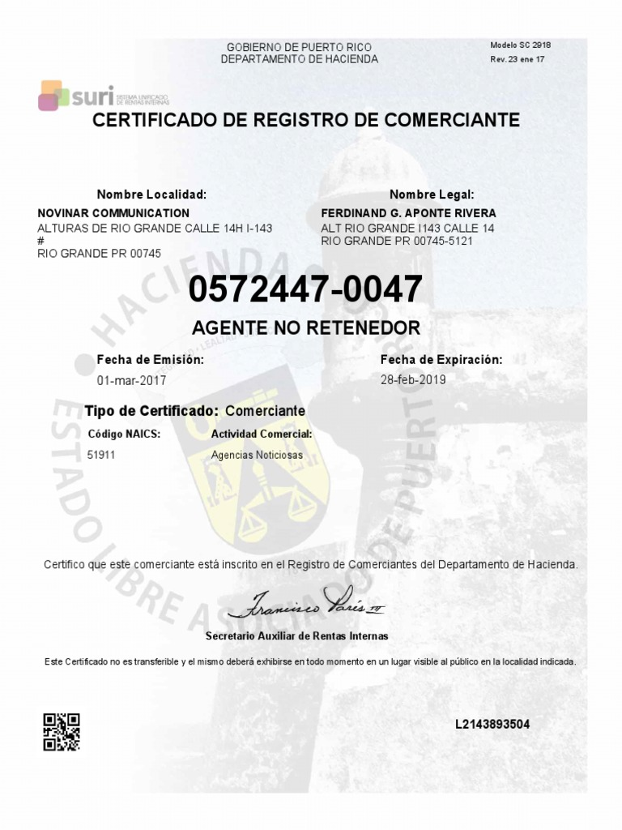
Hint

Slide 12
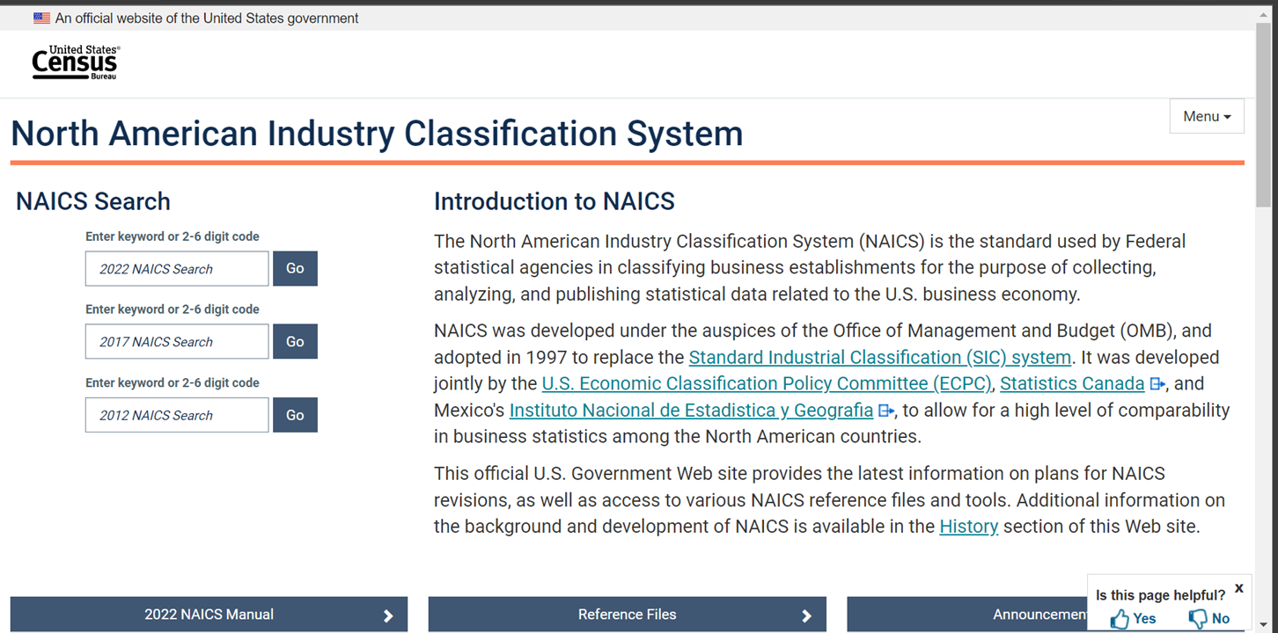
North American Industry Classification System (NAICS) (1)

Slide 13
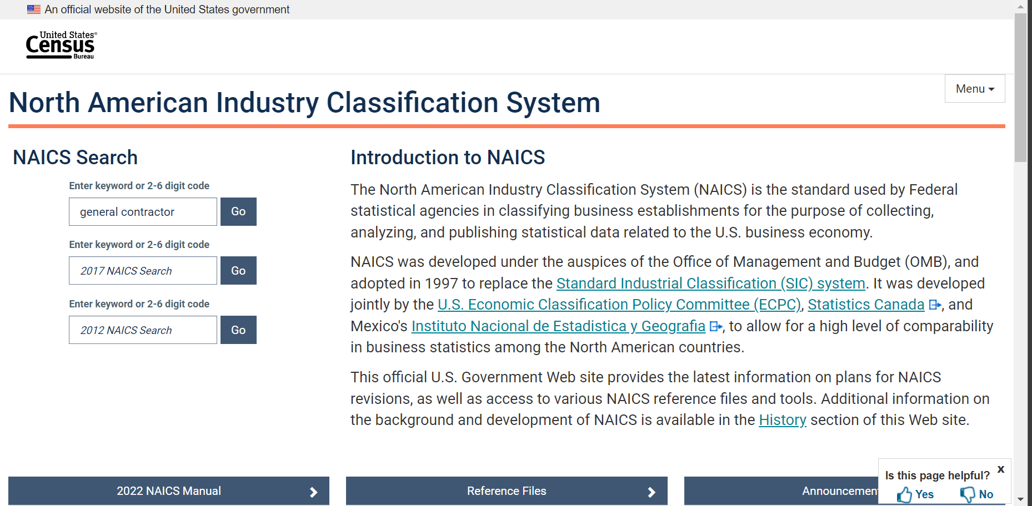
North American Industry Classification System (NAICS) )2)

Slide 14
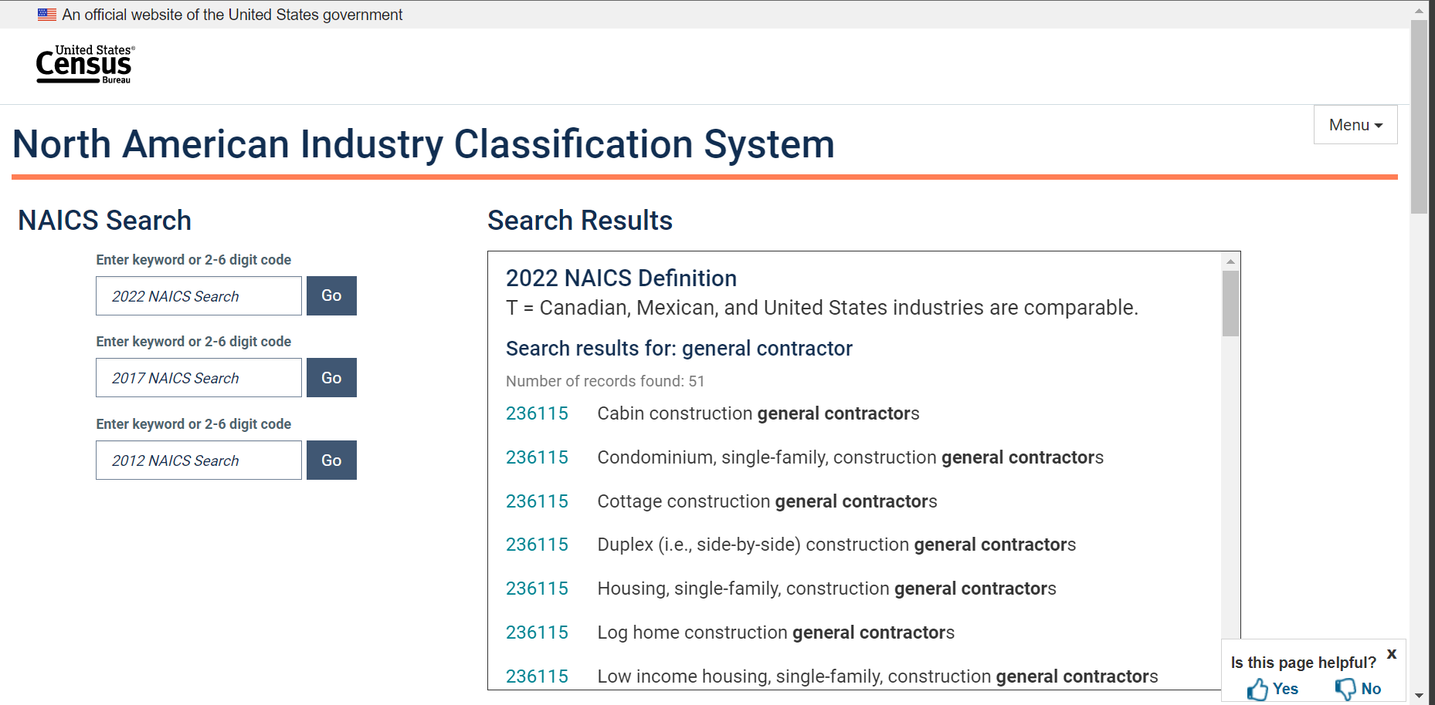
North American Industry Classification System (NAICS) (3)

Slide 15
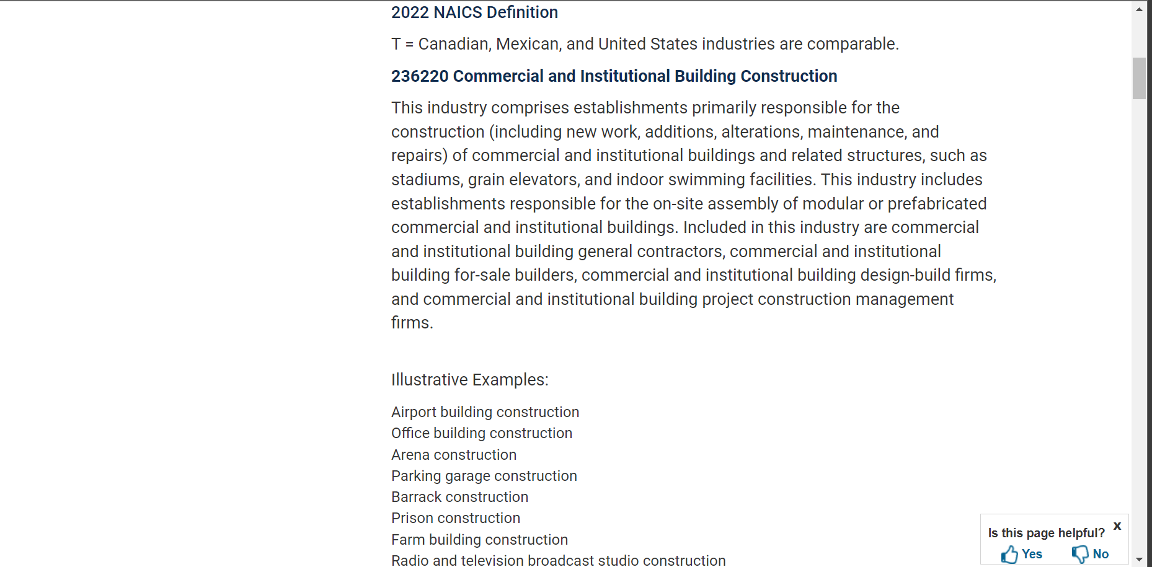
North American Industry Classification System (NAICS) (4)

Slide 16
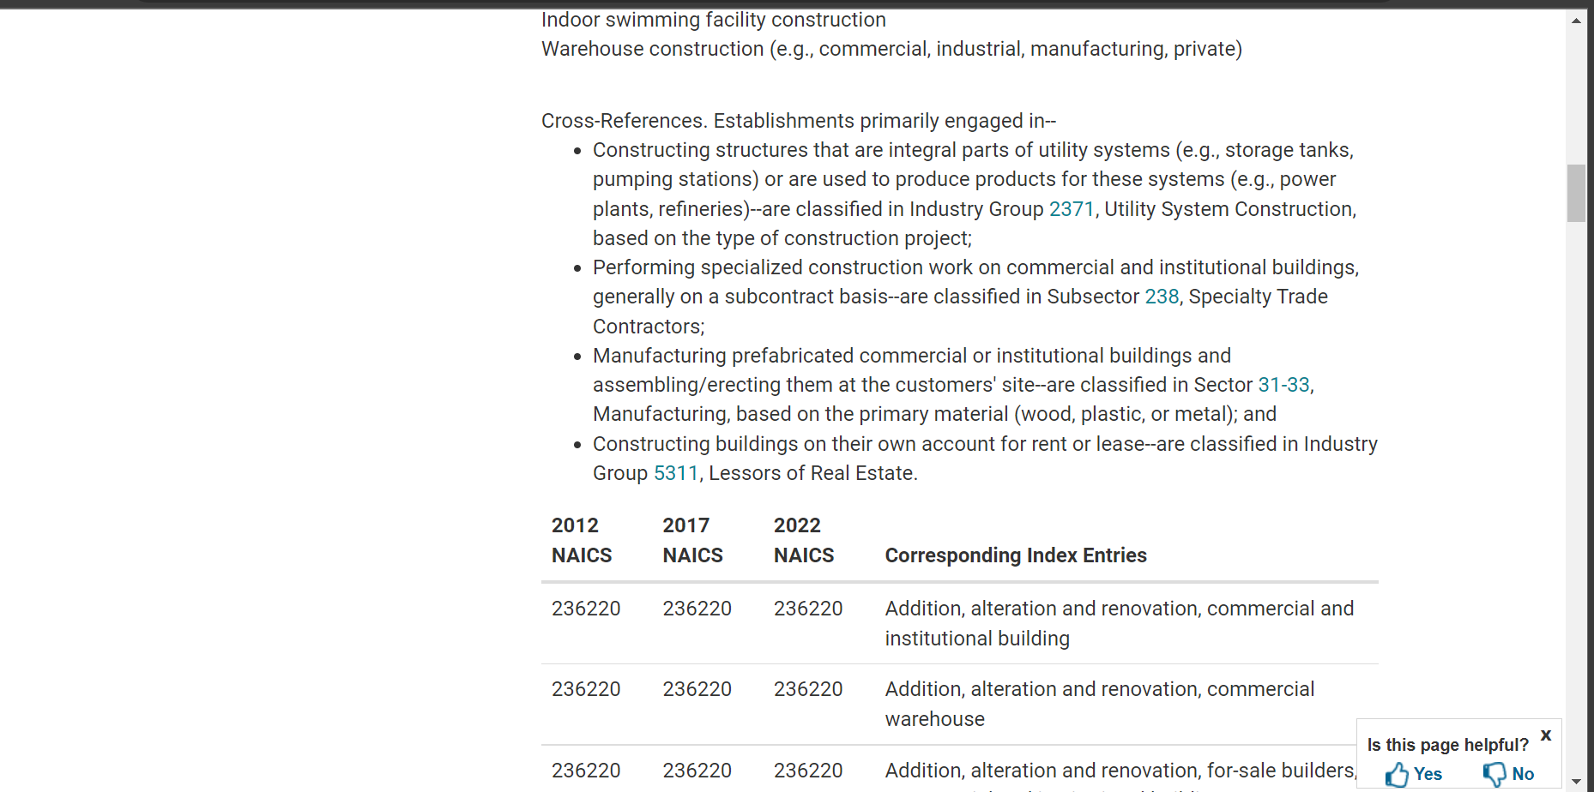
North American Industry Classification System (NAICS) (5)

Slide 17
How to Determine the correct NAICS code
How can I determine the correct NAICS code for my business?

Slide 18
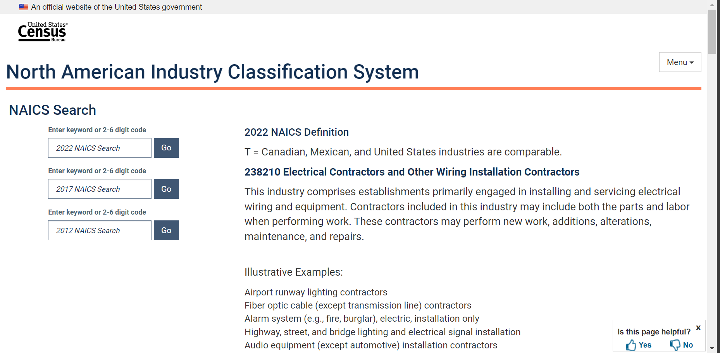
2022 NAICS Codes
2022 NAICS Codes

Slide 19
Small Business Size Standards
SBA establishes small business size standards on an industry-by-industry basis.
FAR 19.102 (a)(1)
www.sba.gov/document/support--table-size-standards

Slide 20
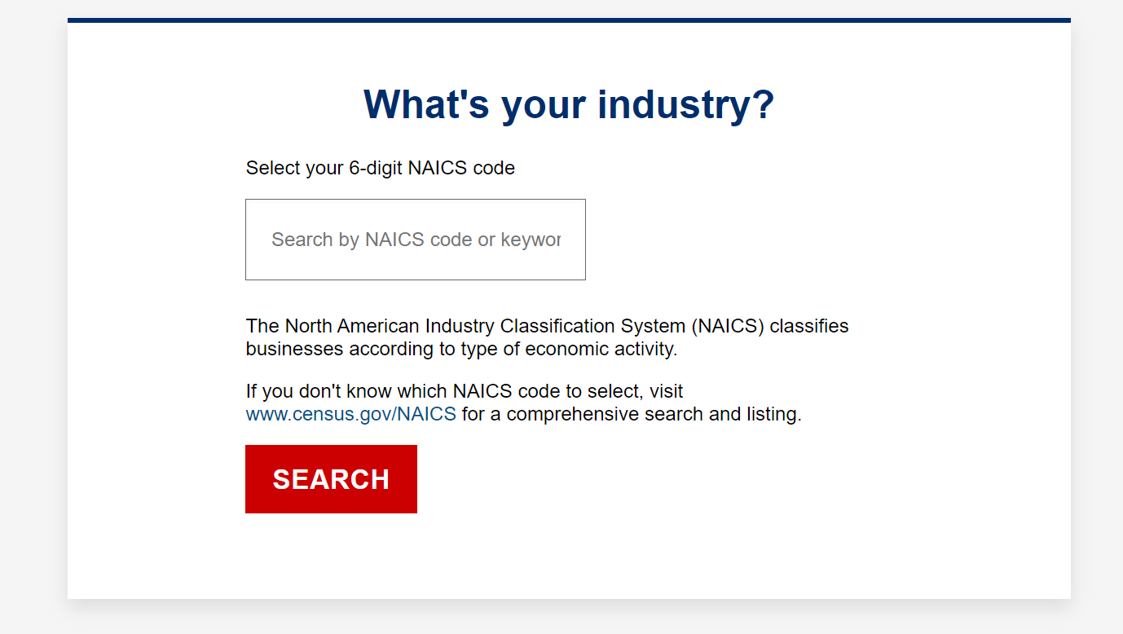
SBA Size Standards Tool
SBA Size Standards Tool
www.sba.gov/size-standards/

Slide 21
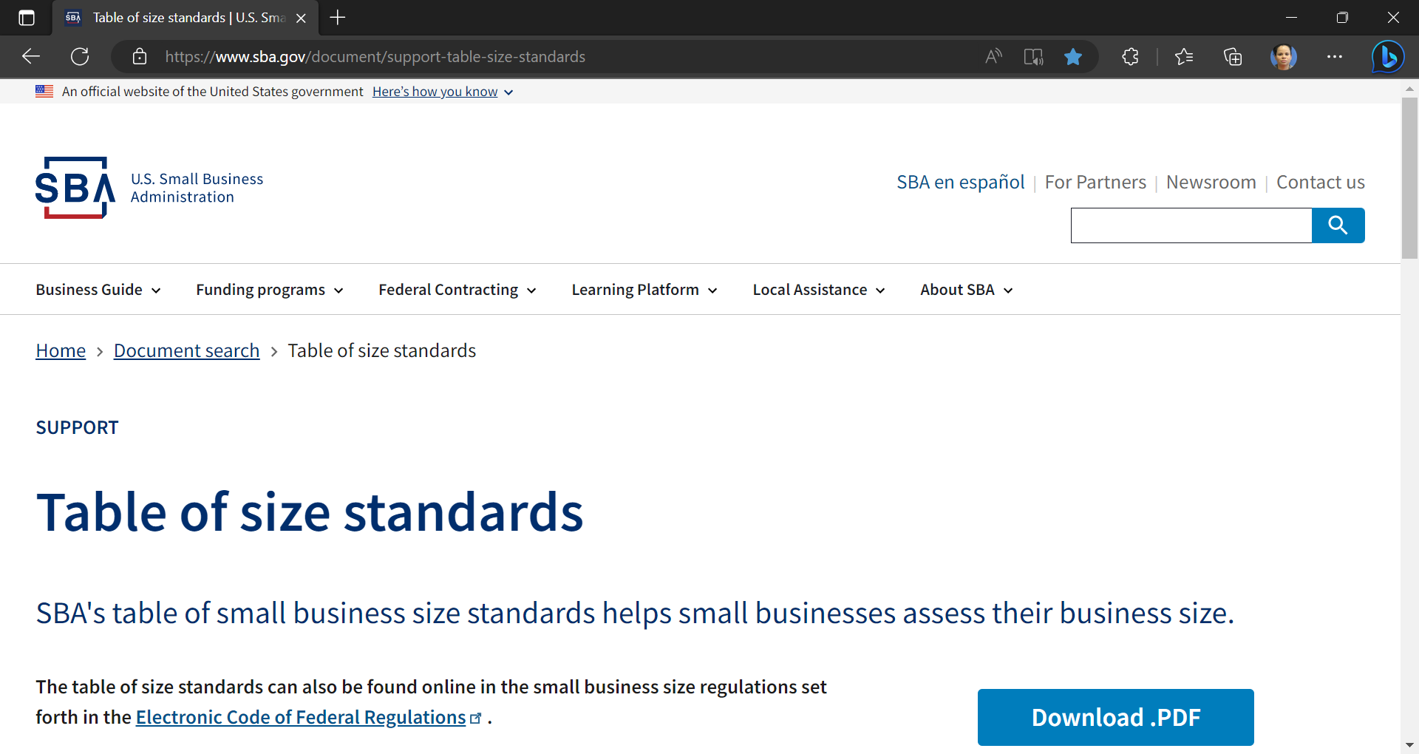
Small Business Size Standards (continued)

Slide 22
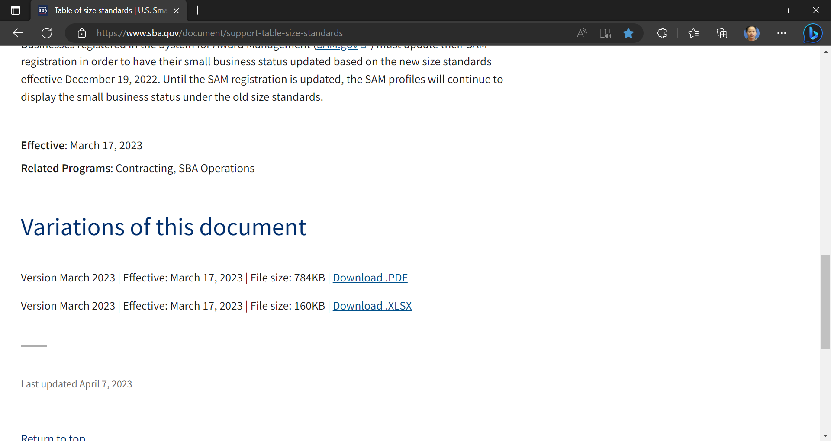
Small Business Size Standards (1)

Slide 23
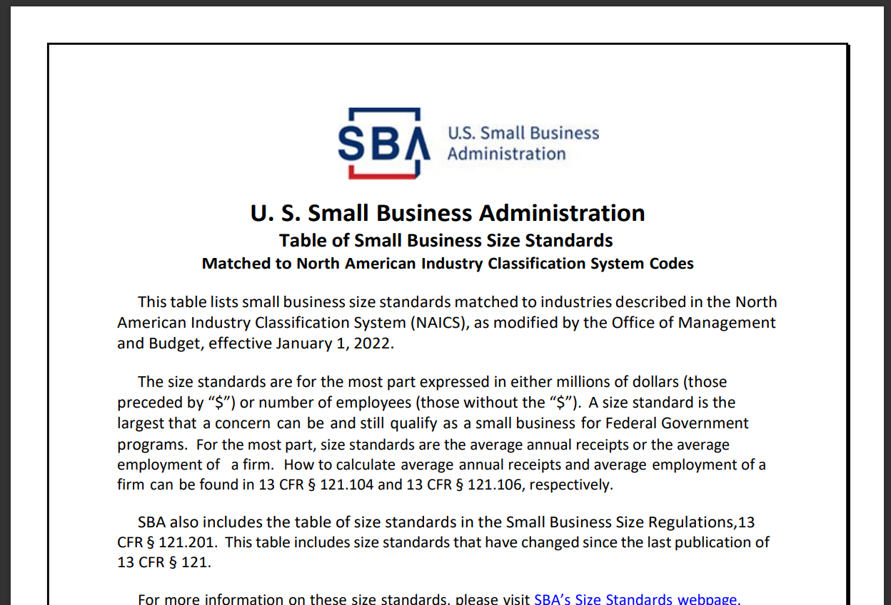
Small Business Size Standards (2)

Slide 24
Small Business Size Standards (3)
These size standards are effective
March 17, 2023
NAICS Codes | NAICS Industry Description | Size standards in millions of dollars | Size standards in number of employees
722310 | Food Service Contractors | $47.0
722320 | Caterers | $9.0
722330 | Mobile Food Services | $9.0
722410 | Drinking Places (Alcoholic Beverages) | $9.0
722511 | Full-Service Restaurants | $11.5
722513 | Limited-Service Restaurants | $13.5
722514 | Cafeterias, Grill Buffets, and Buffets | $34.0
722515 | Snack and Nonalcoholic Beverage Bars | $22.5
Sector 44 – 45 457210 441110 | Retail Trade Fuel Dealers New Car Dealers | $9.0 - $47.0 | 100 200
Sector 31 – 33 | Manufacturing |  | 500 - 1,500
Sector 42 | Wholesale Trade | $9.0 - $47.0 | 100 - 250

Slide 25
Small Business Size Standards (4)
These size standards are effective
March 17, 2023
NAICS Codes | NAICS Industry Description | Size standards in millions of dollars | Size standards in number of employees
238190 | Other Foundation, Structure, and Building Exterior Contractors | $19.0
238210 | Electrical Contractors and Other Wiring Installation Contractors | $19.0
238220 | Plumbing, Heating, and Air Conditioning Contractors | $19.0
238320 | Painting and Wall Covering Contractors | $19.0
236210 | Industrial Building | $45.0
236220 | Commercial and Institutional Building Construction | $45.0
Sector 54 541713 -541715 | Professional, Scientific and Technical Services | $9.0 - $47.0 1,000 – 1,500
561612 | Security Guards and Patrol Services | $29.0
561720 | Janitorial Services | $22.0
561730 | Landscaping Services | $9.5
Notes:
541310 Architectural Services $12.5
541320 Landscape Architectural Services $9.0
541330 Engineering Services $25.5

Slide 26
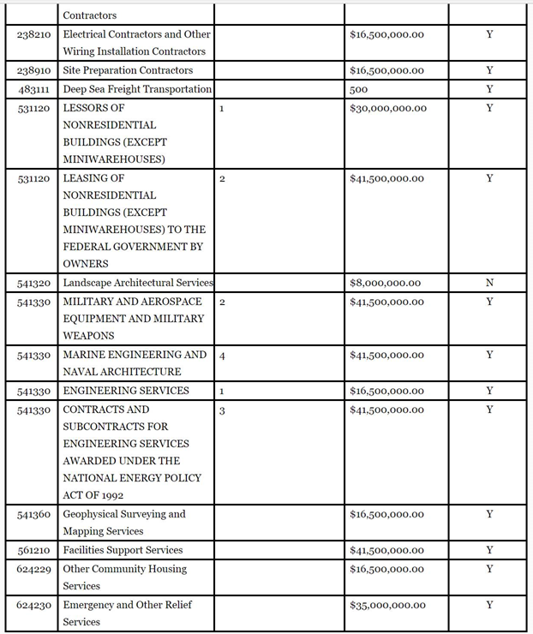
Small Business Size Standards (5)

Slide 27
Identify Your Product or Service
Government coding systems: Knowing the codes that apply to your business will help you identify the government buying offices that have a need for your product or service and register and search for bid opportunities.
NAICS:
The NAICS is the standard used by Federal statistical agencies in classifying business establishments for the purpose of collecting, analyzing, and publishing statistical data related to the U.S. business economy.
Product and Service Code Manual (PSC):
The PSC Group by the lettering system provides the product and service codes that will be used in the Federal Procurement Data System.
Go to www.acquisition.gov/PSC_Manual

Slide 28
Consider the value of the contract
Consider the value of the contract
A small business set-aside is based in part on the value and quantity of the goods or services the government wants to purchase.
Contract value | Small business set-aside requirement
$10,000 to $250,000 | Automatically and exclusively set aside for small businesses.
$250,000 or more | Set aside if there are two or more small businesses that could do the work. (You must first consider SDB, HUBZone, SDVO, and WOSB set-asides).
$750,000 or more (non-construction contracts) | If not set aside for small business, must have a subcontracting plan if awarded to an other than small business.
$1.5 million or more (construction contracts) | If not set aside for small business, must have a subcontracting plan if awarded to an other than small business.
Notes:
Limitations on subcontracting apply to solicitations and contracts for supplies, services and construction, if any portion of the requirement is set-aside for small business and the contract amount exceeds $250,000.
This limitation applies to service contracts, such that at least 50% of the contract cost for personnel must be expended for employees of the small business. For supply contracts, the business must perform work for at least 50% of the cost of manufacturing the supplies, not including the cost of materials.
And finally for general construction contracts, the business must perform at least 15% of the cost of the contract, not including the cost of the materials, with its own employees. For construction by special trade contractors, the business must perform at least 25% of the cost of the contract, not including the cost of the materials, with its own employees.

Slide 29
What is a Set-Aside?
What is a Set-Aside?
A set-aside is the reserving of an acquisition exclusively for participation by a category of small business concerns.
Helps ensure a level playing field so SDB (8(a)), HUBZone, SDVOSB, WOSB/EDWOSB, and small business concerns can compete for Contracting Opportunities.
To award certain acquisitions exclusively to small business concerns.
Notes:
A "set- aside" is a restricted Federal contract for which only small business may submit offers.
The requirements are spelled out in FAR 9.104. A contractor must have: 1) Adequate financial resources to perform the contract, 2) Be able to comply with the required proposed delivery or performance schedule, 3) Have a satisfactory performance record, 4) Have a satisfactory record of integrity and business ethics, 5) Have the necessary organization, experience, accounting, and operational controls, and technical skills or the ability to obtain them, 6) Have the necessary production, construction, and technical equipment and facilities, or the ability to obtain them, 7) Be otherwise qualified and eligible to receive award under applicable laws and regulations.

Slide 30
Other rules affecting set-asides and sole-source awards
Rule of Two
For acquisitions over $250K – are also to be set-aside for small business, when there is a reasonable expectation that offers will be obtained from at least two responsible small business concerns, and the award can be made at a fair market price.
It is important to note, consideration is first for a set-aside or sole source award under the 8(a), HUBZone, SDVOSB or WOSB programs before a general small business set-aside. However, there is no order of precedence among 8(a), HUBZone, SDVOSB or WOSB programs.
FAR 19.502-2
Notes:
For acquisitions over $150K – they too are to be set-aside for small business, when there is a reasonable expectation that offers will be obtained from at least two responsible small business concerns, and the award can be made at a fair market price.
It is important to note, consideration is first for a set-aside or sole source award under the 8(a), HUBZone, Service Disabled Veteran Owned Small Business or Woman Owned Small Business programs before a general small business set-aside. However there is no order of precedence among 8(a), HUBZone, SDVOSB or WOSB programs.

Slide 31
Other rules affecting set-asides and sole-source awards (con’t)
Non-manufacturer rule
If a small business receives a set-aside award but doesn’t manufacture the products it sells to the government, it must supply the products of another small business that's manufactured in the United States. A contracting officer, can apply for an SBA waiver to the non-manufacturer rule if it’s not possible to use a small business’ product, or SBA can waive.
The non-manufacturer rule does not apply to small business set-aside contracts below $250,000, but it does apply to all set-aside contracts under the 8(a), HUBZone, SDVO, and WOSB programs.
The regulations that govern the non-manufacturer rule are outlined in 13 CFR 121.406.
www.sba.gov/document/support--non-manufacturer-rule-class-waiver-list
Notes:
For acquisitions over $150K – they too are to be set-aside for small business, when there is a reasonable expectation that offers will be obtained from at least two responsible small business concerns, and the award can be made at a fair market price.
For Federal government contracts, a concern that supplies a product it did not manufacture is termed a nonmanufacturer. To qualify for Federal government contracting, a nonmanufacturer must have 500 or fewer employees, be primarily in the wholesale or retail trade, and supply the product of a US small manufacturer, if the contract is set aside for a small business. This requirement is called the "nonmanufacturer rule." This rule does not apply to supply contracts of $25,000 or less that are processed under Simplified Acquisition Procedures. The requirement may also be waived through formal procedure by the Associate Administrator for Government Contracting if there is no small manufacturer in the Federal market for a class of products. The nonmanufacturer rule is more detailed in paragraph (b) of 13 CFR §121.406
It is important to note, consideration is first for a set-aside or sole source award under the 8(a), HUBZone, Service Disabled Veteran Owned Small Business or Woman Owned Small Business programs before a general small business set-aside. However there is no order of precedence among 8(a), HUBZone, SDVOSB or WOSB programs.

Slide 32
Set-aside subcontracting limitations
Limitations on subcontracting apply to solicitations and contracts for supplies, services and construction, if any portion of the requirement is set-aside for small business and the contract amount exceeds $250,000.
This limitation applies to service contracts, such that at least 50% of the contract cost for personnel must be expended for employees of the small business. For supply contracts, the business must perform work for at least 50% of the cost of manufacturing the supplies, not including the cost of materials.
And finally for general construction contracts, the business must perform at least 15% of the cost of the contract, not including the cost of the materials, with its own employees. For construction by special trade contractors, the business must perform at least 25% of the cost of the contract, not including the cost of the materials, with its own employees.
FAR 19.505(a)
Notes:
Limitations on subcontracting apply to solicitations and contracts for supplies, services and construction, if any portion of the requirement is set-aside for small business and the contract amount exceeds $150,000.
This limitation applies to service contracts, such that at least 50% of the contract cost for personnel must be expended for employees of the small business. For supply contracts, the business must perform work for at least 50% of the cost of manufacturing the supplies, not including the cost of materials.
And finally for general construction contracts, the business must perform at least 15% of the cost of the contract, not including the cost of the materials, with its own employees. For construction by special trade contractors, the business must perform at least 25% of the cost of the contract, not including the cost of the materials, with its own employees.

Slide 33
Certificate of Competency Program
If an apparent successful offeror is determined to be “non-responsible” by the contracting officer, the contracting officer is required to refer the matter to the SBA for a Certificate of Competency or COC review. Based on the review, the SBA may issue a certificate of competency declaring the “referred company” – as sufficiently responsible for the purposes of receiving and performing the specific contract.
FAR 19.6
Notes:
The COC program is helpful to many small firms.
If an apparent successful offeror is determined to be “non-responsible” by the contracting officer, the contracting officer is required to refer the matter to the SBA for a Certificate of Competency or COC review. Based on the review, the SBA may issue a certificate of competency declaring the “referred company” – as sufficiently responsible for the purposes of receiving and performing the specific contract.

Slide 34
Know the Federal Contracting System
Know the Federal Contract Certifications
Self-Certification:
Small Business (SB)
Small Disadvantaged Business (SDB)
SBA’s Formal Certification Programs:
Service-Disabled Veteran-Owned Small Business (SDVOSB)
Women-Owned Small Business (WOSB) /Economically Disadvantaged Women-Owned Small Business (EDWOSB)
Historically Underutilized Business Zone (HUBZone)
8(a) Business Development Program (8(a))

Slide 35
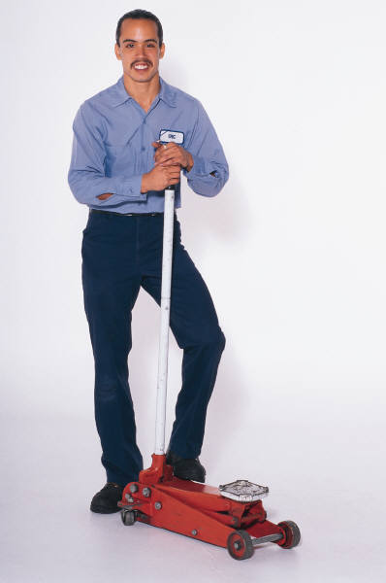
Small Business
Small Business
Small Business
Number of employees over the past year (Manufacture or Wholesalers).*
Average annual receipts over the past 5 years. *
*Size standards vary by industry.

Slide 36
Small Disadvantaged Business (SDB)
1. Social Disadvantage
Native American / Hispanic / African-American / Asia-Pacific-American
2. Economic Disadvantage
Personal net worth (assets minus liabilities) is less than $850,000 excluding*:
Primary personal residence
Ownership in business
Income reinvested or used to pay taxes of business
Funds reinvested in IRA or other retirement account**
Transferred assets within two years if to or on behalf of immediate family member for select purposes***
Adjusted gross income average over three years is $400,000 or less excluding:
Income reinvested or used to pay taxes of business
Fair Market Value of all assets NTE $6.5M
* SBA Form 413 Personal Financial Statement
* *Must be IRA or other official retirement account that is unavailable until retirement age without significant penalty
** *Select purposes are for that individual’s education, medical expenses or other essential support or to family member in recognition of special event
Notes:
Assets cannot exceed $6.5 million
Personal income cannot exceed $400,000, averaged over 3 years
Adjusted net worth must be less than $850,000

Slide 37
Service-Disabled Veteran-Owned Small Business Program (SDVOSB)
Qualify for set-aside opportunities
Build capacity and grow
Establish joint ventures
Notes:
Presenter Tip: Provide general information on the certification level and the qualification requirements.
This program establishes the criteria to be used in federal contracting to determine Service-disabled veteran status, business ownership, control requirements guidelines for establishing sole source and set-aside procurement opportunities and protest appeal procedures for SDVOSB procurements.
In order to be eligible for the Service-Disabled Veteran-Owned Small Business Concern Program (SDVOSB), a business must be at least 51% owned and controlled by one or more service-disabled veterans (SDVs).
An SDV is a veteran with a service-connected disability that has been determined by the Department of Veteran Affairs or the Department of Defense and receives a letter issued by the DOD.
SDVOSB must be small under the NAISC code assigned to the procurement.
The 51% ownership must be at least 51% unconditionally and directly owned by one or more service disabled veterans.

Slide 38
What is a SDVOSB?
FAR Part 2 Definitions
Service-disabled veteran means a veteran, with a disability that is service-connected
Not less than 51% owned by one or more service-disabled veterans
The management and daily business operations of which are controlled by one or more service-disabled veterans or, in the case of a service-disabled veteran with permanent and severe disability, the spouse or permanent caregiver of such veteran.

Slide 39
SDVOSB Sole Source
Only 1 Source
Up to $7M (mfg)
Up to $4M (non-mfg)
Cannot consider if currently 8(a) requirement

Slide 40
What is a Veteran Owned Small Business (VOSB)?
FAR Part 2 Definitions
Not less than 51% owned by one or more veterans
The management and daily business operations of which are controlled by one or more veterans

Slide 41
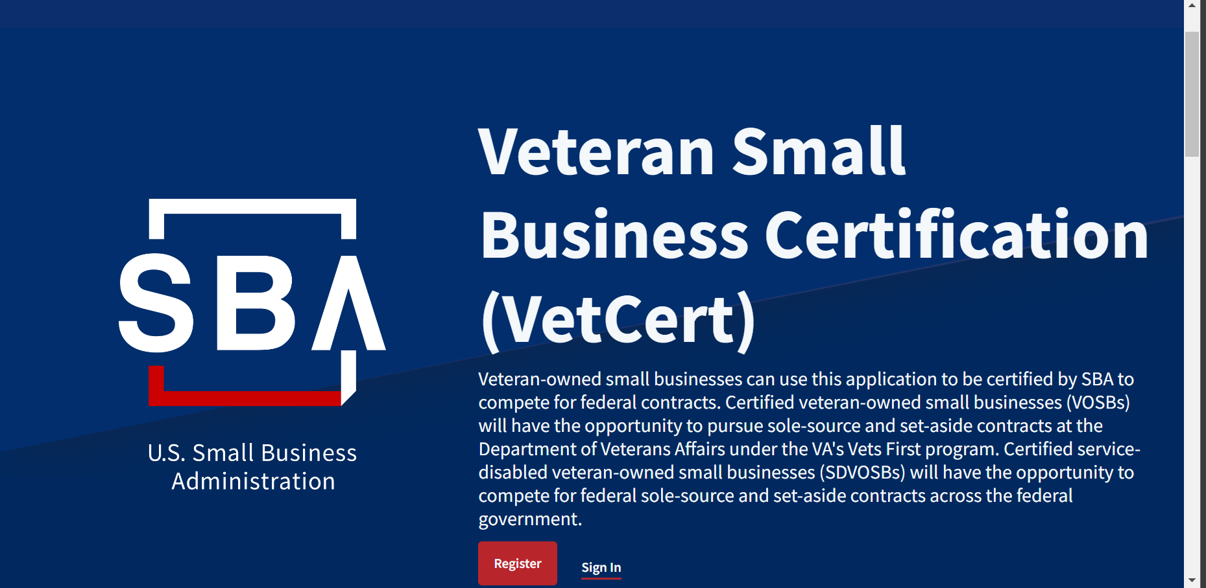
Veteran Small Business Certification (VetCert)
https://veterans.certify.sba.gov/

Slide 42
Women-Owned Small Business (WOSB) Program
Take advantage of annual prime contracting goals
Build capacity and grow
Access set-asides for WOSB and EDWOSB
Notes:
The WOSB Program allows contracting officers to set-aside contracts for WOSBs that also includes economically disadvantaged women-owned small businesses (EDWOSB).
The Federal government has specified annual prime contracting goals for designated small businesses. The prime contracting goal for WOSBs is 5%. Agencies can meet the 5% goal through contract awards made under the WOSB Program.
A WOSB or an EDWOSB is eligible for contract awards under other socio-economic programs for small business. The awards made under other programs will also be counted toward the 5% goal established for WOSBs.
As of December 2015, contracting officers have authority to make sole source awards to WOSBs including EDWOSBs. Sole source contracts are subject to thresholds - $6.5 million for manufacturing and $4 million for services.
WOSB Program is a self-certification program with an option for businesses to obtain certifications from SBA-approved third-party certifiers. Businesses are allowed to continue to self-certify until the SBA implements the NDAA of 2015 which it will do so in 2018 with an estimated launch in 2020 (earliest).

Slide 43
Is the WOSB Certification Appropriate for You?
51 % ownership requirements
No minimum time in business
Highest officer position
Manage daily operations
Proper NAICS codes
Managerial experience
Notes:
Presenter Tip: Depending on the audience, provide some information on when this may be an appropriate certification.
Must be a small business concern for the primary NAICS code or contract. WOSB/EDWOSB has limited NAICS codes.
At least 51% owned and controlled by one or more women who are U.S. Citizens. The 51% ownership must be direct and unconditional.
Women must manage daily business operations including:
A woman must hold the highest officer position within the business
The woman must work at the business full-time during normal working hours
The woman must have managerial experience required to run the business
Women must make long-term decisions for the business
No minimum amount of time for business to be operational

Slide 44
What is a WOSB?
FAR Part 2 Definitions
At least 51% owned by one or more women
Management & daily business operations
Make long-term decisions
Assigned specific NAICS in which women are underrepresented

Slide 45
What is an EDWOSB?
Same as WOSB
Subcategory of WOSB
Assigned specific NAICS in which women are underrepresented
Total assets must be valued at $6.5M or less
Personal Net Worth - $850,000
Personal Income must be $400,000 or less

Slide 46
WOSB and EDWOSB
WOSB: Women-Owned Small Business
EDWOSB: Economically Disadvantaged Women-Owned Small Business; WOSBs whose owner and/or manager claims economic disadvantage
EDWOSB is a subset of WOSB. As such, if you qualify as an EDWOSB, you automatically qualify as a WOSB.
The industry specific NAICS codes for WOSB and EDWOSB are listed here: https://www.sba.gov/document/support--qualifying-naics-women-owned-small-business-federal-contracting-program
WOSB
EDWOSB

Slide 47
Unique Aspects of the WOSB Federal Contracting Program
(759)
Of the 759 eligible industries, 646 are designated for limited competition among all WOSB Program participants, and 113 are eligible for competition among only SBA-certified EDWOSBs.
Notes:
Direct NAICS link here: https://www.sba.gov/federal-contracting/contracting-assistance-programs/women-owned-small-business-federal-contracting-program

Slide 48
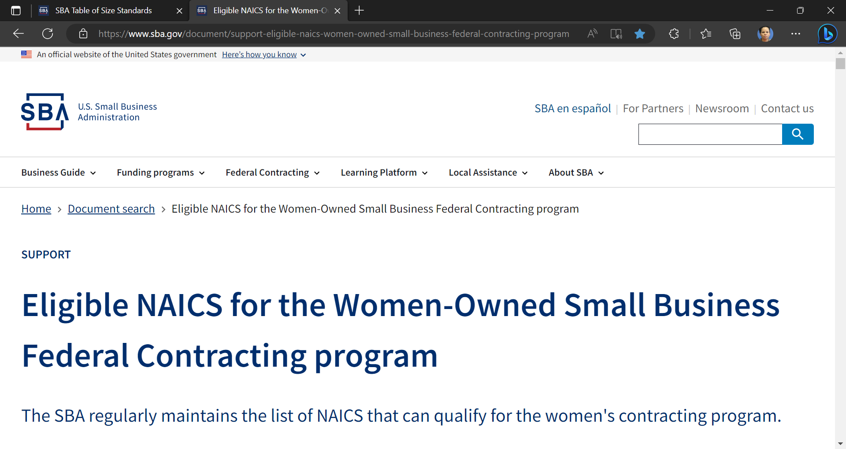
WOSB & EDWOSB NAICS

Slide 49
WOSB/EDWOSB (can be set-aside or sole source)
Set –aside; the CO have a reasonable expectation that at least two responsible WOSBs/EDWOSBs will submit offers
Sole Source WOSB/EDWOSB cannot exceed $7M for manufacturing NAICS codes or $4.5M for all other NAICS codes, and
The CO does not have a reasonable expectation that at least two responsible WOSBs/EDWOSBs will submit offers
Before solicitation
Confirm correct NAICS code for WOSB or EDWOSB
www.sba.gov/document/support--qualifying-naics-women-owned-small-business-federal-contracting-programBefore Award
Confirm that required WOSB or EDWOSB documents have been uploaded to the repository

Slide 50
Historically Underutilized Business Zone (HUBZone) Certification
Stimulate capital investment
Build capacity and grow
Access HUBZone set-aside contract dollars
Notes:
Presenter Tip: Based on the audience determine the level of detail needed from this slide. Skim over details that may not be applicable to the audience.
The purpose of the HUBZone (Historically Underutilized Business Zone) is to:
Provide federal contracting assistance to qualified small firms located in HUBZone areas
Stimulate capital investment
Empower communities through economic leveraging
HUBZone areas or designations are typically areas of low to median household incomes, high unemployment or both. They provide employment opportunities for the underserved.
The Federal government has specified annual prime contracting goals for designated small businesses. For the HUBZone program it is 3%.
The SBA does not have the authority to decide without supporting data that a particular area should or should not be a designated HUBZone.
All areas that were listed as "Re-designated" on 12/12/17 now have their re-designation period extended to December 2021 as a result of the National Defense Authorization Act for FY 2018.
Existing HUBZone areas including Qualified Census Tracts, Qualified Non-Metropolitan Counties, and Re-designated Areas will maintain their designations until December 2021.
Please check www.sba.gov/content/hubzone-maps for the latest updates on qualified areas.
You’ll need to re-certify for the HUBZone program every three years.
There is no limit to the length of time a business can continue to re-certify as long as it continues to qualify.
There are 6 kinds of HUBZones:
Qualified non-metropolitan county - Can become re-designated when HUBZone eligibility ceases. Re-designation lasts 3 years. These maps were frozen on December 12, 2017 and will maintain their designations until December 31, 2021.
Qualified Census Tract - Can become re-designated when ceases HUBZone eligibility. Re-designation lasts for 3 years. These maps were frozen on December 12, 2017 and will maintain their designations until December 31, 2021.
Indian land.
Qualified base closure area.
Qualified disaster area.
Predesignated area.
Must establish business in area identified as a HUBZone.
Must ensure that at least 35% of its employees reside in the HUBZone.
Must be eligible at the time of bid and award.
Maintaining compliance is very difficult-Be Careful!
At any given time, there are about 5,000 firms certified in the HUBZone program.
Mechanisms:
HUBZone set-aside contracts - most commonly used, accounts for approximately 91% of contract dollars.
Full and open competition contracts, when the HUBZone business price offer is not more than 10% higher than the offer (applies only to the large businesses, and not to small businesses) - accounts for approximately 7% of contract dollars.
HUBZone sole source contracts (awarded without competition) - accounts for approximately 2% of contract dollars.

Slide 51
What is HUBZone?
Historically Underutilized Business Zone
Program is designed to help small firms in certain communities gain access to federal contract opportunities
HUBZone areas: typically, areas of low median household incomes or high unemployment, or both
www.sba.gov/federal-contracting/contracting-assistance-programs/hubzone-program
FAR 19.13
Notes:
The HUBZone program is designed to help small businesses -- in certain urban, rural, BRAC, Indian reservation, and difficult development areas outside the U.S. mainland – to gain access to federal procurement opportunities. HUBZone areas are typically areas of low median household incomes or high unemployment, or both.
At any given time, there are some 5,000 small firms certified in the HUBZone program.

Slide 52
Key Program Benefits
The government has a mandate of awarding 3% of all prime contract dollars to HUBZone firms.
Two mechanisms:
Contract set-asides and sole source
10% Price Evaluation Preference (PEP) applied to full and open competition (PEP - only applies to the large business and not to the small business concern)
www.sba.gov/hubzone
Notes:
The program offers significant benefits to certified HUBZone firms. These benefits include:
set asides – that is contracting officers can reserve or set-aside specific contracts for qualified HUBZone firms;
Government-wide contracting goals have also been established requiring that at least 3% of all federal prime contracting dollars and 3% of all federal subcontracting dollars flow to certified and qualified HUBZone firms;
In addition, a price evaluation preference of 10% can be applied to certified HUBZone firms in full and open contract competitions.
§ 126.613 How does a price evaluation preference affect the bid of a qualified HUBZone SBC in full and open competition?
(a)(1) Where a CO will award a contract on the basis of full and open competition, the CO must deem the price offered by a qualified HUBZone SBC to be lower than the price offered by another offeror (other than another SBC) if the price offered by the qualified HUBZone SBC is not more than 10% higher than the price offered by the otherwise lowest, responsive, and responsible offeror. For a best value procurement, the CO must apply the 10% preference to the otherwise successful offer of a large business and then determine which offeror represents the best value to the Government, in accordance with the terms of the solicitation.
(2) Where, after considering the price evaluation adjustment, the price offered by a qualified HUBZone SBC is equal to the price offered by a large business (or, in a best value procurement, the total evaluation points received by a qualified HUBZone SBC is equal to the total evaluation points received by a large business), award shall be made to the qualified HUBZone SBC.
Example 1: In a full and open competition, a qualified HUBZone SBC submits an offer of $98, a non-HUBZone SBC submits an offer of $95, and a large business submits an offer of $93. The lowest, responsive, responsible offeror would be the large business. However, the CO must apply the HUBZone price evaluation preference. In this example, the qualified HUBZone SBC's offer is not more than 10% higher than the large business' offer and, consequently, the qualified HUBZone SBC displaces the large business as the lowest, responsive, and responsible offeror.
Example 2: In a full and open competition, a qualified HUBZone SBC submits an offer of $103, a non-HUBZone SBC submits an offer of $100, and a large business submits an offer of $93. The lowest, responsive, responsible offeror would be from the large business. The CO must then apply the HUBZone price evaluation preference. In this example, the qualified HUBZone SBC's offer is more than 10% higher than the large business' offer and, consequently, the qualified HUBZone SBC does not displace the large business as the lowest, responsive, and responsible offeror. In addition, the non-HUBZone SBC's offer at $100 does not displace the large business' offer because a price evaluation preference is not applied to change an offer and benefit a non-HUBZone SBC.
Example 3: In a full and open competition, a qualified HUBZone SBC submits an offer of $98 and a non-HUBZone SBC submits an offer of $93. The CO would not apply the price evaluation preference in this procurement because the lowest, responsive, responsible offeror is a SBC.

Slide 53
HUBZone Sole Source
Only 1 Source
Up to $7.5M (mfg)
Up to $4.5 M (all other)

Slide 54
HUBZone Qualifications
Historically Underutilized Business Zones, or HUBZones
Requirements:
Must be a small business by SBA size standards
Concern must be 51% owned and controlled by US Citizens, Community Development Corporation or Indian Tribes
The principal office must be located in a HUBZone (high-unemployment, low-income areas in economically distressed communities, referred to as, to promote job growth, capital investment and economic development in these areas, including Indian reservations.
At least 35% of the concerns employees must reside in any HUBZone
www.sba.gov/hubzone

Slide 55
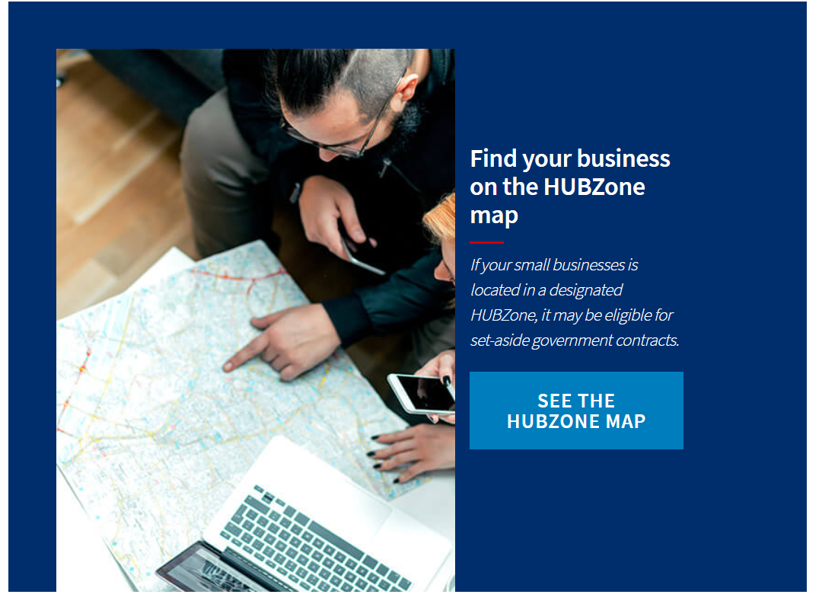
HUBZone map landing page
The HUBZone maps landing page
www.sba.gov/federal-contracting/contracting-assistance-programs/hubzone-program
Notes:
OK…. So how do you know if your firm or employees are located in a designated HUBZone area?
SBA has a HUBZone map where you can insert the address and zip code of a specific location (or its coordinates) to determine if that location is recognized as a designated HUBZone. HUBZones are determined by the government – using the most current census, unemployment and other data. This tool will help you determine if your business location and employees are located within a HUBZone area.
At you convenience, return to this slide or the resource section at the end of the course and use the hyperlink to access the HUBZone Map landing page. The landing page contains the most updated information about HUBZone areas that may not yet be represented in the maps, has the link to the HUBZone maps and a geocoding toolkit. The geocoding toolkit is perfect for finding the coordinates for addresses that the HUBZone map cannot find. Once you get the longitude and latitude, you can plug these in the HUBZone map by pressing “Coordinate Input” right next to the “Reset” button on the right of the address field.

Slide 56
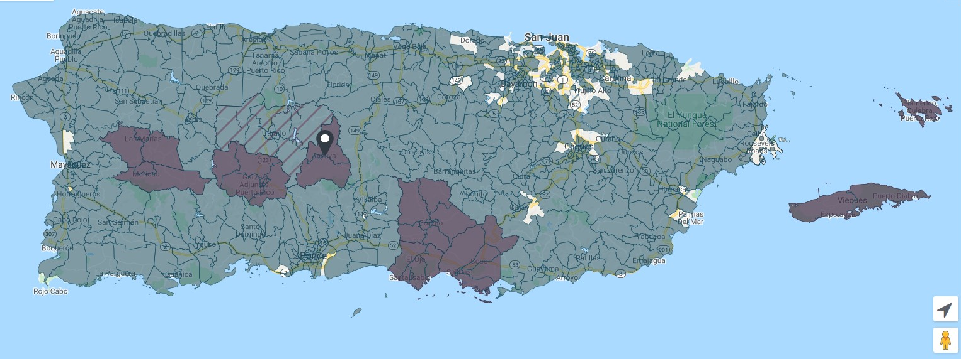
HuBZone en Puerto Rico
HUBZones en Puerto Rico
Always check https://maps.certify.sba.gov/hubzone/map for the latest updates on qualified areas!
Notes:
OK…. So how do you know if your firm or employees are located in a designated HUBZone area?
SBA has a HUBZone map where you can insert the address and zip code of a specific location (or its coordinates) to determine if that location is recognized as a designated HUBZone. HUBZones are determined by the government – using the most current census, unemployment and other data. This tool will help you determine if your business location and employees are located within a HUBZone area.
At you convenience, return to this slide or the resource section at the end of the course and use the hyperlink to access the HUBZone Map landing page. The landing page contains the most updated information about HUBZone areas that may not yet be represented in the maps, has the link to the HUBZone maps and a geocoding toolkit. The geocoding toolkit is perfect for finding the coordinates for addresses that the HUBZone map cannot find. Once you get the longitude and latitude, you can plug these in the HUBZone map by pressing “Coordinate Input” right next to the “Reset” button on the right of the address field.

Slide 57
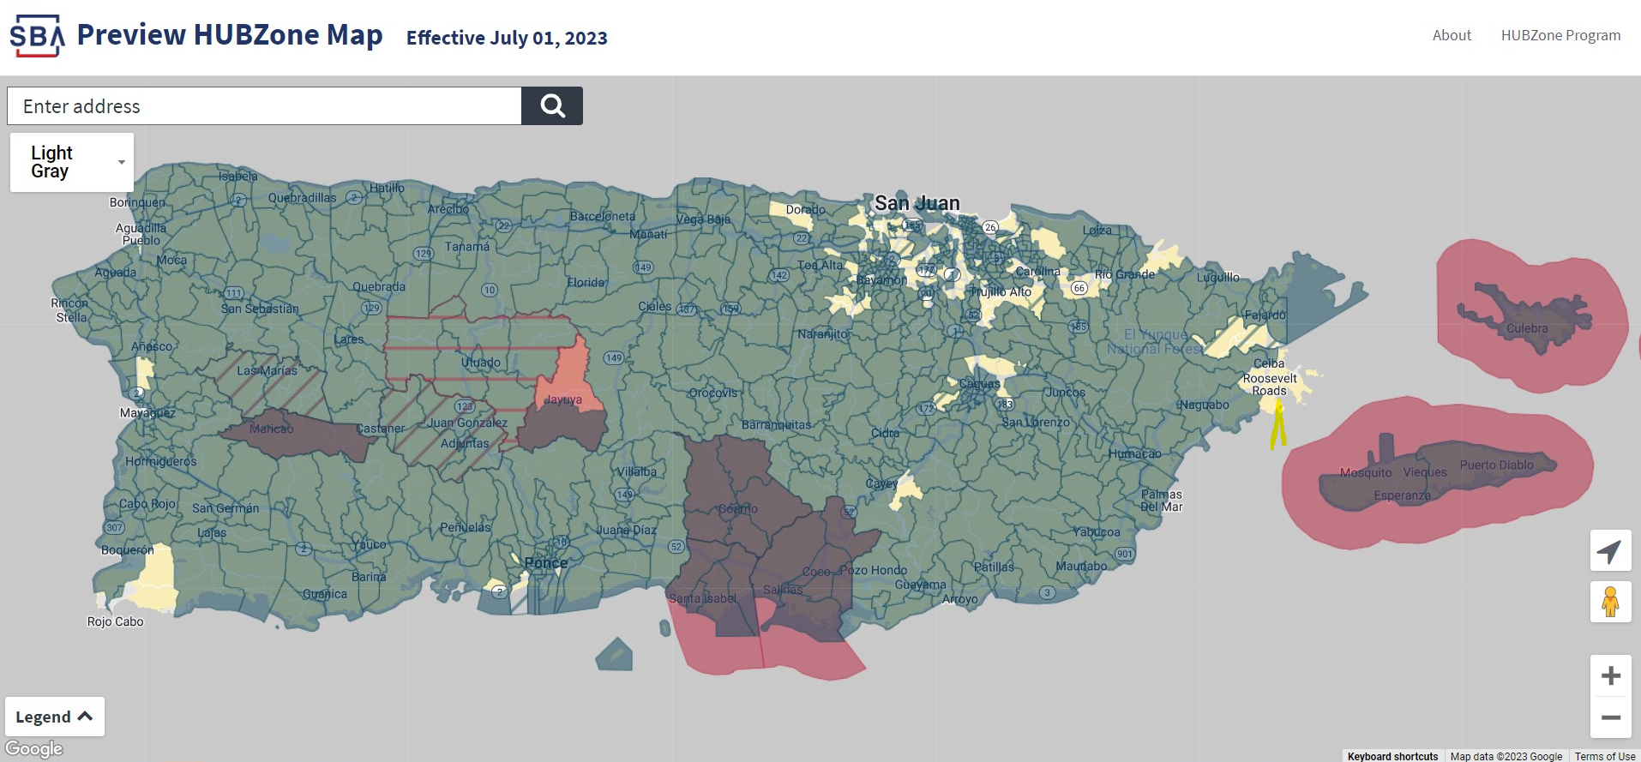
HUBZones in Puerto Rico
HUBZones en Puerto Rico
The HUBZone map is changing! Find out if your business will be in a designated HUBZone. Check the official preview of the new HUBZone map. https://preview-maps.certify.sba.gov/hubzone/map#center=18.474697,-66.299148&zoom=9
Notes:
OK…. So how do you know if your firm or employees are located in a designated HUBZone area?
SBA has a HUBZone map where you can insert the address and zip code of a specific location (or its coordinates) to determine if that location is recognized as a designated HUBZone. HUBZones are determined by the government – using the most current census, unemployment and other data. This tool will help you determine if your business location and employees are located within a HUBZone area.
At you convenience, return to this slide or the resource section at the end of the course and use the hyperlink to access the HUBZone Map landing page. The landing page contains the most updated information about HUBZone areas that may not yet be represented in the maps, has the link to the HUBZone maps and a geocoding toolkit. The geocoding toolkit is perfect for finding the coordinates for addresses that the HUBZone map cannot find. Once you get the longitude and latitude, you can plug these in the HUBZone map by pressing “Coordinate Input” right next to the “Reset” button on the right of the address field.

Slide 58
8(a) Business Development Program
Access to business development support
Build capacity and grow through contracts
Nine-year program available once per lifetime
Notes:
Designed to assist socially and economically disadvantaged owned small businesses compete in the federal marketplace.
A certified firm has the potential to receive sole source contracts (no competition) up to $4 million for goods and services, including construction, and $7 million for manufacturing requirements.
The Federal Government has specified annual prime contracting goals for designated small businesses. For Small Disadvantaged Business, (which includes the 8(a) program) it is 5%.
A certified firm has only one 9-year tenure in this program. The first 4 years are considered a development stage and the last 5 years are considered a transitional stage.
Continuation in the program is dependent upon the firm’s continuing eligibility as a socially and economically disadvantaged firm with day-to-day management control by the individual upon whom eligibility is based.
The program provides business development support such as technical and management assistance, financial assistance, subcontracts and prime contracts.

Slide 59
Benefits of the 8(a) Program
The program’s benefits for 8(a) certified companies include:
Contracting
Subcontracting
7(J) Trainings
Mentor-Protégé Program
Joint Venture Program
Nine-year Development Program
www.sba.gov/federal-contracting/8a

Slide 60
Eligibility for 8(a) Program
A small business 51% owned and controlled by US Citizen
Not already have participated in the 8(a) program
Have all its principals demonstrate good character
Show potential for success and be able to perform successfully on contracts (In business at least 2 years to demonstrate potential for success)
FAR 19.8
Notes:
The 8(a) Business Development Program is designed to assist eligible socially and economically
disadvantaged small businesses. The program provides qualified firms access to capital and credit,
business counseling and training, and Federal and non‐Federal procurement opportunities.
Through the award of sole source and limited‐competition contracts, the 8(a) program provides market
access and growth for qualified businesses. The 8(a) program is not intended for everyone. You must be
eligible to participate and receive formal certification from the SBA.
Use the hyperlinks, at a later time, to learn more about the 8(a) program and determine if you are
eligible and suited for the program.
Assets cannot exceed $4 million
Personal income cannot exceed $250,000, averaged over 3 years
Adjusted net worth must be less than $250,000

Slide 61
Eligibility for 8(a) Program (cont.)
Social Disadvantage
Native American / Hispanic / African-American / Asia-Pacific-American
Economic Disadvantage
Personal net worth (assets minus liabilities) is less than $850,000 excluding*:
Primary personal residence
Ownership in business
Income reinvested or used to pay taxes of business
Funds reinvested in IRA or other retirement account**
Transferred assets within two years if to or on behalf of immediate family member for select purposes***
Adjusted gross income average over three years is $400,000 or less excluding:
Income reinvested or used to pay taxes of business
Fair Market Value of all assets NTE $6.5M
* SBA Form 413 Personal Financial Statement
* *Must be IRA or other official retirement account that is unavailable until retirement age without significant penalty
** *Select purposes are for that individual’s education, medical expenses or other essential support or to family member in recognition of special event
Notes:
Assets cannot exceed $6.5 million
Personal income cannot exceed $400,000, averaged over 3 years
Adjusted net worth must be less than $850,000

Slide 62
8(a) Sole Source
Up to $7.5M (mfg)
Up to $4.5 M (all other)
Up to $25 M (require a justification for a sole-source)

Slide 63
I am a small business, now what?
By conducting market research, you can find out which Federal agencies are procuring what professional services or products.
How can you market your business to the Federal Government?
Does the Federal Government buy your service or product?
Identify federal buyers and get to know them
Market Research
Contract Awards
Who are your customers, find Government customers
Participate in the GC Classroom Part2 Training - Online Resources for Market Research
Notes:
Aside from some of the differences we have already talked about, selling to the government is not that
much different than selling in the private sector.
It all comes down to marketing. Learn what agencies or prime contractors have a need for and reach out
to them, demonstrating how you can add value and why they should buy from you.
In addition, be active. Participate in procurement related conferences, activities and match‐making
events. Use these activities to become known and to be a “player.”

Slide 64
Learn Federal Contracting Procedures
In order to win federal contracts, you will want/need to become familiar with federal regulations
Federal Acquisition Regulations (FAR)
www.acquisition.gov
Part 8.4 – Federal Supply Schedules
Part 12– Acquisition of Commercial Items
Part 13– Simplified Acquisition Procedures
Part 14 – Sealed Bidding
Part 15 – Contracting by Negotiation
Part 19 – Small Business Programs
Part 22 – Application of Labor Laws to Government Acquisitions
Defense Federal Acquisition Regulation Supplement (DFARS) DFARS | Acquisition.GOV
GSA’s Acquisition Regulations: General Services Acquisition Manual (GSAM) | Acquisition.GOV
Notes:
If you want to participate in the Federal procurement arena, you have to know the rules. Understanding the government’s procurement rules is critical to your success as a government contractor. The Federal Acquisition Regulation system is the roadmap for doing business with the government. It outlines all of the rules.
The FAR is issued and maintained jointly by a collaborative board of government agencies and Federal procurement executives. It is a comprehensive guide indexed by topic. Do not be intimidated by its size or apparent complexity. It is an excellent resource tool. The most common FAR sections used by small business are: Subpart 8.4 – Federal Supply Schedules Part 13 – Simplified Acquisitions Part 15 – Contracting by Negotiation Part 19 – Small Business Programs Check out the FAR after you complete this course. You can access it by clicking on the hyperlink. Remember, it’s a tool use it when you need it.

Slide 65
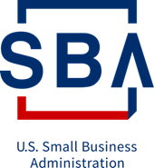
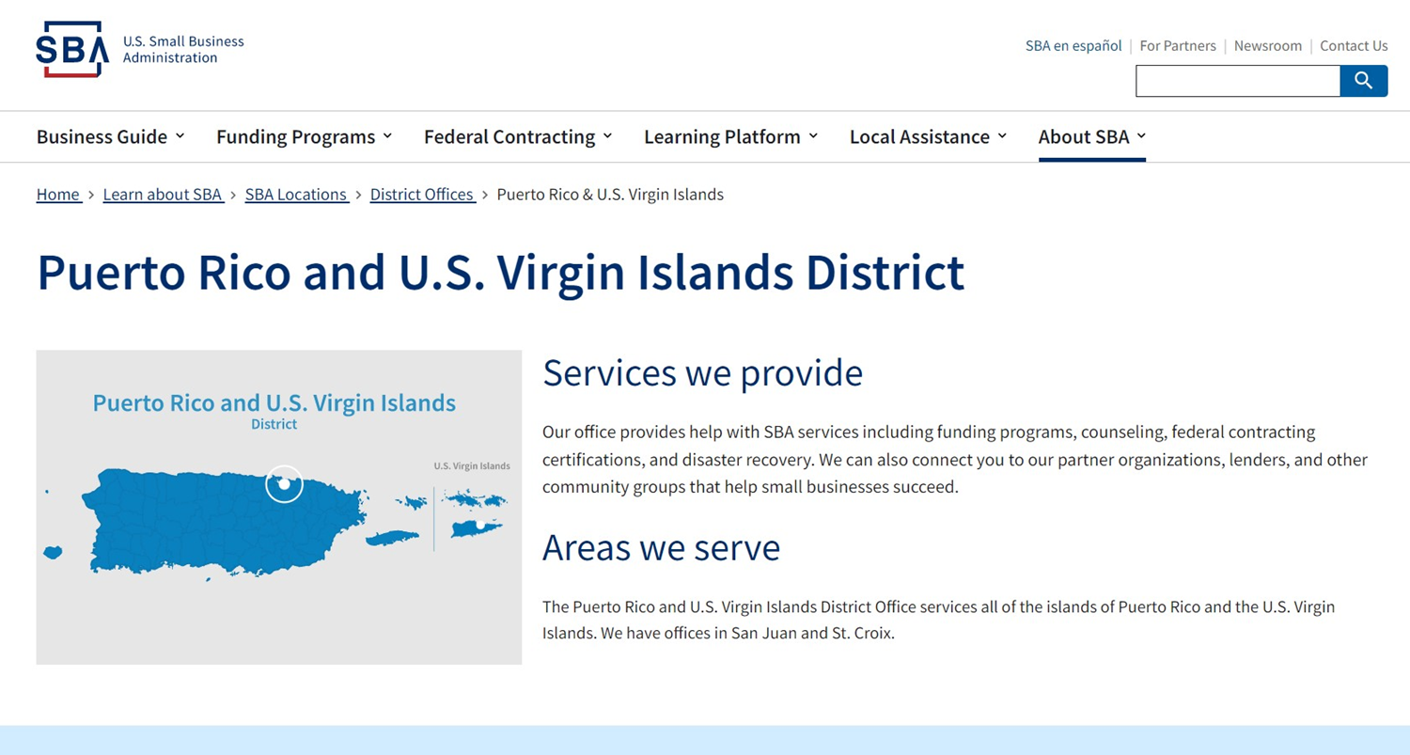
Your local SBA District Office Can Help
Your local SBA District Office Can Help
For News, events, and updates visit our website:
www.sba.gov/pr
Contact us at the District Office:
By Phone: (787) 766-5572
By Email: puertorico_DO@sba.gov
Follow us on X at: @SBA_PuertoRico
Notes:
The FREE SBA newsletters listed below offer a wide variety of information and business opportunities for small businesses. Subscribe to one or many and receive e-mail notification as soon as items are published. It's easy!

Slide 66
Get Help!
APEX Accelerator – Puerto Rico Federal Contracting Center (FeCC)- Provide assistance to business firms in marketing products and services to the Federal, state and local governments available at no cost.
(787) 758.4747 x.3181 www.federalcontractingpr.com
Puerto Rico MBDA Business Center - Provide technical assistance to minority firms, contract opportunity and capital access to create new Jobs. MBDA aids with the SBA certifications to do business with the federal government.
(787) 753-8484 https://puertoricombdacenter.com
Pathstone Enterprise Center - Provide assistance to business firms with the registrations and SBA certifications to participate in the federal market at no cost.
(787) 658-1640 https://theenterprisecenterinc.org
Puerto Rico Manufacturing Extension (PRIMEX)- Provide assistance to small and medium manufacturing business by providing cost effective assistance in new technologies and business practices.
(787) 756-0505 www.primexpr.org

Slide 67
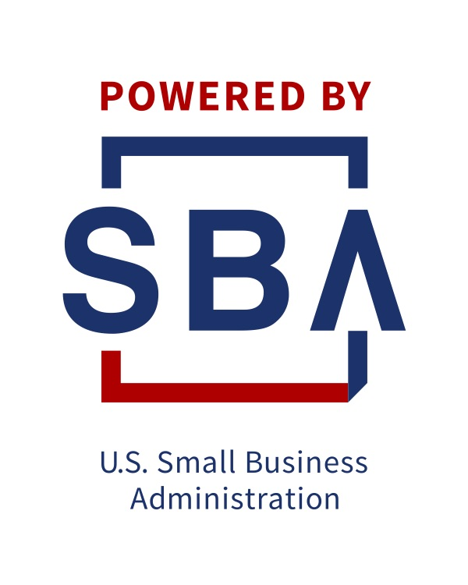
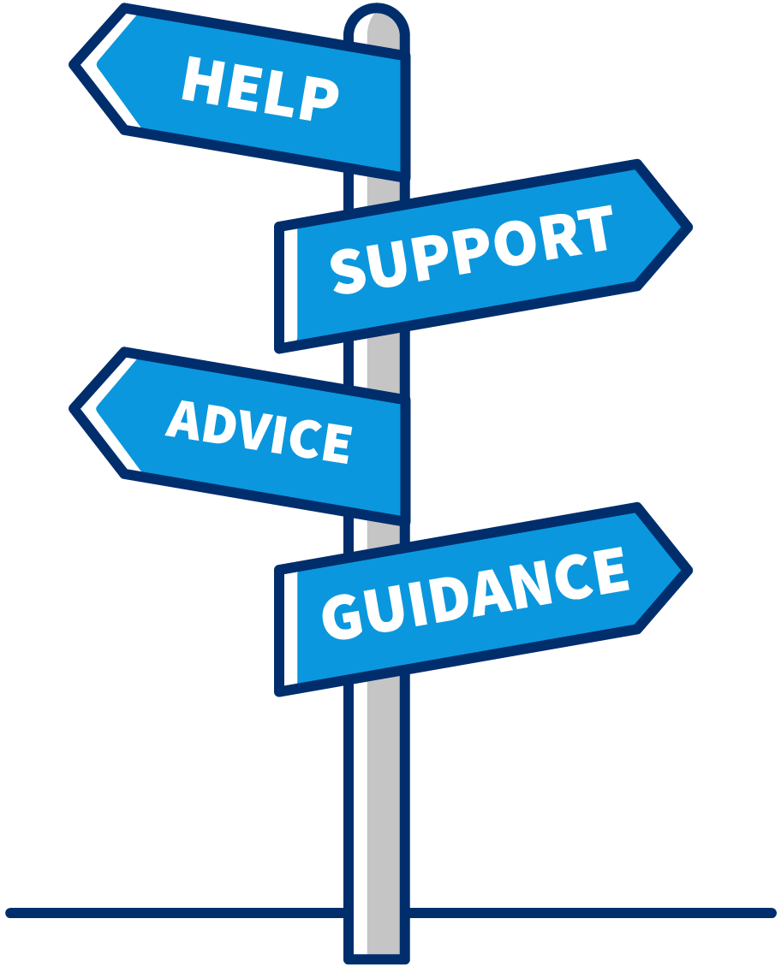
The SBA Resource Partner Network
Access the right tools at the right time—wherever you are.
Approved and funded by the SBA
1,400+ partner offices nationwide
Find local resource partners near you at
SBA.gov/local-assistance
Notes:
Talking Points:
When you need reliable advice to start or grow your business, the SBA can connect you with experts who understand the business climate at both a national level, as well as in your specific region or market.
The SBA’s Resource Partner Networks helps to extend our reach to serve the nation’s small business community outside of our District Offices.
Whether you need to create successful business plan, get expert advice on expanding your business, or train your team, the SBA makes sure you’re never far from the help you need.
In FY 2017, over 1.4 million small business owners received counseling or training from an SBA resource partner.
You can find resource partners closest to you using our local partners search page at SBA.gov/local-assistance.
Tips:
Provide a few examples of experts and resource partners in your community in your community.
Distribute or reference the associated Fact Sheet.

Slide 68
SBA presentation – ending slide
Jezabel Rodriguez - Procurement Center Representative
787-766-5016 | jezabel.rodriguez@sba.gov
Jorge Betancourt - Economic Development Specialist
787-766-5556 | jorge.betancourt@sba.gov

