Slide 1
Rural Development Mission Area United States Department of Agriculture
Human Resources Office

Slide 2
Rural Development – Rural America’s Partner in Prosperity
Rural Development (RD) is a catalyst for rural prosperity. Through loans, grants, and partnerships with local leaders, RD provides tools and resources that ensure rural families, businesses, and communities have what they need to prosper.
RD invests in infrastructure and high-speed internet
opening doors to better jobs, innovation and
healthcare.
RD partners with rural families, businesses, and utilities
to provide technical assistance and financial support.
Together, these programs help create jobs,
support economic development, and build
essential services like housing, community
facilities, and infrastructure.

Slide 3
RD Employee Value Proposition Statement – WIIFM??
How do you make change in the world? Join the team that’s investing in a strong future for the people of rural America.
A strong community is rooted in its people. USDA Rural Development invests in rural America with grants and relending programs so first responders can put people’s safety first, schools can teach kids, and hospitals can care for everyone. Our partnerships support infrastructure so the people of rural America get connected to new markets and jobs of the future. Together, with local leaders and partners, we promote growth and prosperity in communities.
Rural Development is an on the ground, place-based, community driven government agency – we are here to make tomorrow’s Rural America a better, stronger place to live, work and play.
Join us! RD offers employees good pay, training and development opportunities, coaching and mentoring programs, flexible schedules for work/life balance, and an employee assistance program.
We recognize our dedicated teams with career development opportunities and awards for their excellence and for the difference they make in local communities. Rural Development also offers a variety of benefits to include retirement, matching retirement savings and investment plans, health and life insurance, supplemental dental and vision insurance, flexible spending accounts, accrued leave programs, paid family leave, and Federal holidays.
When you’re a part of USDA Rural Development, you’re a part of an organization that puts rural people and rural communities first.

Slide 4
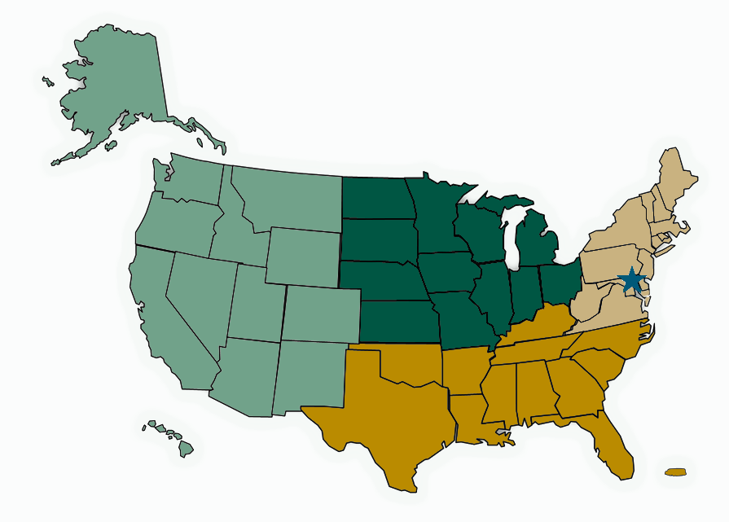
Rural Development Offices
We have staff in every State across the nation, as well as U.S. Territories
Employ @ 4500 employees
47 State Offices
4 Regions
400 Area Offices
National Office
Rural Housing Service
Rural Utilities Service
Rural Business - Cooperative Service
Business Center and Other Support Offices

Slide 5
Rural Development Programs
Rural Development
Together, America Prospers

Slide 6
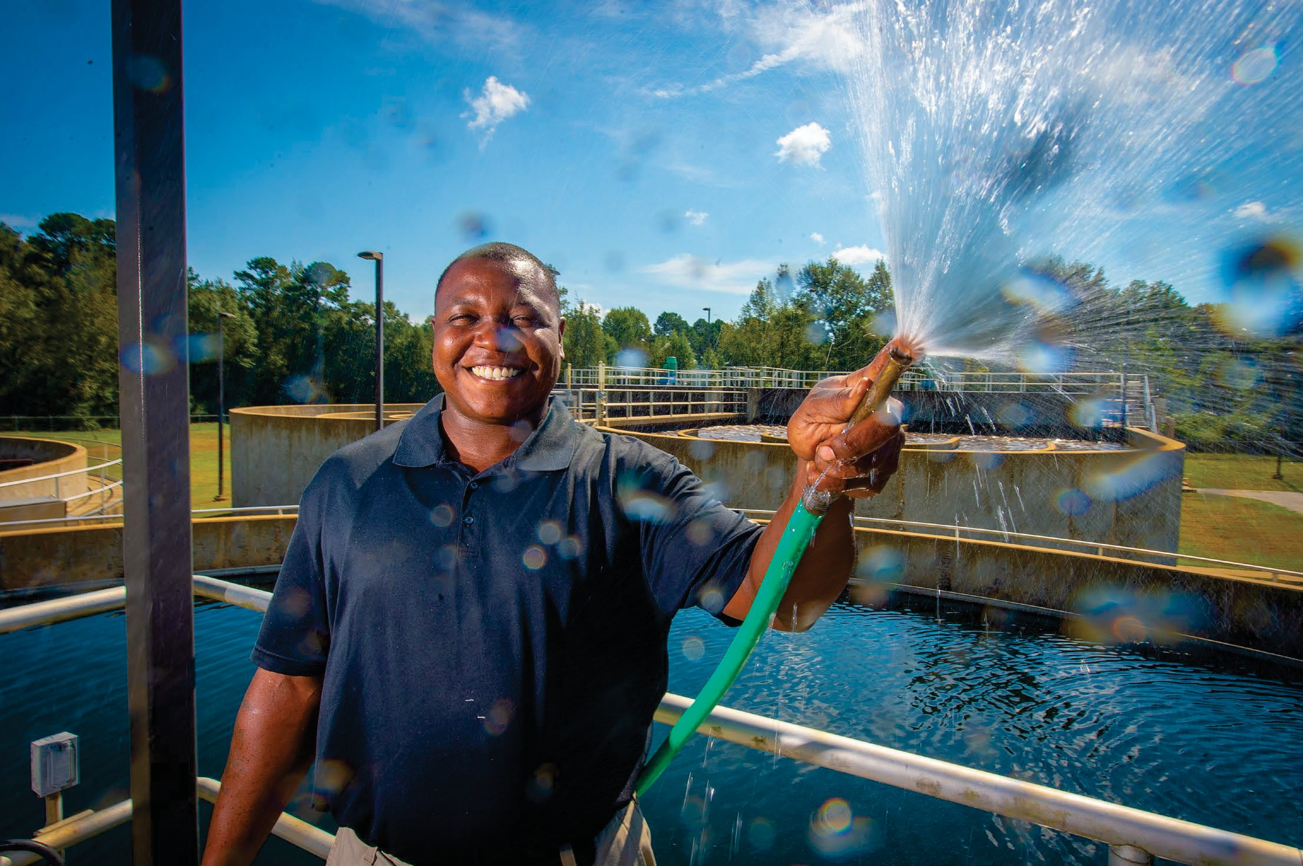
Rural Development Programs (https://www.rd.usda.gov/programs-services/all-programs)
WE HAVE MORE THAN 70 PROGRAMS TO SUPPORT RURAL AMERICA
Telecommunications Programs
Electric Programs
Community Facilities Programs
Water and Environmental Programs
Business and Cooperative Programs
Single-Family Housing Programs
Multi-Family Housing Programs

Slide 7
How Rural Development supports businesses
Support for Businesses
Affordable financing for construction or expansion
New markets
Entrepreneurship
Renewable energy

Slide 8
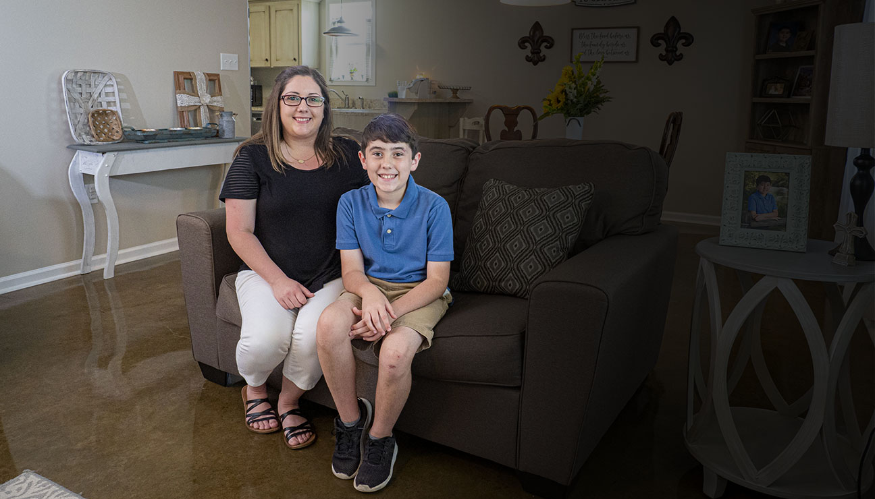
Single-Family Housing Program
Single-Family Housing
Affordable homeownership options
Access for persons with disabilities
8

Slide 9
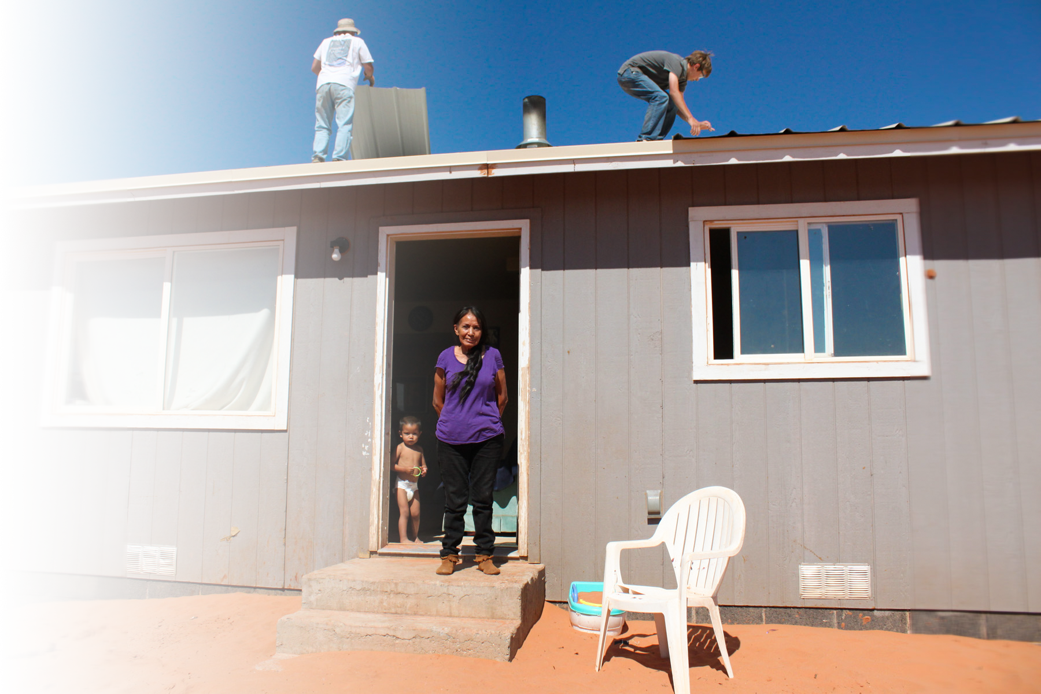
Single Family Housing Program - Continued
Single Family Housing
Home repair loans and grants
Roofs and septic tanks
Energy-saving upgrades and more

Slide 10
Multi-Family Housing Program
Multi-Family Housing
Multi-family housing improves access to affordability

Slide 11
Community Facilities Program
Community Facilities
Hospitals, health clinics
Schools
Daycares
Fire houses, first responder vehicles and equipment
Community centers and more

Slide 12
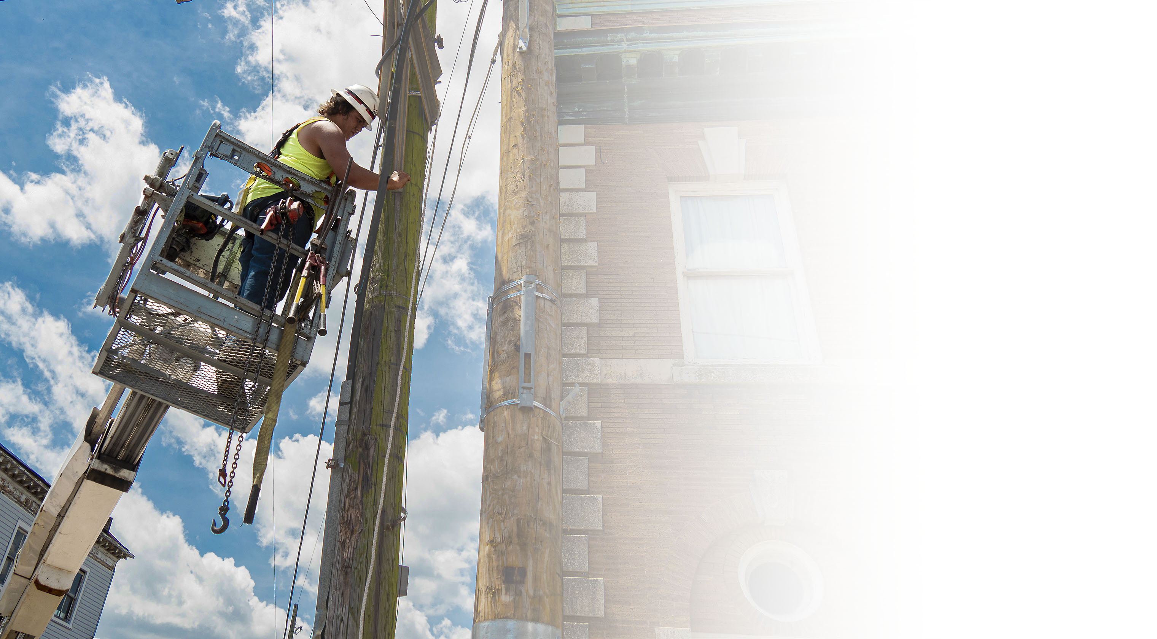
Electric Program
Electric Program
The Electric Program provides capital and leadership to maintain, expand, upgrade and modernize America’s vast rural electric infrastructure.
The loans and loan guarantees finance the construction or improvement of electric distribution, transmission, and generation facilities in rural areas.
The Electric Program also provides funding to support demand-side management, energy efficiency and conservation programs, and on-and off-grid renewable energy systems.

Slide 13
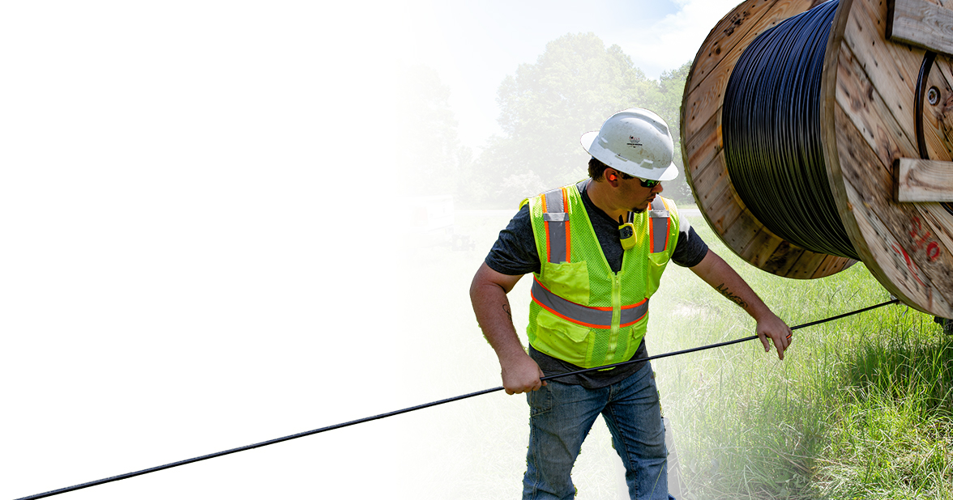
Telecommunications Program
Telecommunications
Program
The Telecommunications Program improves the quality of life in rural America by providing capital for the deployment of rural telecommunications infrastructure.
Rural Development is committed to ensuring that rural areas have access to affordable, reliable, advanced telecommunications services comparable to those available throughout the rest of the United States.
With this access, rural America will see improved educational opportunities, health care, safety and security and ultimately,
higher employment.

Slide 14
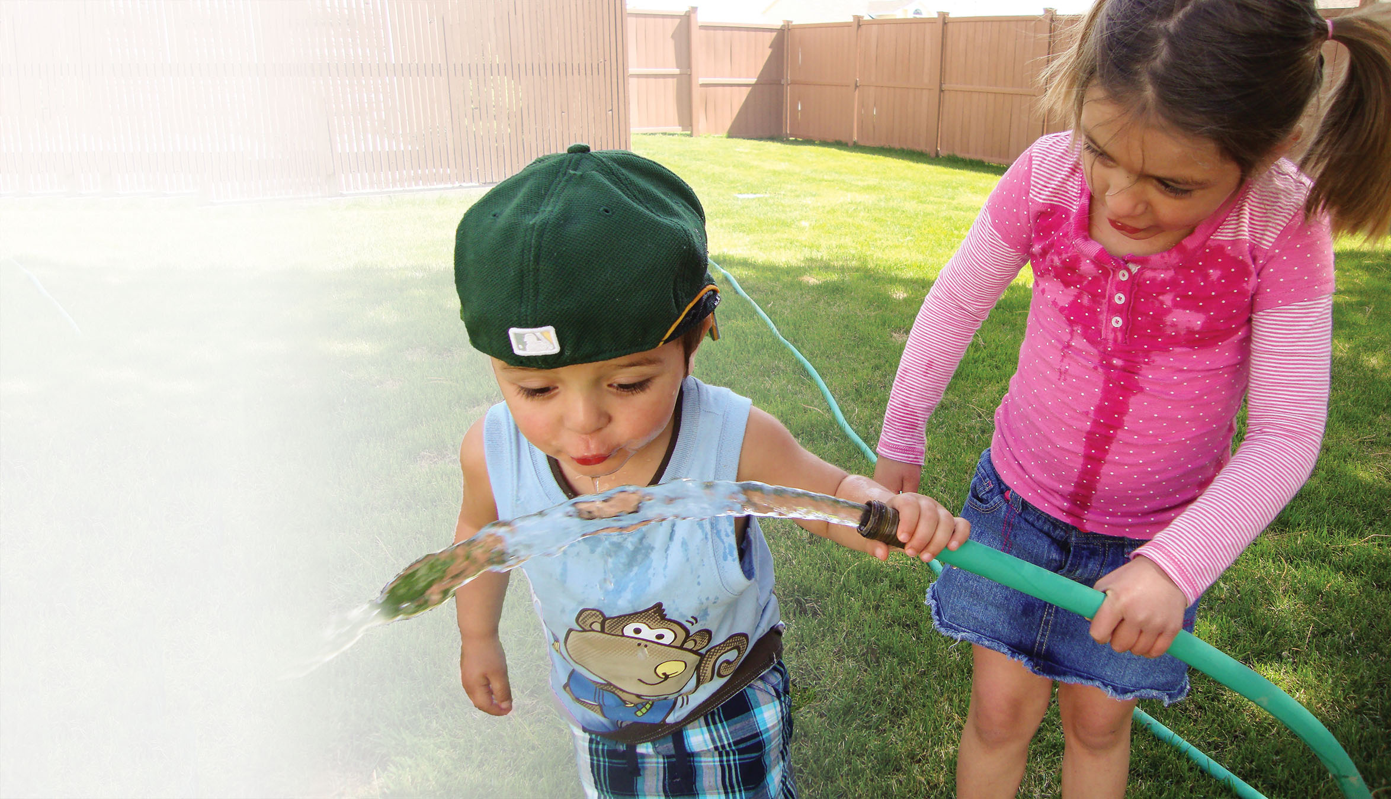
Water and Environmental Programs
Water and Environmental Programs
Our Water and Environmental Programs provide loans, grants and loan guarantees for drinking water, sanitary sewer, solid waste and storm drainage facilities in rural areas and cities and towns of 10,000 or less.
Public bodies, non-profit organizations and recognized Indian tribes may qualify for assistance. Preplanning and other technical assistance is available to financially distressed rural communities looking to improve their water and waste disposal systems.
WEP also makes grants to non-profit organizations to provide technical assistance and training to help rural communities with their water, wastewater and solid waste problems.

Slide 15
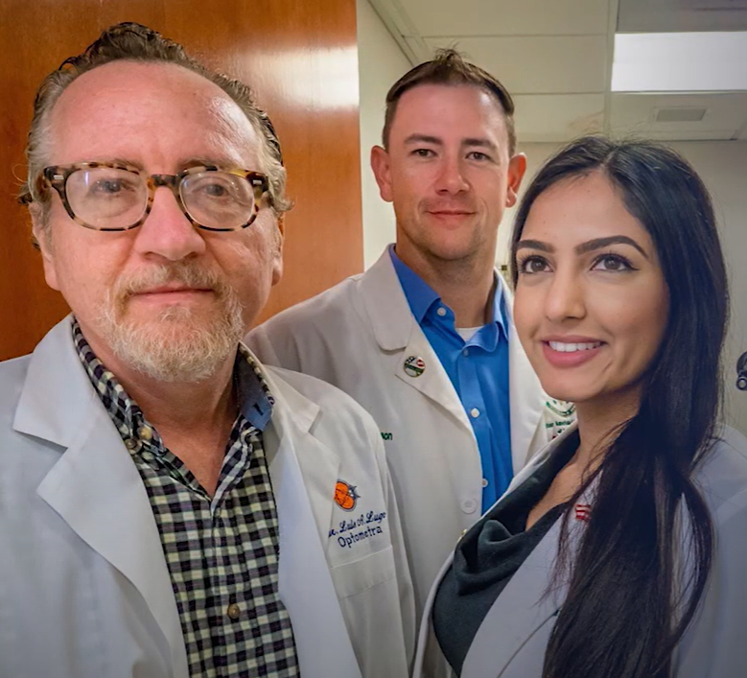
RD Videos – “Together, America Prospers”
USDA Vision - https://youtu.be/DxVmz7qzq_A (2 min 46 sec)
USDA History; 30 Leaders; 150 Years - https://youtu.be/r0w6hDLJKIA (16 min 34 sec)
USDA Rural Development – Who We Are and Who We Serve - https://youtu.be/gaSxg6Xbl0g (2 min 29 sec)
The Story of Rural Development - https://youtu.be/D1BAJ3U7PTg (3 min 10 sec)
USDA Rural Development – Our Mission and Vision - https://youtu.be/Nt2_AeEAmWE (2 min 25 sec)
Why I Like Working for USDA Rural Development - https://youtu.be/edc8fy7jXXQ (6 min 32 sec)
View more videos at Rural Development’s YouTube
Channel: https://www.youtube.com/c/USDARurDev

Slide 16
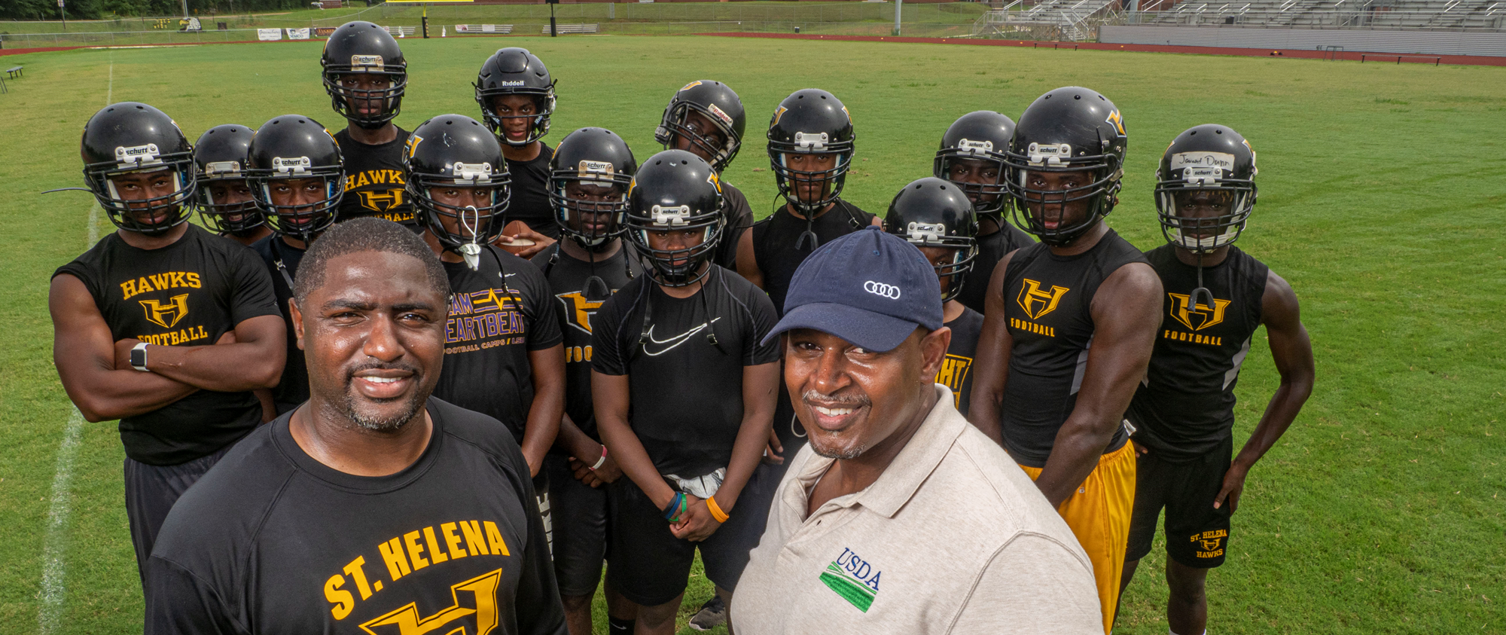
Construction funded by Community Facilities Program
St. Helena Parish, Louisiana
$2.88 Million Community Facilities Loan
Notes:
The St. Helena Parish School Board received this loan from RD to enable them to construct an athletic complex, replacing a football field in such bad shape and so lacking in lighting and other modern amenities that teams from other schools refused to play there. The team was even forced to travel to other venues to practice, seriously harming their training and morale.
The new complex includes a new football field house, stadium, concession stand, and parking lot. New concrete sidewalks and aluminum canopies were added between the new education building and stadium. The existing parking lot was re-striped, and accessibility upgrades and new lighting were added to give them a venue that could proudly welcome any visiting team.
In addition to having a wonderful facility and gathering place for the parish to assemble on Friday nights, the team is now consistently at the top of their district standings.

Slide 17
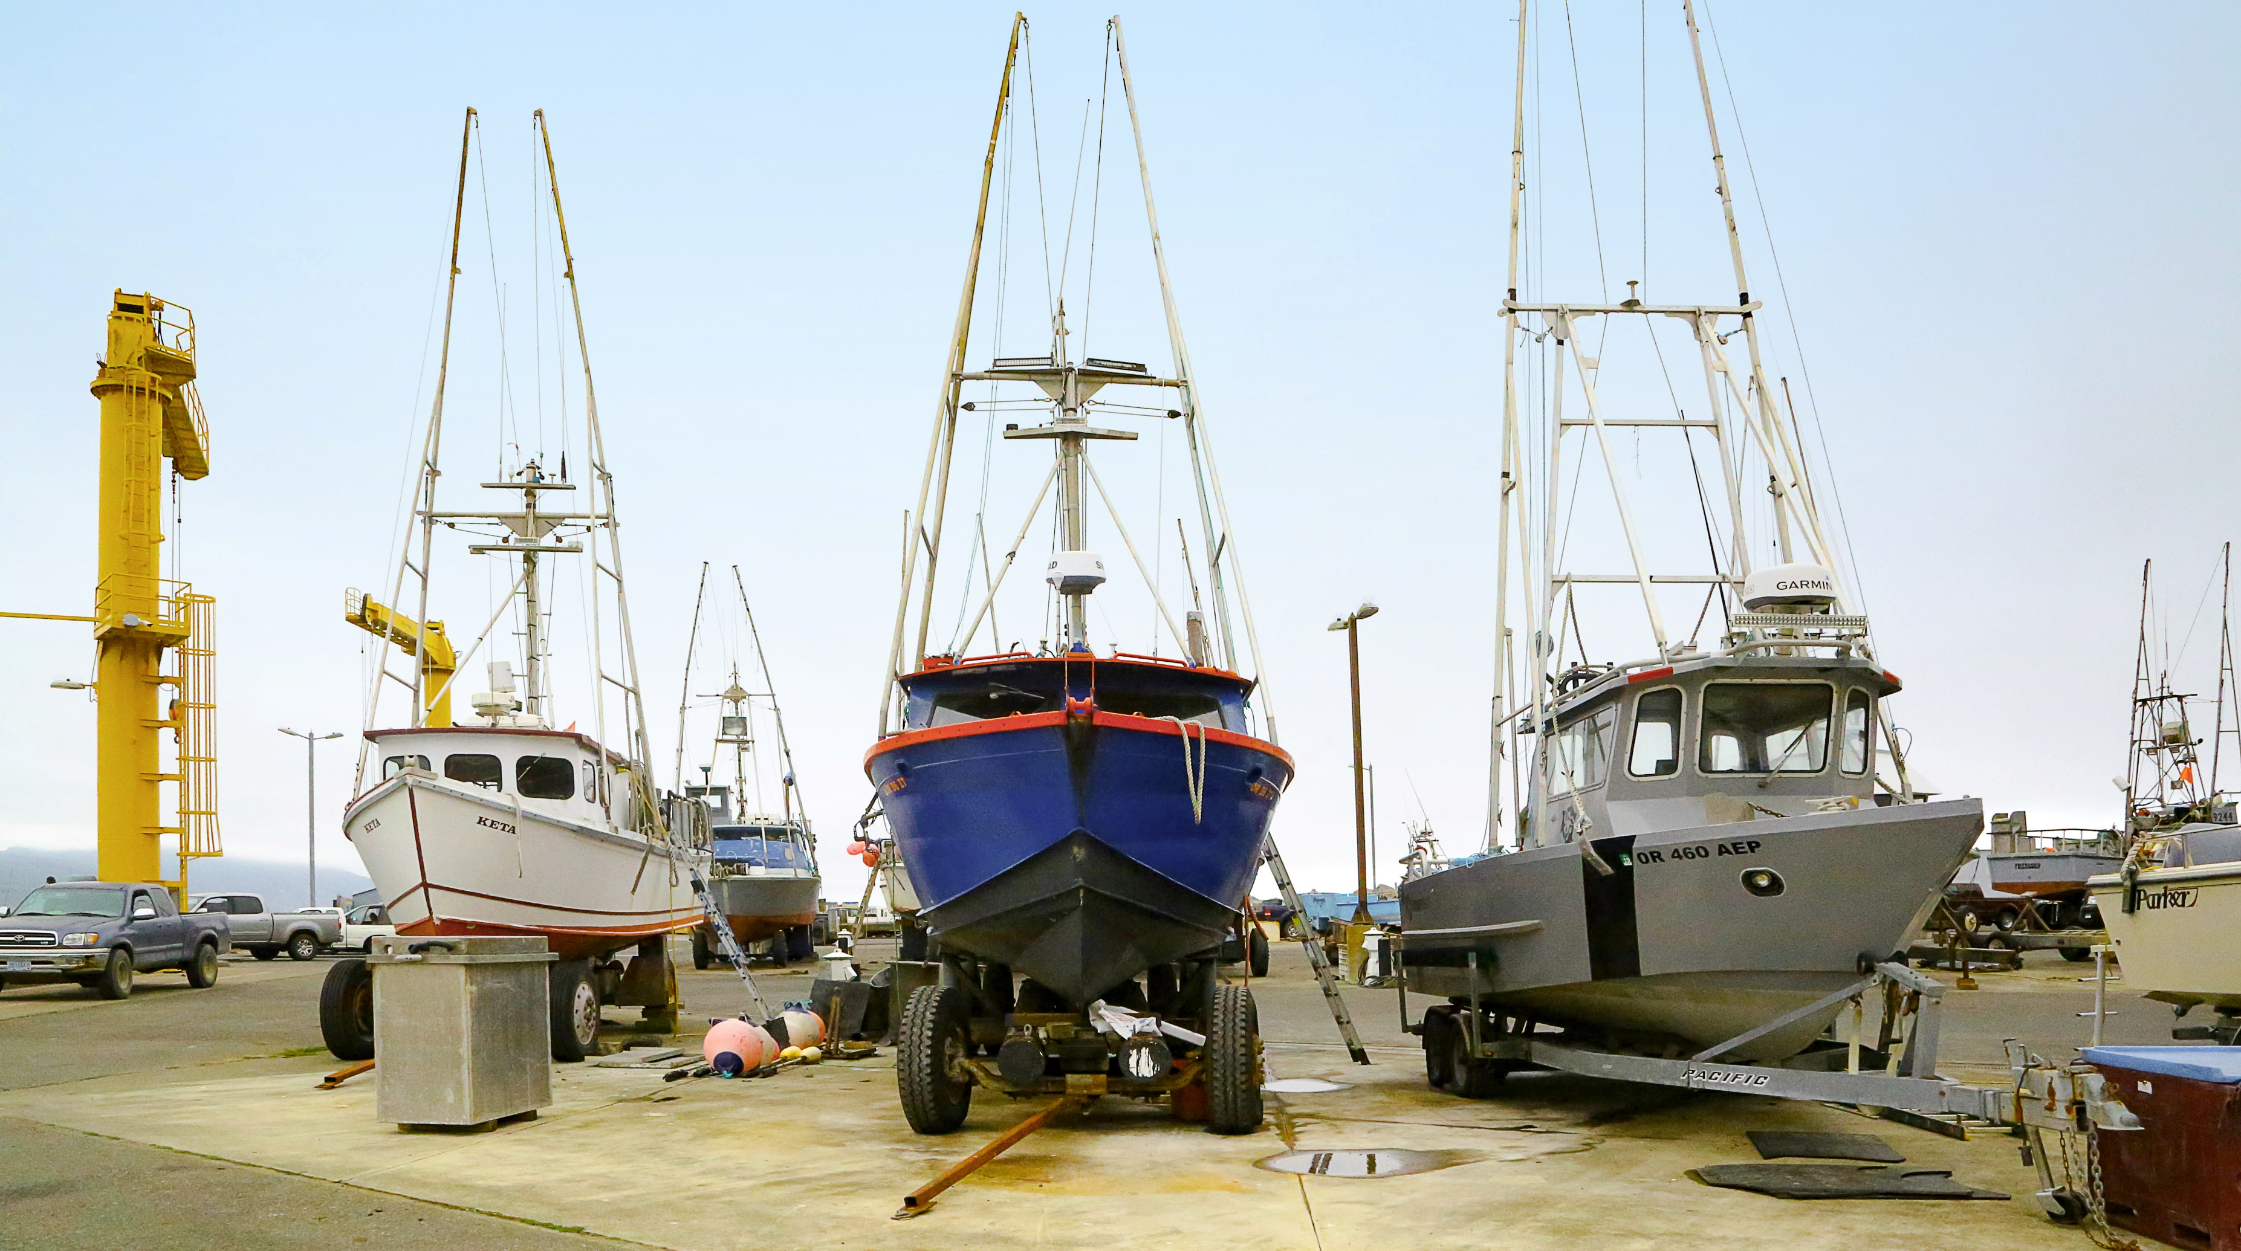
Facility funded by Value-Added Producer Grant Program
Port Orford Sustainable Seafood Cooperative
$25,000 Value-Added Producer Grant
Notes:
This grant enabled a sustainable fishing cooperative to modernize its operations and compete more effectively in the modern marketplace. It also enabled the co-op to build an online fish store, allowing it to efficiently manage its customer base, update its brand, and publicize its products and its sustainable approach to harvesting food from the sea.

Slide 18
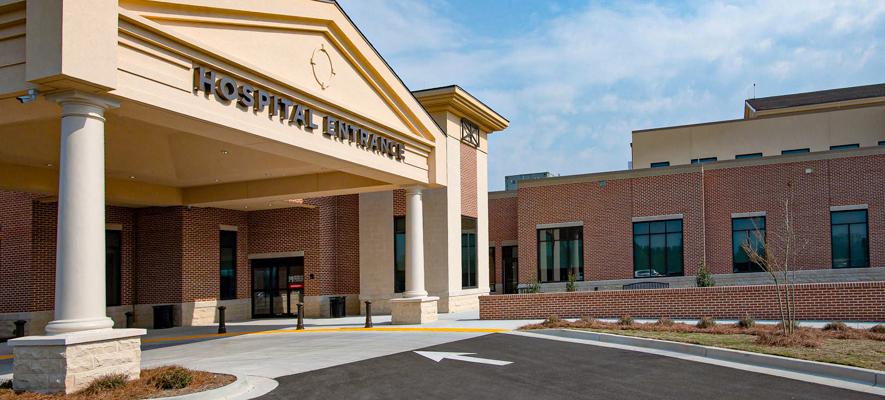
Hospital construction funded by a Community Facilities Program Loan
Morgan County, Georgia
$35 Million Community Facilities Loan
Notes:
This loan made it possible for Morgan County in Georgia to construct a badly-needed replacement for its small, aging local hospital. It allowed the hospital to construct a replacement 25-bed critical access hospital that more than doubles the size of the old facility and enabled updated medical equipment to be installed.

Slide 19
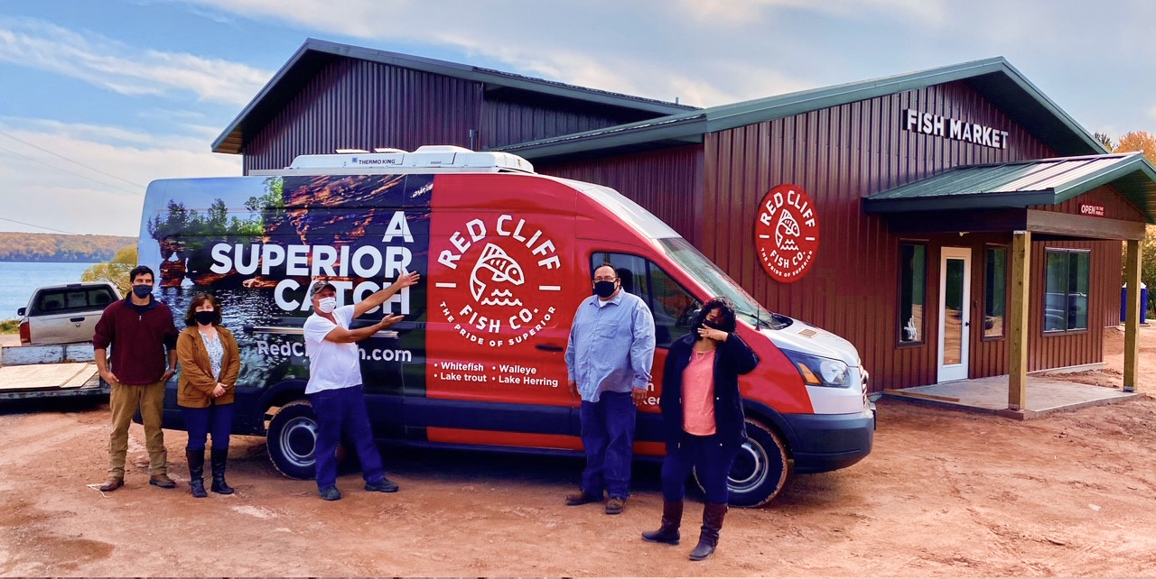
Facility funded by a Rural Business Development Grant
Red Cliff Band Chippewas, Wisconsin
$28,292 Rural Business Development Grant
Notes:
This grant helped the Red Cliff Band of Lake Superior Chippewa Indians build a new facility to process commercial fish and provide packaged products to distributors, restaurants and local markets.

Slide 20
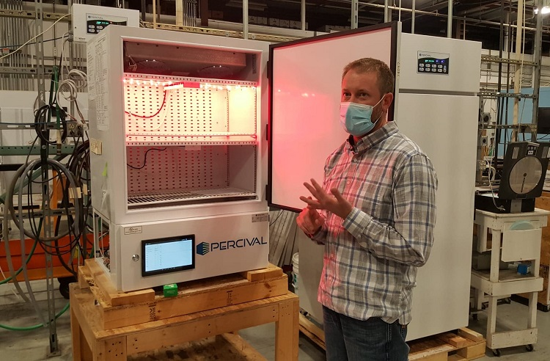
Project funded by a Rural Economic Development Loan
Percival Scientific, Iowa
$2 Million Rural Economic Development Loans
Notes:
This funding was awarded to Iowa to assist 25 projects throughout the state, creating more than 200 jobs. One of these projects is a facility expansion at Percival Scientific in Perry, in Iowa. Percival Scientific President Gary Wheelock described the impact this funding will make, “The decision to move forward with the building expansion, especially during these very uncertain economic times, was made easier through the USDA program. “

Slide 21
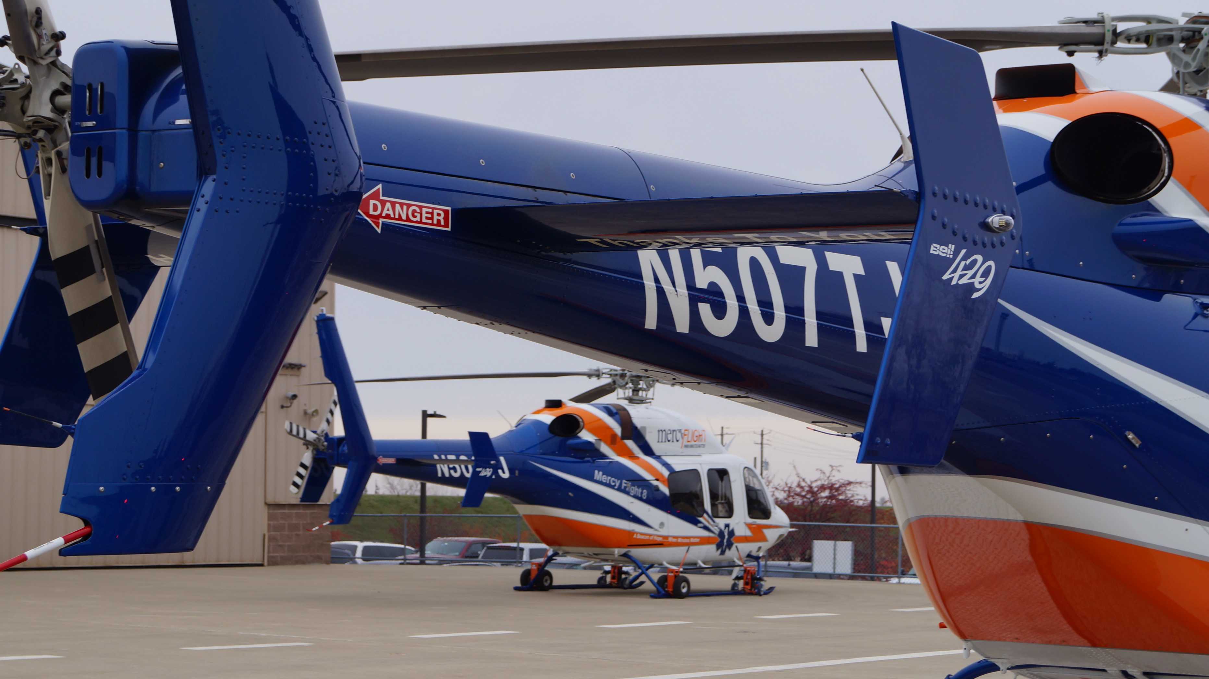
Project funded by a Community Facilities Loan
Mercy Flight Western, New York
$23 million Community Facilities Loan
Notes:
Rural Development helped Mercy Flight Western of Batavia, New York acquire 3 new Bell 429 Series medivac helicopters. The new aircraft expanded Mercy Flight’s fleet and offer modernized technology and reduced maintenance requirements. The upgrade allows expanded service to western NY, bringing reliable aerial medivac services to an economically depressed, highly rural area where such services can often make the difference between life and death.

Slide 22
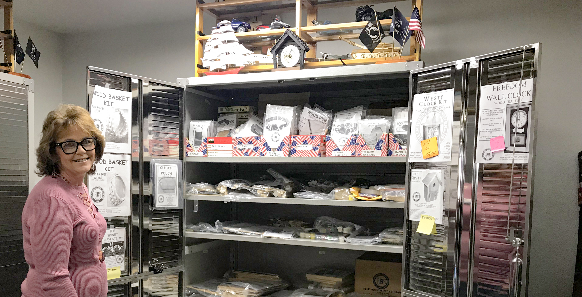
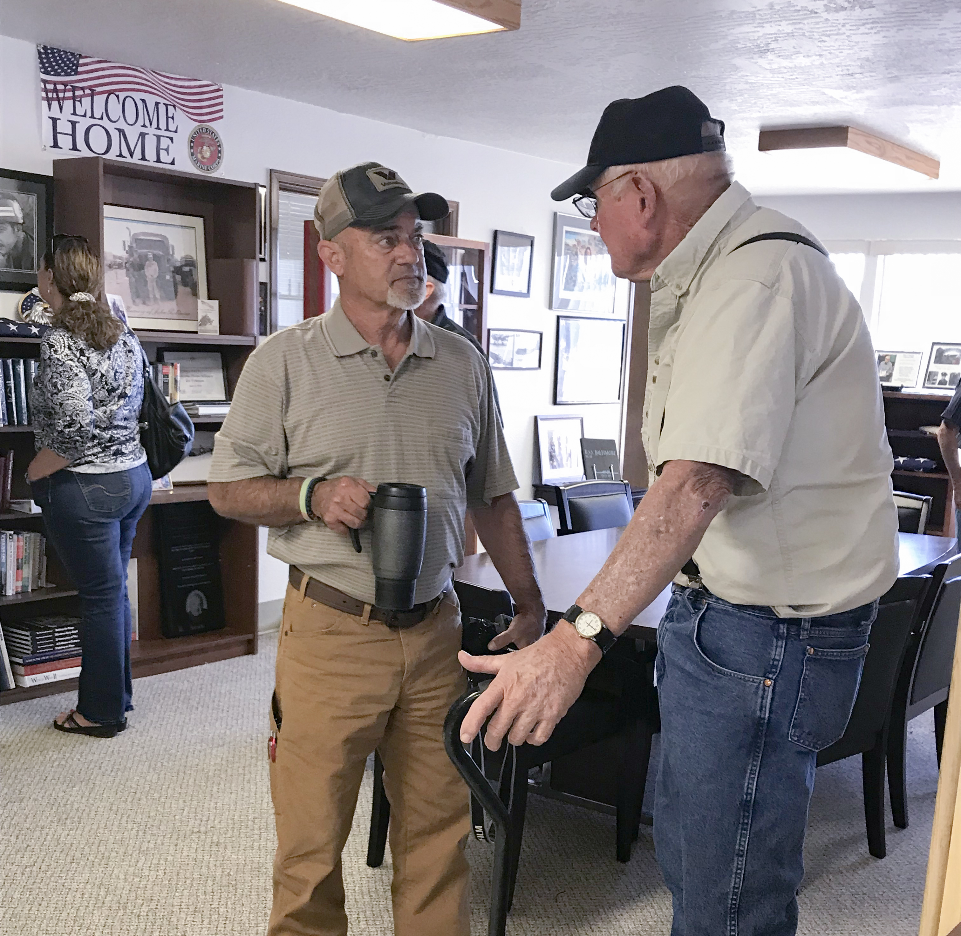
Project funded by a Community Facilities Direct Loan
Welcome Home Alliance for Veterans, Colorado
$528,000 Community Facilities Direct Loan
Notes:
This loan was provided to the Welcome Home Alliance for Veterans, a non-profit organization dedicated to serving veterans of the armed forces. Funding was used to purchase a building and for the continuation of veteran services such as peer support groups, counseling services for both veterans and their family members, training and social networking opportunities, and recreation and alternative therapies.

Slide 23
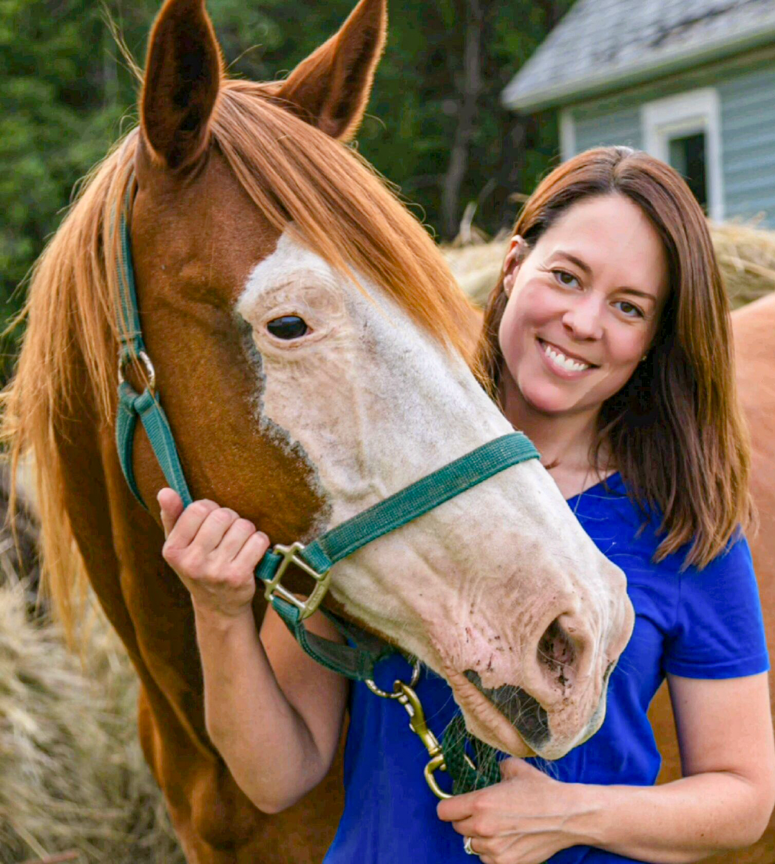
Project funded by a ReConnect Grant
A Moment of Freedom, North Dakota
ReConnect Grant
Photos courtesy of A Moment of Freedom
Notes:
This grant was provided to the Moment of Freedom, located in Buchanan, North Dakota, who provides equine therapy to special needs children. Prior to the installation of a broadband internet connection, the owner would have to travel 20 minutes just to have the ability to use the internet for business, from sending forms to parents to general communication. Now they have quality high-speed internet on the premise, resulting in huge time savings and better efficiency.

Slide 24
Family home funded by a Single Family Housing Direct Loan
Desiree Thomas, Louisiana
$140,000 Single Family Housing Direct Loan
Notes:
A $140,000 Single Family Housing Loan enabled Desiree Thomas, a single mother living on a fixed income to purchase a home in the town of Plaisance, Louisiana. Owning her own home is the culmination of a life-changing effort to improve her life.

Slide 25
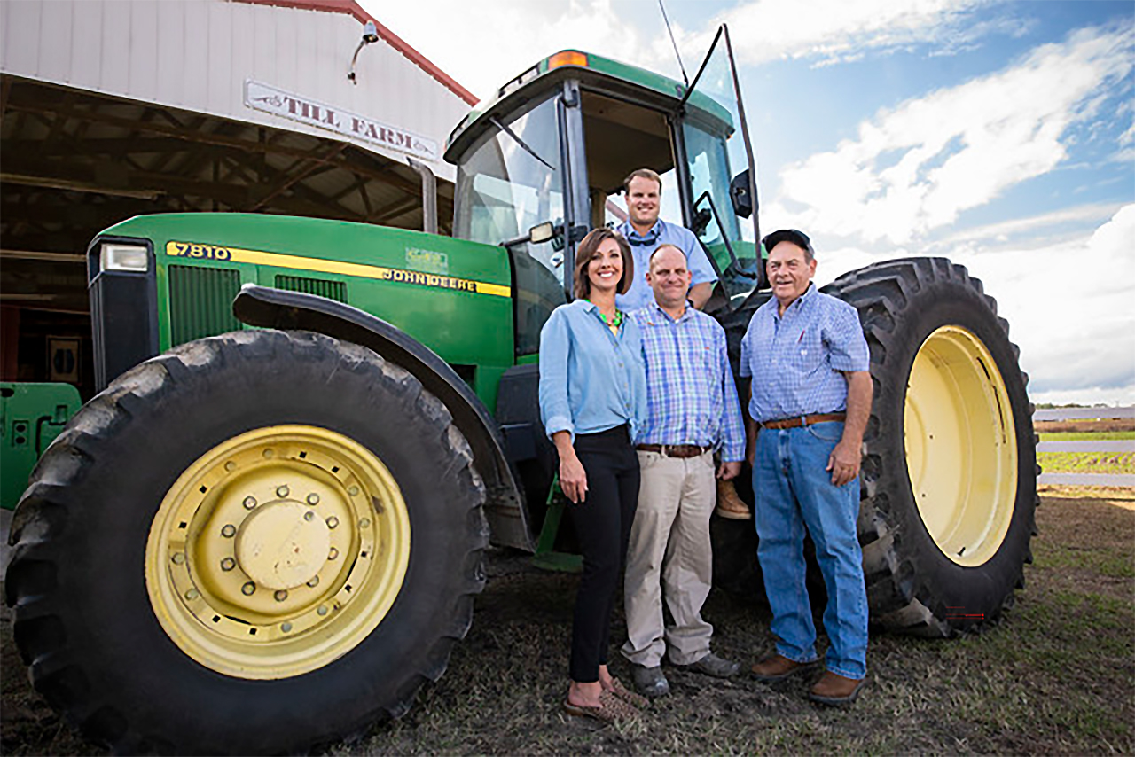
Farming equipment funded through the ReConnect Program
Till Family Farm, South Carolina
ReConnect Program
Notes:
Our Rural Utilities Service provided 82 ReConnect awards impacting 34 states across America. The investment represents $744,303,168 in grant and loan funding for high-speed broadband infrastructure projects. These 82 critical investments connected approximately 13,000 farms, enabling them to enhance and utilize precision agriculture technologies for specialty crop production. The Till Family Farm in Orangeburg County, South Carolina, pictured, is one of the countless farm operations that have benefited from the program.

Slide 26
Final Presentation slide

