Slide 1
TIPS AND TRICKS FROM A CONTRACTING OFFICER USDA PMO Aug 2024

Slide 2
AGENDA
USDA Forecast
USDA Vendor Capability Submission
Tips and Tricks
USDA wants to hear from YOU
Solicitation is out – What Should YOU Do Next
Sub-Contracting Opportunities “TEAMS”
Congratulations!!! YOU WON!...
What matters NOW
Why is Performance Important
QR code for USDA
2

Slide 3
USDA FORECAST
The Procurement Forecast tool is a list of anticipated USDA solicitations that small businesses, small disadvantaged businesses, women-owned small businesses, HUBZone small businesses, and service-disabled veteran-owned small businesses may be able to perform under direct contracts with USDA.
WEBSITE
Forecast of Business Opportunities | USDA

Slide 4
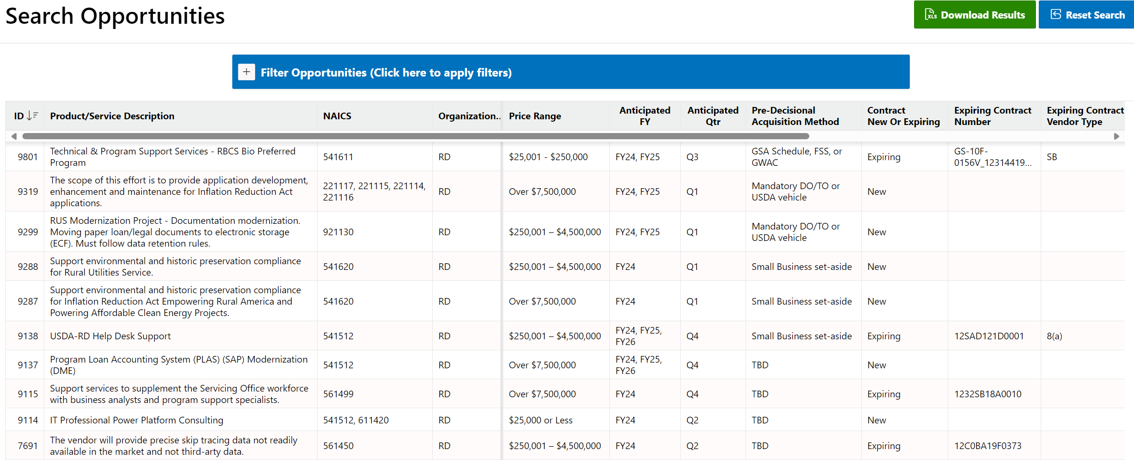
USDA FORECAST CONT.

Slide 5
USDA VENDOR CAPABILITY SUBMISSION PORTAL
Interested in doing business with USDA? To get started, we need you to answer a few questions. Once you submit the form, our team will review your submission and may reach out with more information.
Note: Submitting this form does not guarantee an offer for procurement; USDA OSDBU will record your capabilities to support ongoing market research.
Website
https://www.usda.gov/da/osdbu/vendor-survey

Slide 6
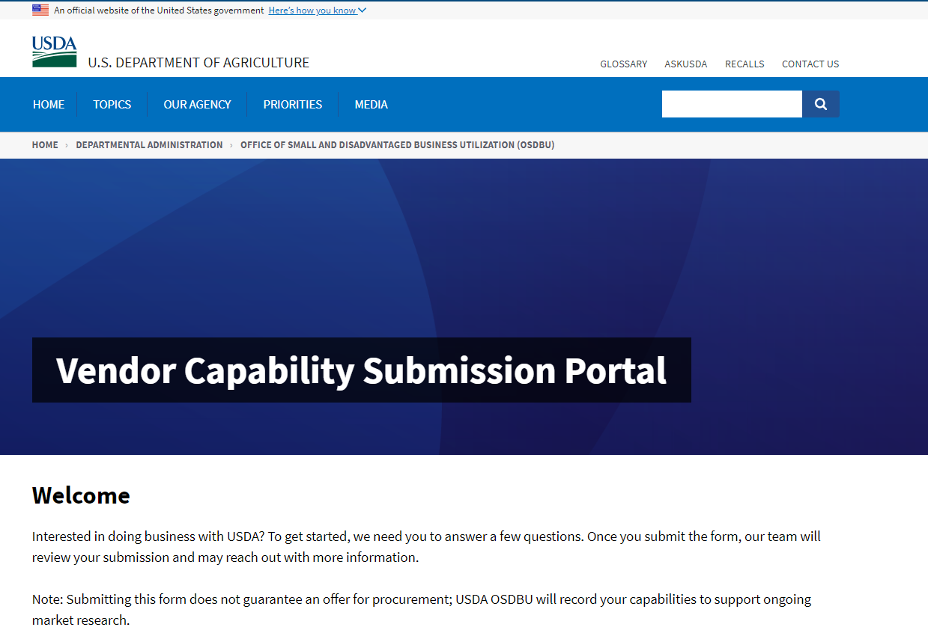
USDA VENDOR CAPABILITY SUBMISSION PORTAL CONT.

Slide 7
TIPS AND TRICKS
Understand the nuances of government contracting is crucial for success
Build relationships, not just transactions
Stay agile and adaptable
Leverage technology and data analytics
Emphasize value and impact
Continuous learning is key
Think long-term
Be proactive in seeking feedback
Notes:
Understanding the nuances of government contracting is crucial for success. It's not just about submitting a bid; it's about crafting a strategic approach that aligns with your business goals and the government's needs.
Build relationships, not just transactions. Networking and forming partnerships can give you a competitive edge in the government contracting arena. Don't underestimate the power of a strong professional network.
Stay agile and adaptable. Government regulations and requirements can change rapidly. Being able to pivot and adjust your strategies accordingly will set you apart from the competition.
Leverage technology and data analytics. In today's digital age, harnessing the power of data can provide valuable insights for optimizing your government contracting strategies. Embrace innovation to stay ahead.
Emphasize value and impact. In your proposals and interactions, focus on the value you can deliver and the impact it will have. Show how your solutions can address the government's challenges effectively.
Continuous learning is key. Government contracting is a dynamic field, and staying informed about industry trends, best practices, and regulatory changes is essential for ongoing success.
Think long-term. Building a sustainable government contracting strategy requires a forward-looking approach. Consider how your decisions today can impact your future opportunities in the market.
Be proactive in seeking feedback. Understanding the perspectives of government agencies and stakeholders can help you refine your strategies and improve your chances of winning contracts.

Slide 8
USDA WANTS TO HEAR FROM YOU
What is the importance of Market Research? How can your company benefit from responding?
Request for Information (RFI) & Sources Sought Notices (SSN) assist the government in determining set-asides for Small Business vs Full and Open Competition; as well making restrictions to WOSB, 8a, SDVOSB, etc.
Attend Industry Day’s and provide feedback ensuring no miscommunication or lack of understanding
Provide a strong Capabilities Statement will make your company more valuable when responding to SBA’s Dynamic Small Business Search.
Ask questions and reach out to the contracting POC’s for additional information such as: Who is the current CONTRACTOR ? Are there are any subcontract opportunities?
Provide contact information that can be shared with Prime Contractors
Notes:
What should you have set-up?
Small Business and Socio-Economic status is up to date
Develop a strong capabilities statement
Include corporate experience and relevant / recent clientele

Slide 9
SOLICITATION IS OUT WHAT SHOULD YOU DO NEXT
Read the solicitation thoroughly
Does it make sense to you and what you do
Do you have any input that can better the requirement for the Government
Request clarification from the agency
If you are a Small Disadvantaged company – should they set it aside for your social economical status
Address any assumptions based on how the solicitation is written
Address all the elements within the evaluation criteria (Technical, Past Performance, Pricing, etc...)
Don’t miss the deadline, to provide feedback on the solicitation
Notes:
(This is the best time to give feedback on issues in the solicitation that you may want addressed, changed, or clarified.)
(Contracting Officer / Contract Specialist)

Slide 10
SUBCONTRACTING OPPORTUNITIES “TEAMIMG” “DAWSON”
Teaming with other companies is IMPORTANT….WHY
Learn from Prime Contractors… they have been doing this for a long time
Less Risk… Helps you navigate Government Contracting
USDA NATIONAL DEFAULT MANAGEMENT SERVICES
Two Prime Contractors that service Puerto Rico area
Contractor Contact information: Dawson’s Realty and Mortgage, Inc.
Dba Dawson’s management
Phone: 770-962-4981 / info@dawsonsmanagement.com
Potential Subcontracting Opportunities:
SFH Valuation/Appraisals Services
SFH Property Occupancy Inspection Services
SFH Property Preservation/Caretaking Services
Legal Foreclosure Attorney Services
Eviction Services
Property Disposition/Sales Services

Slide 11
SUBCONTRACTING OPPORTUNITIES “TEAMIMG” “ISN”
Teaming with other companies is IMPORTANT….WHY
Learn from Prime Contractors… they have been doing this for a long time
Less Risk… Helps you navigate Government Contracting
USDA NATIONAL DEFAULT MANAGEMENT SERVICES
Two Prime Contractors that service Puerto Rico area
Contractor Contact information: Information Systems and Networks Corp (ISN)
Sarah Dallas
Phone: 301-222-0705 / sdallas@isncorp.com
Potential Subcontracting Opportunities:
SFH Valuation/Appraisals Services
SFH Property Occupancy Inspection Services
SFH Property Preservation/Caretaking Services
Legal Foreclosure Attorney Services
Eviction Services
Property Disposition/Sales Services

Slide 12
CONGRATULATIONS!!! YOU WON...
READ
Understand the Contract Before services begin
Read the contract and then read it again! What matters..
You must understand All Terms and Conditions in the contract
Provisions for making changes to the contract
Method of payment, the payment schedule, and office responsible for paying
REVIEW
What did you propose over and above of the requirement
You must deliver
Don’t Rely on “Normal” Procedures
Notes:
It can be a game-changer for your business when you’re awarded a government contract. But like anything when dealing with government agencies, there may be some red tape to work around.
As a government contractor, ethics and rules are essential. You don’t want to find yourself in violation of something simply because you didn’t know about it.
Such as, ensuring sufficient cash flow to cover upfront expenses in support of production, services, and subcontractor fulfillment.
Be familiar with any unique specifications and deliverable(s)/milestones.

Slide 13
CONGRATULATIONS!!! YOU WON...CONT.
When It Comes To Working With The Government, Expect The Unexpected
Ensure compliance with all relevant labor statutes
Keep detailed records
DOCUMENT
Prepare Yourself/Quality Control
WHEN are items do the government
Notes:
It can be a game-changer for your business when you’re awarded a government contract. But like anything when dealing with government agencies, there may be some red tape to work around.
As a government contractor, ethics and rules are essential. You don’t want to find yourself in violation of something simply because you didn’t know about it.
Such as, ensuring sufficient cash flow to cover upfront expenses in support of production, services, and subcontractor fulfillment.
Be familiar with any unique specifications and deliverable(s)/milestones.

Slide 14
WHAT MATTERS NOW
Don’t Dismiss the Requirement and the Laws applicable
Understand the Regulations; such as the FAR and Laws applicable to the services you are providing
State law
Conduct periodic internal reviews ensuring ongoing compliance with specifications and federal regulations
Do Learn the Art of Communication
Always make sure you document all your conversations save all emails pertinent to your contract
Notes:
It can be a game-changer for your business when you’re awarded a government contract. But like anything when dealing with government agencies, there may be some red tape to work around.
As a government contractor, ethics and rules are essential. You don’t want to find yourself in violation of something simply because you didn’t know about it.

Slide 15
WHAT MATTERS NOW CONT.
BEST PRACTICES
Quarterly email your Contracting Officer/Contracting Officer Representative and ask about your performance, what are you doing right and what areas need improvement
Address any process improvement(s) that may be beneficial to the Government and YOU
Contracts are designed to be a WIN-WIN opportunity for YOU as the contractor and the Government
A Streamline process with cost avoidance in the future is a Win - WIN
Notes:
It can be a game-changer for your business when you’re awarded a government contract. But like anything when dealing with government agencies, there may be some red tape to work around.
As a government contractor, ethics and rules are essential. You don’t want to find yourself in violation of something simply because you didn’t know about it.

Slide 16
WHY IS PERFORMANCE IMPORTANT?
Every contract is different, what can you do ensure a successful performance rating?
Your performance is being monitored and will be rated yearly, upon completion, and as needed
Supplies and Service Contracts
Contractor Performance Assessment Reporting System (CPARS) rating
Past Performance Questionaries sent from one government entity to another
Stay on top of your rating(s) – Don’t be surprised; maintain all documentation relevant to your performance
Notes:
Request performance status through out the life of the contract
Every contract is different, what can you do ensure a successful performance rating?
Request a Post-Award Meeting and Performance Reviews through out the life of the contract.
Discuss: Government expectations, clarifying roles and responsibilities, and address any questions pertaining to the contract for clarification.
Know your Scope of Work Must-Haves
Highlight all requirements within the scope addressing “shall or will.”
Understand your Performance Requirement Summary (PRS)
Locate all tasking(s) & deliverables
Read all performance standard(s) and allowable tolerance
Establish remedies if you are not able reach performance standard

Slide 17
WHY IS PERFORMANCE IMPORTANT? CONT.
What does it do? Provides contractors strengths and weaknesses. Captures current, complete, and accurate information. Used to determine contractor(s) capability in future requirements.
Meet or Exceed Deliverable Milestones
Highlight major milestones
Don’t stray from the Critical Path
Track your progress and know in real-time if you are ahead or behind the set milestones and overall completion
Notes:
Request performance status through out the life of the contract
Every contract is different, what can you do ensure a successful performance rating?
Request a Post-Award Meeting and Performance Reviews through out the life of the contract.
Discuss: Government expectations, clarifying roles and responsibilities, and address any questions pertaining to the contract for clarification.
Know your Scope of Work Must-Haves
Highlight all requirements within the scope addressing “shall or will.”
Understand your Performance Requirement Summary (PRS)
Locate all tasking(s) & deliverables
Read all performance standard(s) and allowable tolerance
Establish remedies if you are not able reach performance standard

Slide 18
CONTRACTING WITH USDA QUICK REFERENCE GUIDE

Slide 19
Questions
QUESTIONS?

