Slide 1
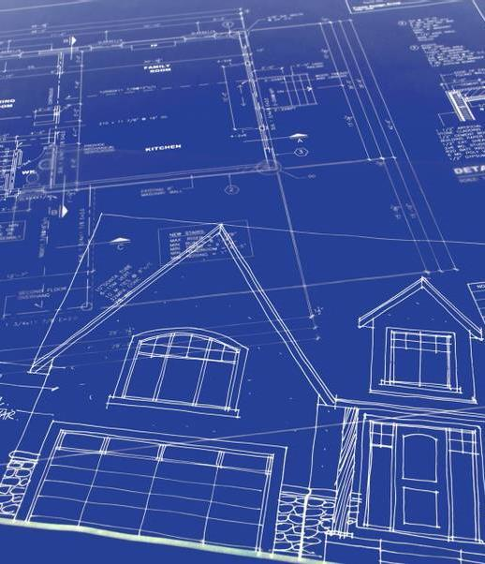
Orientation to
USDA Rural Development’s
Self-Help Housing Program for Rural Development Staff
January 2026

Slide 2
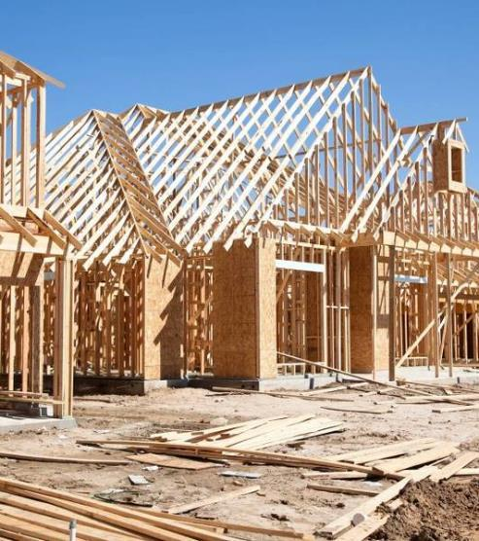

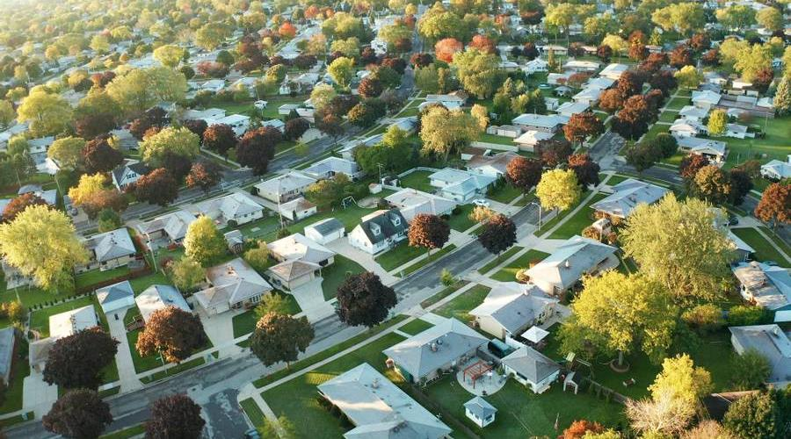
Agenda
Overview of Program
New Construction
Rehab
Guidance and Instruction
Grant Requirements / Application

Slide 3
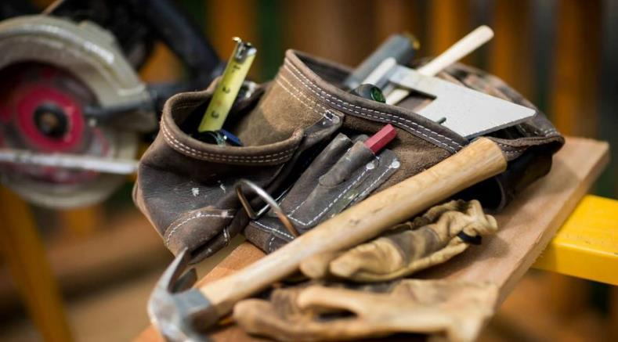

What is Self-Help Housing?
A method for low and very low-income households to achieve homeownership
Families working to build or repair their own homes
Affordable financing
A private, non-profit housing authority or tribal entity

Slide 4

Self-Help Housing
Similar to the barn raising method used by pioneering rural Americans
USDA Rural Development began funding mortgages through the 502 program in the 1960’s
In 1971 Rural Development began the
523 Grant Program
Over 60,000 homes have been successfully built or repaired through this method

Slide 5
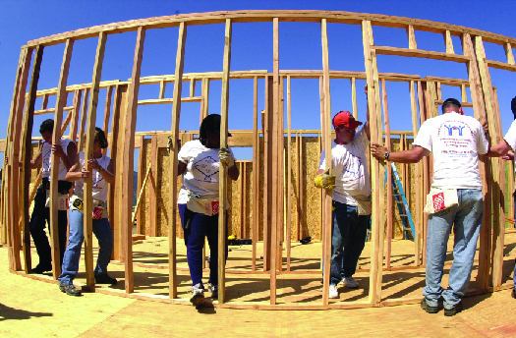
Self-Help Statistics
Currently about 82 grantees
Between 600-700 homes built or repaired per year
$25 million in 523 grants in Fiscal Year 2026

Slide 6
Elements of Self-Help Housing
Two-year grant periods
Grant Amount determined by number of homes to be built
Requires accurate reports, annual audits, cost allocation, sound bookkeeping and financial management policies
Helpful experience for a 523 grant application includes: construction, 502 loan packaging, project management, housing development, land development, and organizational management
Authorized 523 grant uses include staff salaries/benefits, office expenses, tools, audits/accounting system, travel, advertising and participant recruitment

Slide 7

Meet the Team-Necessary Elements
Participants – provide labor
USDA Rural Development - $$
    502 (or 504) and 523 funds
    Other mortgage financing may be used and could be recommended due to limited RD resources
Grantees (Non-Profit Housing corporations) - organize and assist the families
Orientation

Slide 8
Self-Help Housing-Participants
Must be low or very low income
Must qualify for a mortgage for new
construction or rehab loan or grant
Opportunity to own an affordable, energy
efficient and attractive home
Invest in a home versus renting, building a
long-term asset
Mortgage is reduced through sweat equity, with savings varying by participant
Gain valuable skills which can enhance employment opportunities and learn skills to assist in home maintenance

Slide 9

Self-Help Housing Benefits
Community:
Creates new affordable housing opportunities
Enhances and improves local housing stock
Brings in federal grant funding
Participants:
Gain stability & security by owning their own home
Learn valuable skills and build community
Helps to build wealth and equity
Self-Help Organizations:
Helps achieve mission
Creates new revenue stream and offers flexibility
Involvement with USDA Rural Development may lead to additional opportunities

Slide 10

Section 523 and 502/504 Regulations
Section 523 Mutual Self-Help Housing
7 Code of Federal Regulations (CFR) 1944 , subpart I
Rural Development Instruction 1944-I
Uniform Guidance 2 CFR 200
Section 502/504 Program Regulations
Handbook 1-3550
7 CFR 3550
Additional Guidance
Administrative Notices
Unnumbered Letters
Procedure Notices

Slide 11
Regulations
1944-I governs the Self-Help Housing Program
https://www.rd.usda.gov/files/1944i.pdf
        Appendix 13 in the 3550 Handbook also provides guidance on Self-Help Housing

Slide 12
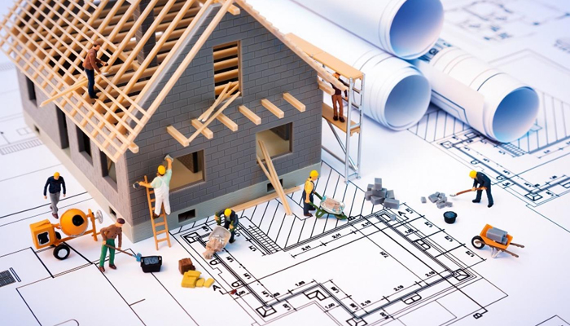
Types of Self-Help Housing
New Construction
Rehab
Acquisition Rehab
Owner-Occupied Rehab

Slide 13

New Construction

Slide 14
Mutual Self-Help Housing - New Construction
Families work together in groups of 4-10 to build their homes, contributing 65% of the labor tasks under the supervision of a construction supervisor as outlined in Exhibit B-2
Houses start and finish construction together
No one moves in until all homes are finished and approved
Work is done by the participants in the evenings, on weekends and days off
Self-help construction is a commitment of time and labor

Slide 15

How long will it take to build the homes?
The total process takes 11 to 16 months
  3 to 4 months in pre-construction
  8 to 12 months in construction

Slide 16
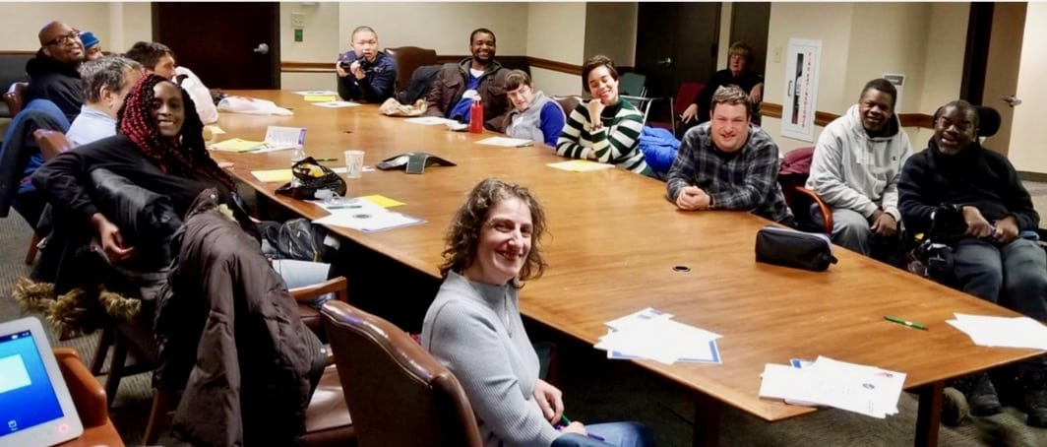
Pre-Construction Tasks
Choosing house plans
Selecting building sites
Completing Rural
Development paperwork
Waiting for loan approval
Participating in Pre-Construction Meetings—Key to success
Education

Slide 17
Family Labor Contribution
Families contribute as much labor as is required to complete ALL houses in the group
Families must complete a minimum of 65% of the construction labor tasks
Technical work such as foundation, plumbing, heating and electrical is subcontracted out
Generally, each family contributes 30 to 35 hours each week
Family hours include the labor of either spouse
Volunteer labor is allowed with approval from USDA Rural Development

Slide 18
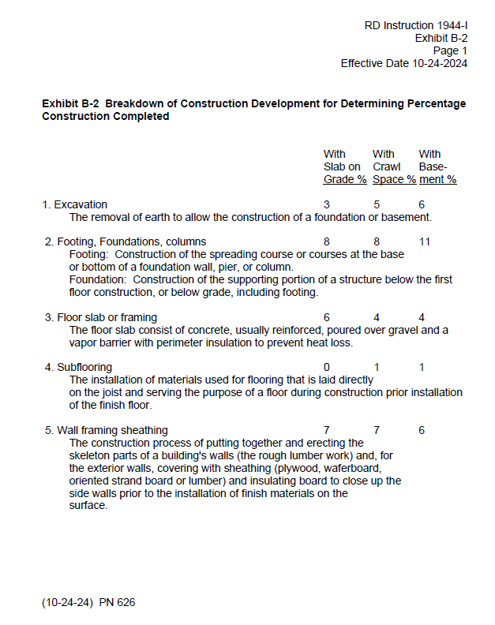
Mutual Self-Help Housing New Construction
Exhibit B-2

Slide 19
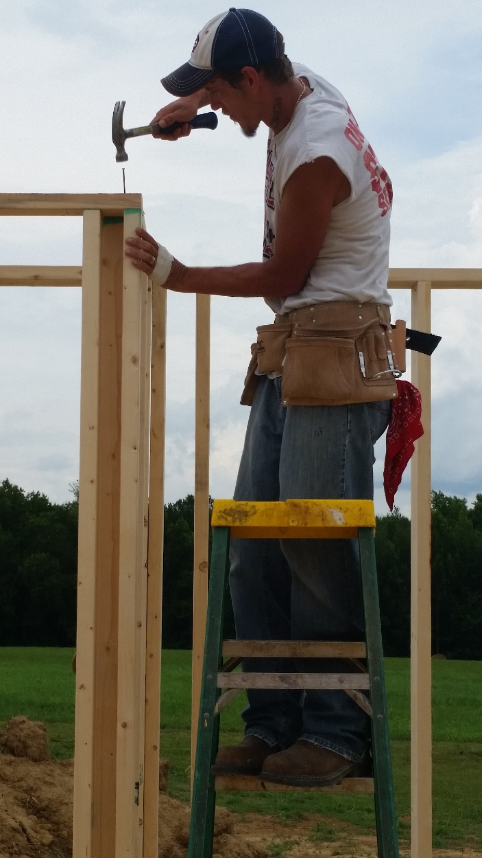
Participants tasks can include:
  excavation
  framing
  setting of trusses
  roofing
  insulation
  sheathing
  siding
  windows & doors
  drywall
  painting
  interior trim & cabinets
  flooring install
  landscaping

Slide 20
Rehab

Slide 21

Self-Help Rehab
Self-Help Rehab is allowed in regulations
Labor is not mutual
Acquisition Rehab or Owner-Occupied Rehab
      Either or a combination
Rehab grants can be combined with New Construction grants

Slide 22

Elements of Rehab
USDA RD would like to see a cost savings (Self-Help homeowner labor vs what it would cost if a contractor completed the work)
This is will vary by project, service area, and region
Repairs will be completed over an 8-12 week period, though this may vary
Technical Assistance that is provided by the grantee
includes:
  Assisting with applying for funds
  Training participants in tasks
  Managing and paying bills

Slide 23
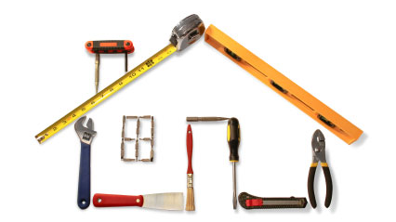
Elements of Repairs for Rehab
Each home will be inspected on an individual basis with repairs that will vary
  Health and safety repairs first
  Energy efficiency issues next
  Cosmetic issues last
  Care needs to be taken in rehabbing
  older homes (lead paint, etc)
  If the home is habitable, the borrower
  receives a regular 502 loan with the
  extra funds for repairs going into an SBA or custodial account
  If the home is not habitable in the first 30 days, the borrower receives a construction loan

Slide 24
Self-Help Technical Assistance Grant
Purpose:
Provide technical assistance and supervision to low and very low-income families to construct, repair, and/or rehab a home
To pay administrative costs associated with operating a self-help program
Generally, grants may not exceed 24 months
(Extensions of time may be granted, no more than one year at a time)
  https://www.rd.usda.gov/programs-services/single-family-housing-programs/mutual-self-help-housing-technical-assistance-grants

Slide 25

Who Qualifies for a Grant and Requirements
501 C (3) Non-Profit
Housing Authority or Tribal Entity
Public Bodies
Rural Areas as designated by USDA Rural Development
Meet Program Performance Goals

Slide 26
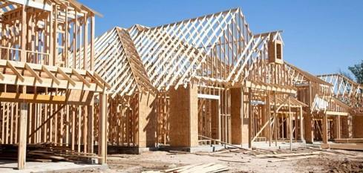


Grantee Responsibilities
Recruiting participants (40% very low income)
Conducting construction and pre-construction meetings
Locating suitable building sites or homes
Selecting house plans or determining repairs to be made
Preparing cost estimates

Slide 27
Grantee Responsibilities
Assisting participants in applying for a 502/504 loan or other funding
Subcontracting work on the participants’ behalf
Supervising and training participants in the construction/repair of homes
Supervising the participants’ 502 or 504 funds (or other)
Attend Quarterly Review meetings

Slide 28

Grant Performance Goals
Must meet 3 of 5 to earn Acceptable Rating, outlined in 1944-I Exhibit O
Assist the projected number of families in obtaining adequate housing (Production Goals)
Assisting very low-income families (40% very low income)
Meeting the family labor requirement in Exhibit B-2 (65% labor completed by the families)
Meeting the projected Technical Assistance Cost
Meeting all other grant requirements
This Photo by Unknown Author is licensed under CC BY-SA

Slide 29
Grant Amount for New Construction
Determined by the number of homes to be built for new construction
New construction-typically 15% of the Equivalent Value of Modest Housing (EVMH) as determined by USDA Rural Development
    EVMH X 15% = TA Cost X # of proposed homes = TA Grant Amount

Slide 30
Grant Amount for Rehabilitation
Determined by the number of homes to be rehabilitated
Rehabilitation-negotiated between the applicant and USDA Rural Development
1 complete project = 1 EU

Slide 31
Use of TA Grant Funds
Authorized expenses:
Personnel salaries
Reasonable office expenses and supplies
Employment benefit costs
Purchase or lease of power tools
Insurance
Reasonable fees for training
Consultant and legal fees
Annual audits
Prohibited use of funds:
Paying for labor on the houses
Purchasing real estate or building materials for the families
Paying any debts, expenses or costs to the participants
Any lobbying activities prohibited in 2CFR 200 Subpart F

Slide 32
Typical Staffing 1944.405 (h)
Full or Part time Director
Group Coordinator
Secretary-Bookkeeper
Construction Supervisor

Slide 33
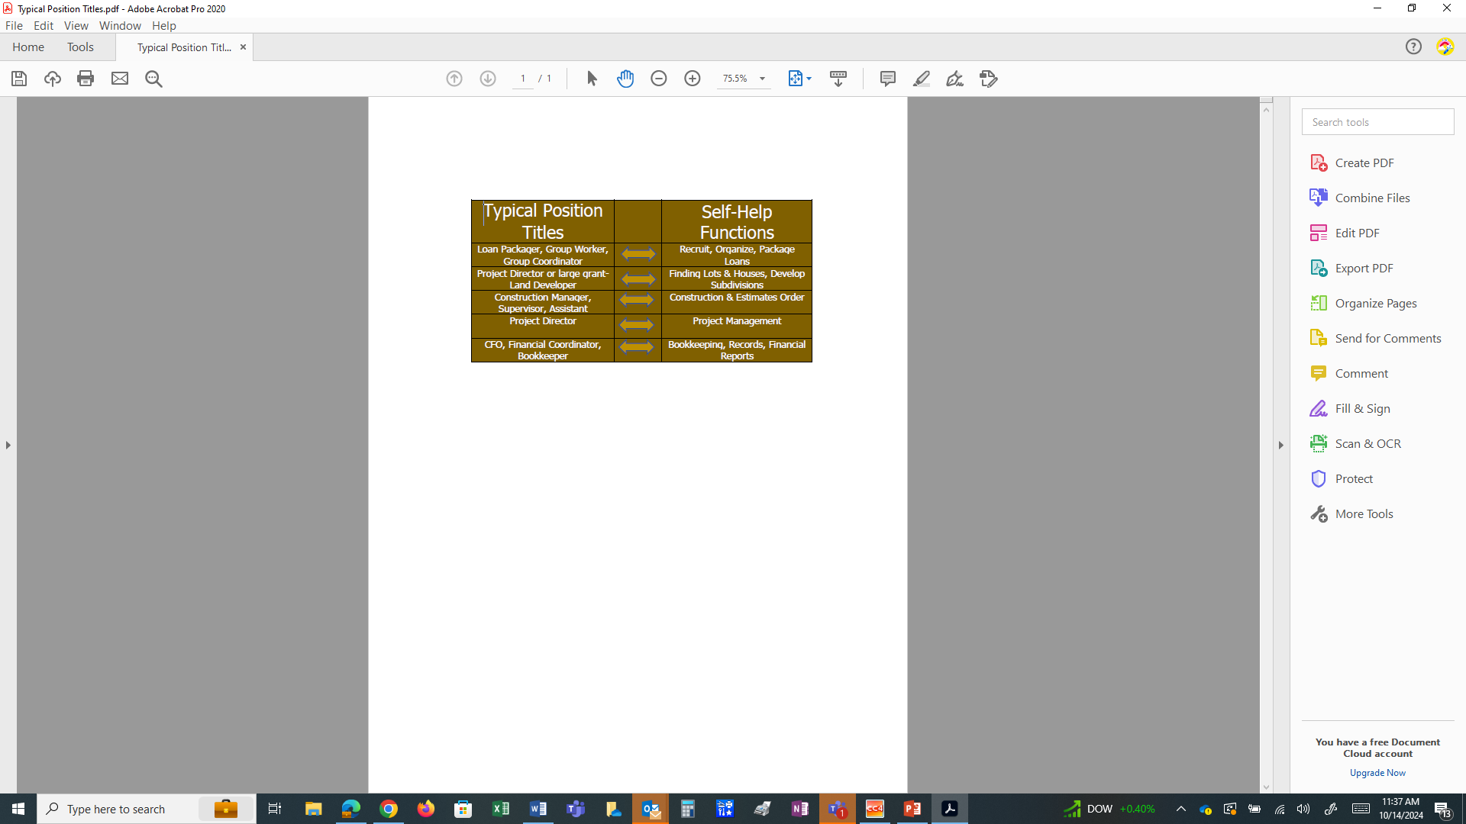
Additional Self-Help Staffing Titles

Slide 34
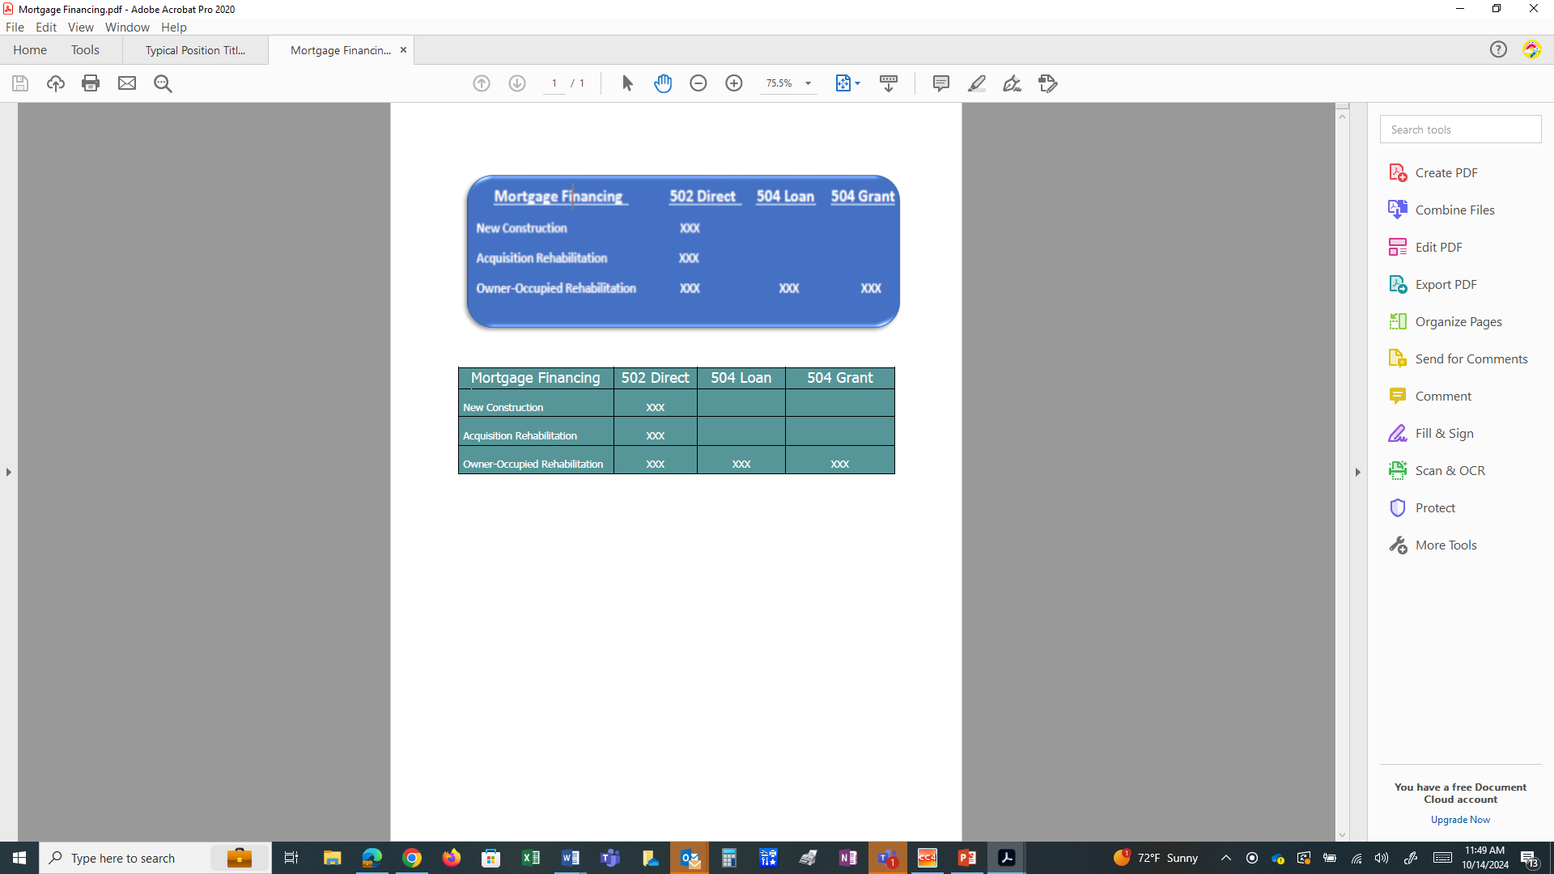
Financing
New Construction and Acquisition Rehab - most common source of funding is USDA Rural Development 502 Direct Loan
Owner Occupied Rehab - most common source of funding is a USDA Rural Development 504 Loan and/or Grant
    Funding can be leveraged with other funding sources to maximize loan and/or rehab
    Grantees are able and encouraged to seek other sources of financing as RD funds get harder to obtain

Slide 35



USDA Rural Development’s Responsibilities
Determine loan or grant eligibility
Review and Process 523, 504, and 502 Funds
Quarterly Reviews
Grant Evaluation
Review grant close-out reports and activity

Slide 36

Self-Help Housing and 502 Loans
Most Self-Help participants use 502 loans, this is not required
Self-Help Loans are Priority 4
Handbook Letter 16A is used
for eligibility
The loans are closed prior to
construction start
At closing the lot is purchased
and an amount is drawn to start
construction
Future draws are made to pay for construction expenses
Funds are either put in an SBA account or an account controlled by the grantee

Slide 37
523 Grant Draws
The grantee requests draws no more than monthly
They have to put this in an interest-bearing, two-signature checking account (there are exceptions to having the interest-bearing checking account)
Monthly they supply an accounting of funds spent with the new request

Slide 38
Quarterly Review Meetings
  Required by 1944.417
  Attended by USDA Rural Development and the Grantee
  SHARES reports are reviewed
  Funding status and policy updates discussed
  The following Grantee performance requirements are reviewed:
    Is grantee assisting the projected number of families?
    Is grantee serving very low-income families of at least 40%?
    Is the 65% labor contribution by the families being accomplished?
    Is the grantee with the proposed TA cost – Total EU’s completed?
    Is the grantee on track?

Slide 39
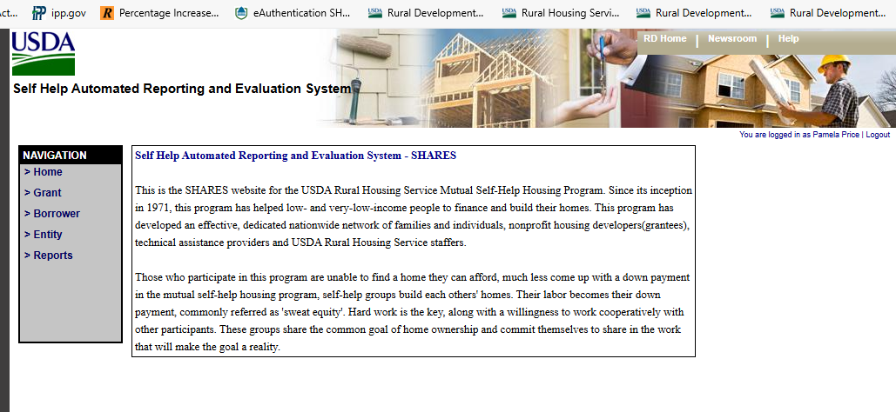
SHARES Reporting and Tracking
  Self-Help Automated Reporting and Evaluation System
  (SHARES)
    Used to track grantee
    progress
    Construction
    Funding
    Grantees required to enter
    data
    RD staff reviews and accepts, can enter notes

Slide 40
Repair and Rehab Reporting and Tracking
  1944-I Exhibit M is used to track grantee progress including:
    EU increase for the quarter
    Method of Rehab
    Average construction investment
    Average cost savings
    Number of houses/EUs completed
    Number of houses under Rehab
    Number of families in pre-rehab
    Average time needed to complete a rehab project
    List of adverse effects during the quarter

Slide 41

Applications for Funding
  All applications are now electronic
  Reviewed and submitted to RD
  RD at State level reviews and recommends to National Office
  National Office provides approval and obligation

Slide 42


Applications Requirements
  First group of applicants must be loan eligible (10% for rehab)
  First group’s lots have been secured
  All qualified key staff have been hired and available
  House plans, specs, & estimates complete
  Organizational documents
  Adequate accounting system
  Detailed budgets

Slide 43
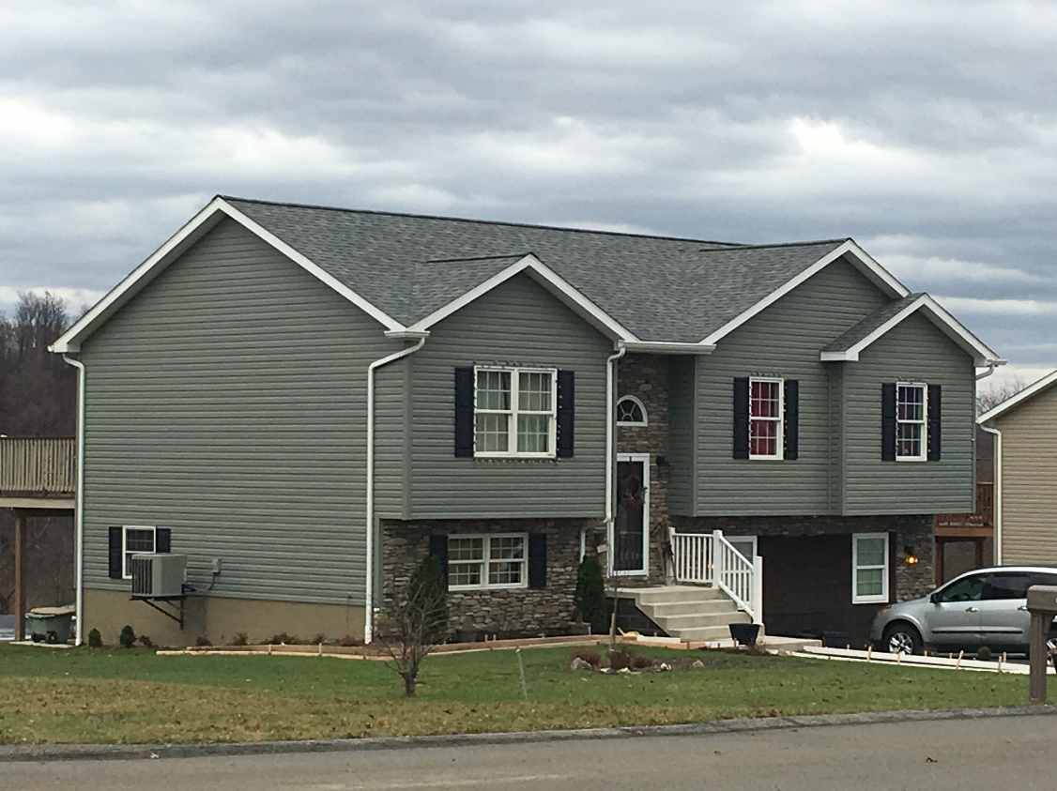
Sample Self-Help Homes
A completed home in western Pennsylvania, sponsored by Threshold Housing Development

Slide 44
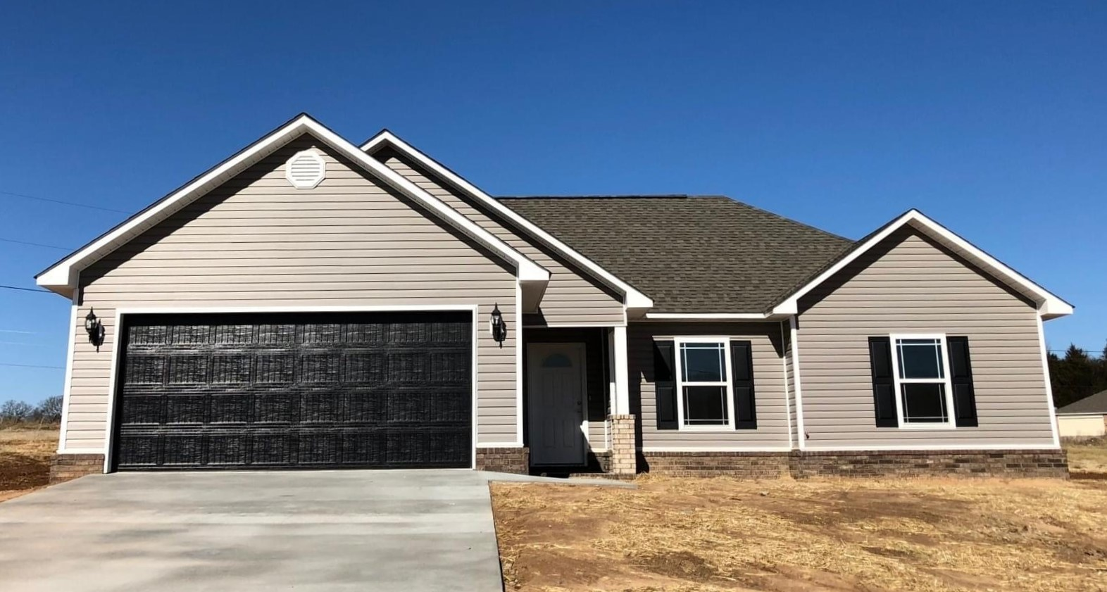
A completed home in Fort Smith, Arkansas sponsored by Crawford Sebastian CDC

Slide 45
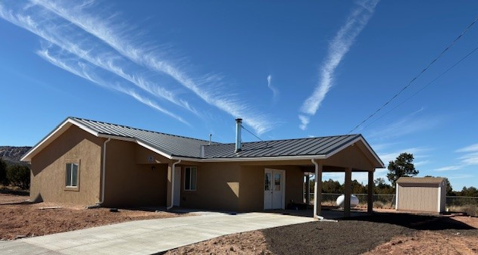
This home was completed in Zuni, New Mexico by Zuni Housing Authority

Slide 46
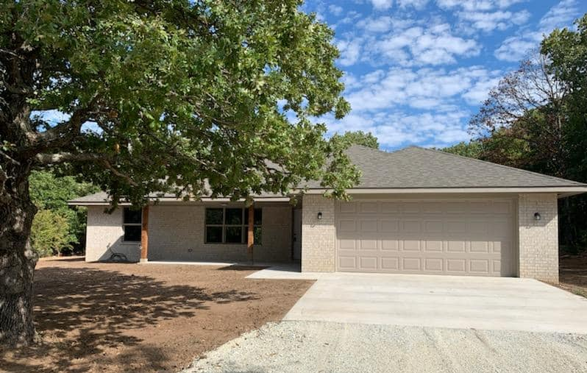
This home was completed in Ada, Oklahoma under the sponsorship of Tri-County Indian Nations CDC

Slide 47
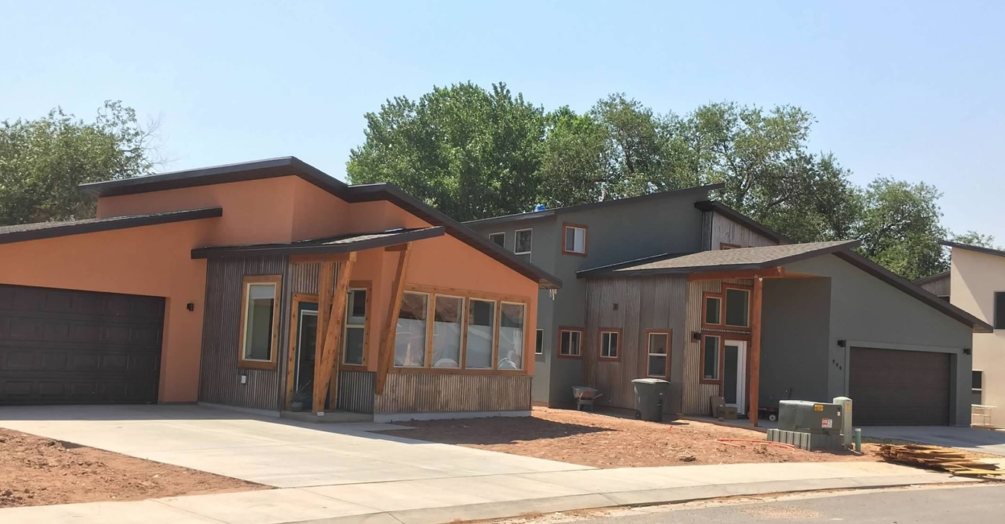
A completed home in western Moab, UT sponsored by Housing Authority of Southeastern Utah

Slide 48
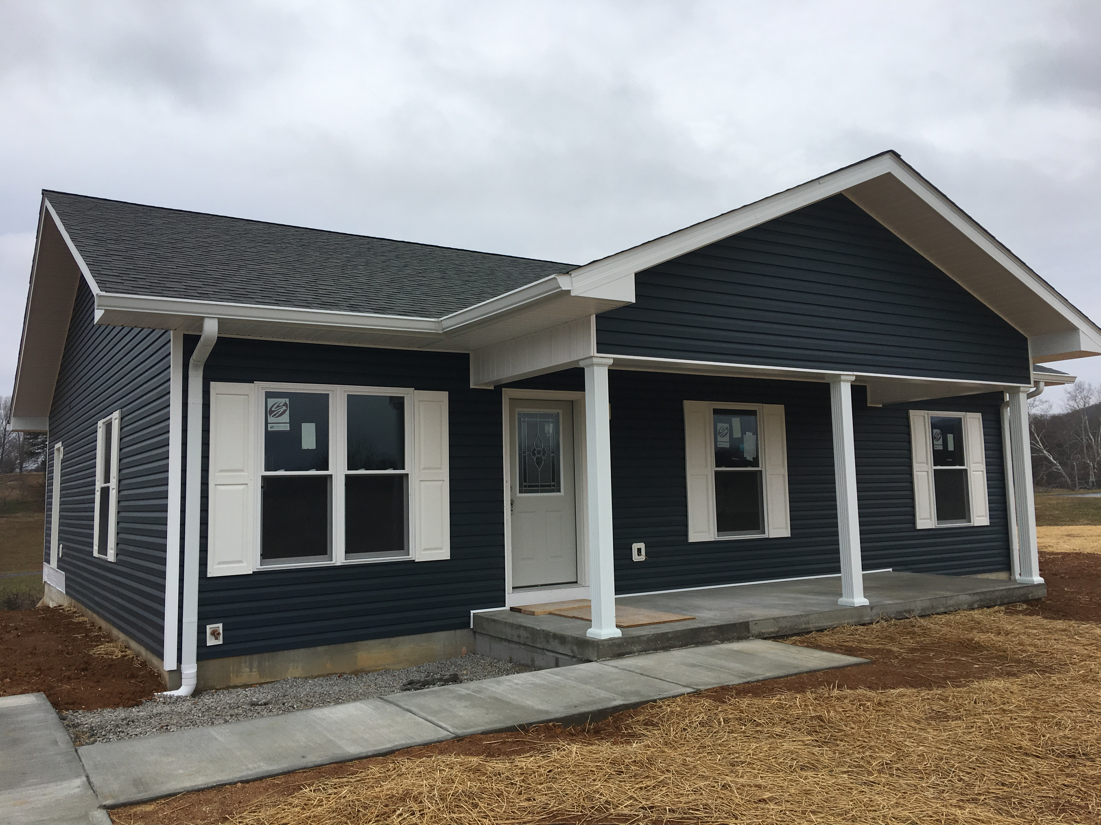
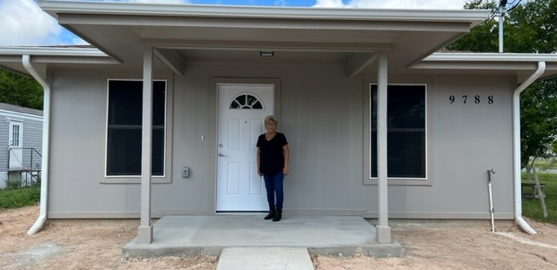
This home was completed in San Juan, Texas under the sponsorship of Proyecto Azteca
This home was completed in Monticello, Kentucky by Southern Tier Housing

Slide 49
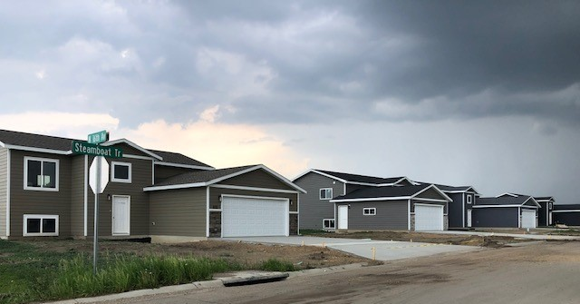
These homes were completed homes in South Dakota under the sponsorship of Inter-Lakes CAP

Slide 50

Resources
Rural Development Website
https://www.rd.usda.gov/programs-services/single-family-housing-programs/mutual-self-help-housing-technical-assistance-grants
Spotlight Website
  www.selfhelphousingspotlight.org

Slide 51
Now What?
If you know of any interested organizations:
  Contact your Rural Development State Office
  Optional - Conduct a Feasibility Study
      Helps determine if the organization and area are right for the program
  Application assistance is provided
  Grant funding is not guaranteed

Slide 52




Thank you

